Slide 1
Developing California emission inventories: innovation and challenges
2015 International Emissions inventory conference: April 14, 2015

Slide 2
Presentation overview
Meeting California’s air quality and climate goals – the role of emission inventories
  Reducing near-source risk
  Attaining federal air quality standards
  Achieving greenhouse gas reduction goals
Developing Innovative inventory approaches
Addressing the inventory needs of the future

Slide 3
Reducing near-source risk
CalEnviroScreen defines socioeconomically disadvantaged communities disproportionally impacted by pollution
Key emissions inputs:
  Diesel particulate matter emissions
  Toxic releases from facilities
  Pesticide use
Tracking emissions provides method to demonstrate risk reduction

Slide 4
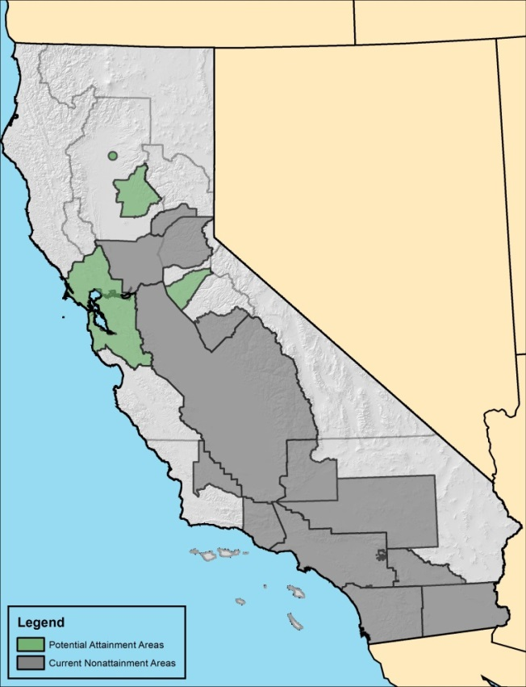
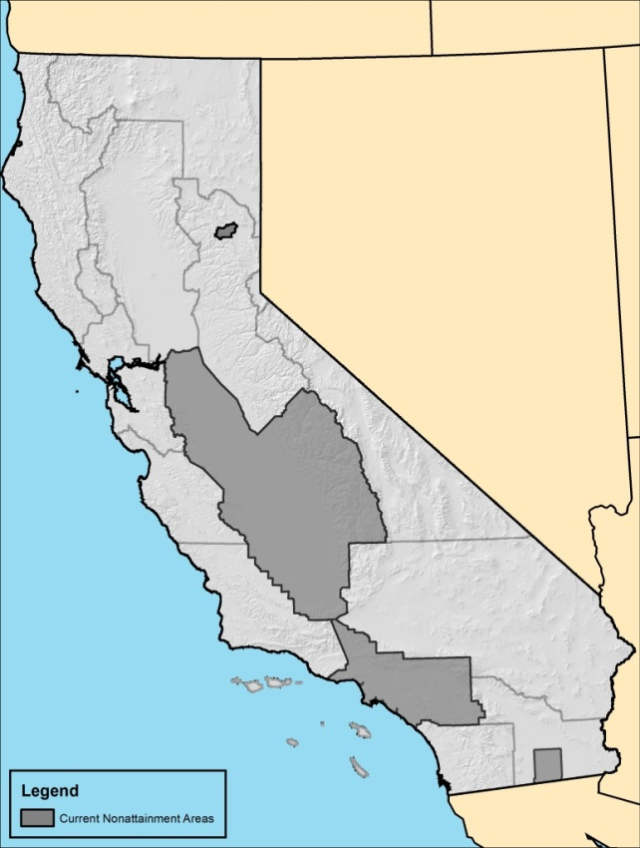
Attaining federal air quality standards
Emission inventories support many aspects of SIP planning:
  Determining key source categories
  Assessing role of precursors
  Defining attainment targets
  Specifying reasonable further progress
  Foundation for development of regulations and incentive programs
Nonattainment Areas for 75 ppb Standard
Nonattainment Areas for 12 µg/m³ Annual Standard

Slide 5
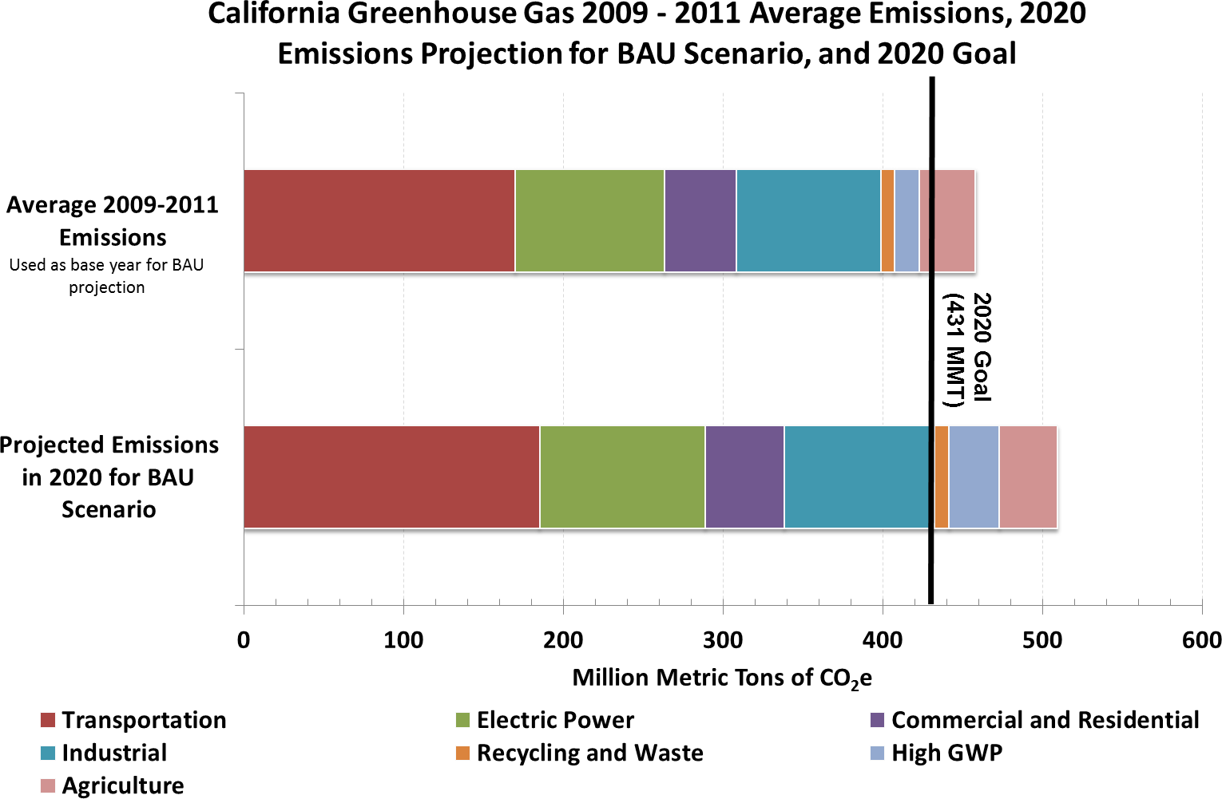
achieving greenhouse gas reduction goals
AB 32 – Reduce GHG emissions to 1990 levels by 2020
Governor’s Executive Order – Reduce GHG emissions 80% by 2050
New plan for reducing short-lived climate pollutants under development
Emissions inventory is metric for tracking progress towards these goals

Slide 6
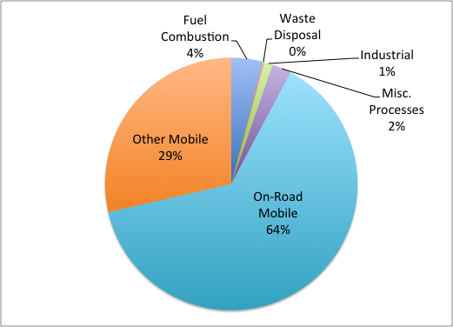
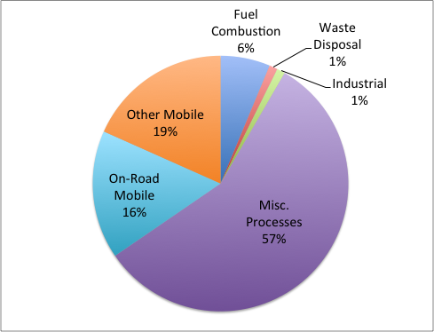
California emissions criteria pollutants
San Diego County 2012 NOx Emissions
San Diego County 2012 PM2.5 Emissions

Slide 7
California’s mobile source emissions model
EMFAC2014 is California’s on-road mobile source emissions model
Includes both criteria pollutant and GHG emissions estimates through 2050
Updated to include latest emission factors and EPA/ARB regulations and standards:
  Advanced Clean Cars program
  In-Use Heavy Duty Diesel Regulation
  Tractor-Trailer Regulation
  Phase 1 GHG Regulation
Includes new forecasting methods reflecting modeling of new vehicle sales and VMT growth

Slide 8
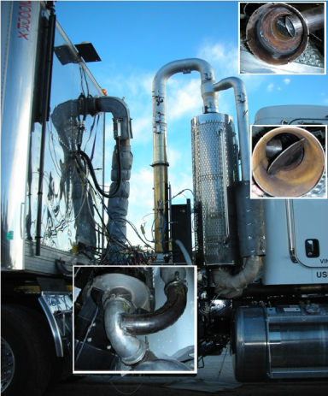
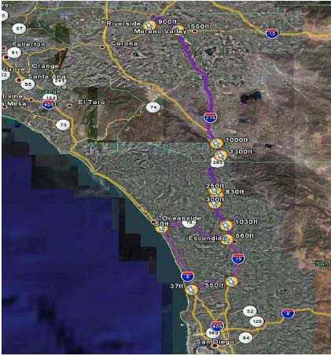
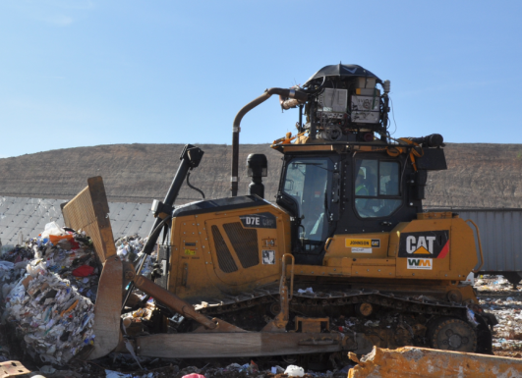
On-Board Emission Measurements
Portable Measurement Systems
  PEMS: Portable Emission Measurement System
  PAMS: Portable Activity Measurement System
Measuring emissions and/or activity under actual in-use operating conditions
An alternative to engine and vehicle dynamometer laboratory testing
  Lower cost
  Greater number of vehicles tested within a relatively short timeframe
  Significant benefits for emission modeling
Notes:
The development of accurate emissions factors under a variety of real world in-use conditions is important for improving mobile source emissions inventories. The continuing development of Portable Emissions and Activity Measurement Systems (PEMS/PAMS) has greatly enhanced the potential for characterizing in-use emissions for on-road vehicles and off-road equipment. Over the past few years, there has been a considerable effort made to standardize PEMS/PAMS systems to meet regulatory in-use compliance measurements requirements for on-road vehicles and off-road equipment.
On-road testing is very different from the laboratory testing, bringing considerable benefits but also some new challenges. As PEMS testing can take place during the regular operation of the tested vehicles, a large number of vehicles can be tested within a relatively short period of time and at relatively low cost. Engines that cannot be easily tested in a laboratory (such as off-road equipment), can be tested using PEMS. Using PEMS, emissions data can be obtained under real world in-use conditions for a wide variety of applications.
However, it is important to note that real-world emissions data can be highly variable as real-world conditions are highly variable (with different rates of speeds and acceleration, road grades and individual driver operations). Significant variances in emissions results can exist even among identical engines due to the different operational parameters. On-road emissions testing therefore requires a different mindset than the traditional approach of testing in the laboratory using very standardized operational parameters. In the absence of established methods to incorporate these data into mobile source emission inventories, use of PEMS data will require some careful, thoughtful, and a broad analytical approach.

Slide 9
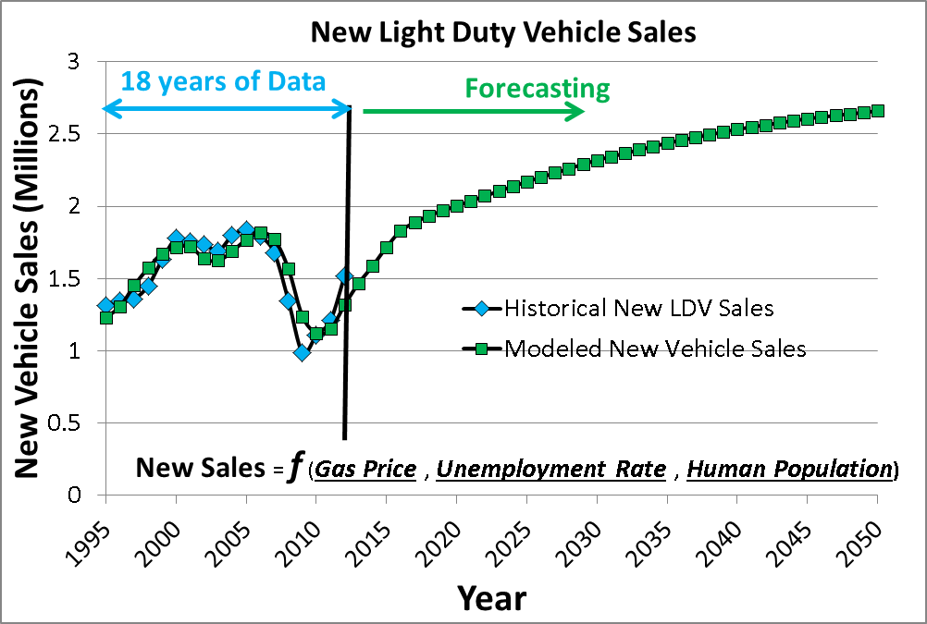
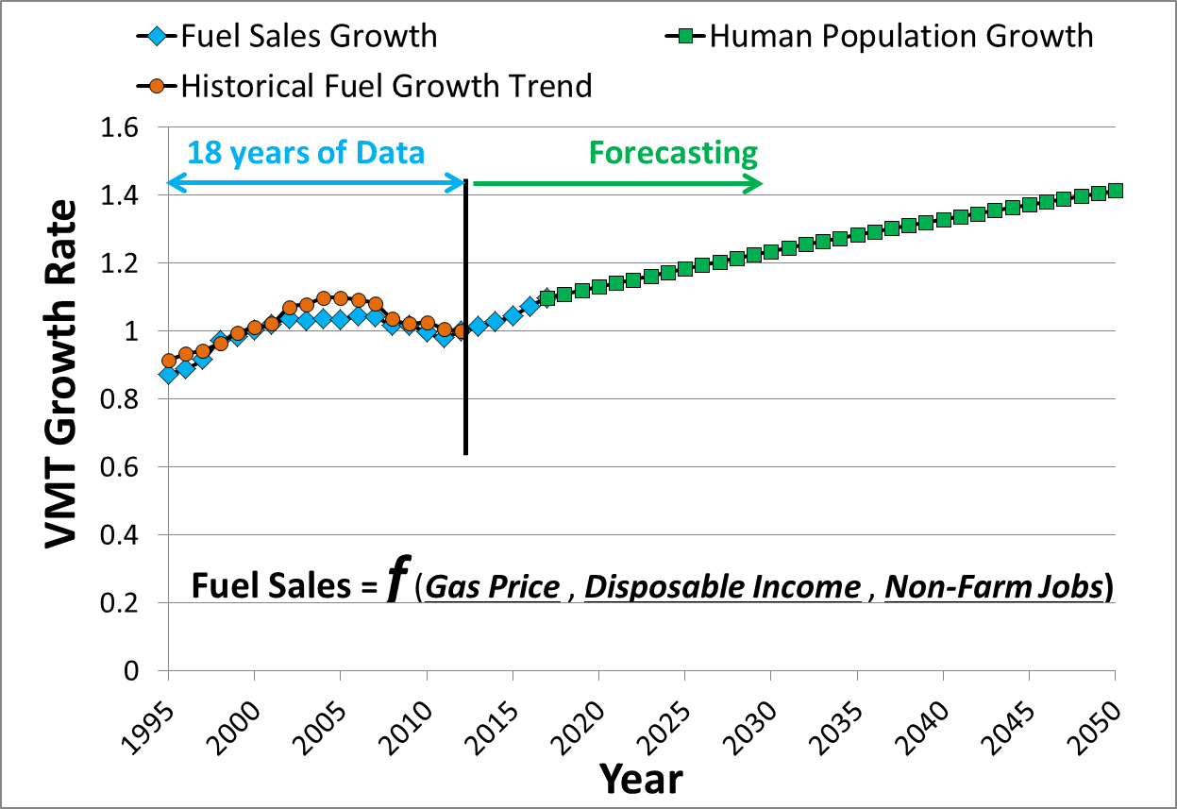
EMFAC2014: Activity Forecasting
New vehicle sales and VMT growth are based on socio-economic indicators:
  Gas Price
  Unemployment Rate
  Disposable Income
  Non-Farm Jobs
Statewide VMT growth is matched to:
  Forecasted fuel growth for 2013-2017
  Human-population growth for 2018-2050
Notes:
To inform policy for meeting the State’s multi-pollutant goals into the future, California’s most recent on-road model version is “EMFAC2014” which forecasts future activity out to calendar year 2050. EMFAC2014’s activity forecast utilizes socio-econometric modeling techniques that tie California’s transportation activity to economic and demographic indicators such as Gas Price, Unemployment Rate, Disposable Income, Non-Farm Jobs, and county level human population growth rates.
The forecasted new vehicle sales are a function of Gas Price, Unemployment Rate, and statewide human population.
For the Statewide VMT growth, a regression model was developed based on the past 18 years of historical data to estimate the future fuel sales growth as a function of Gas price, disposable income and non-farmed jobs (assuming no benefit in fuel economy from ARB regulations). EMFAC2014 applies the fuel sales growth rates to the base year VMT estimate to forecast the future VMT. After 2017, with the assumption that California is recovered from the economy recession and VMT per capita stays relatively constant, EMFAC2014 uses human population growth to forecast the VMT up to 2050.

Slide 10
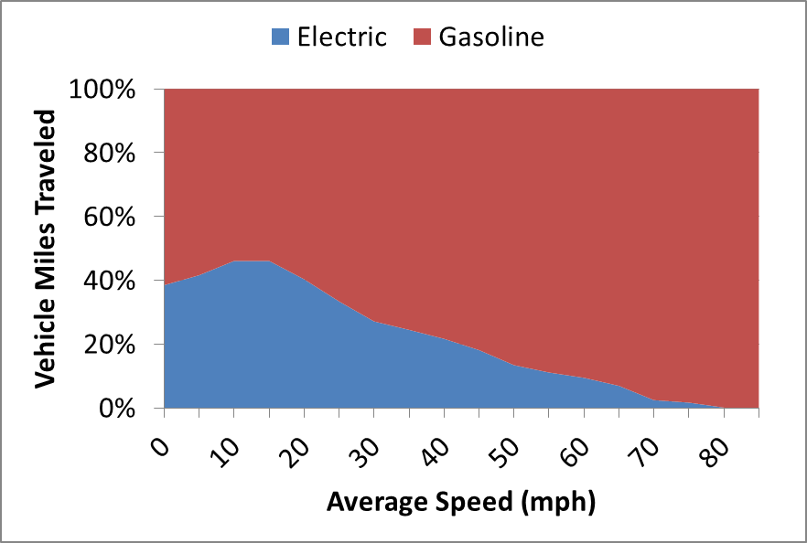
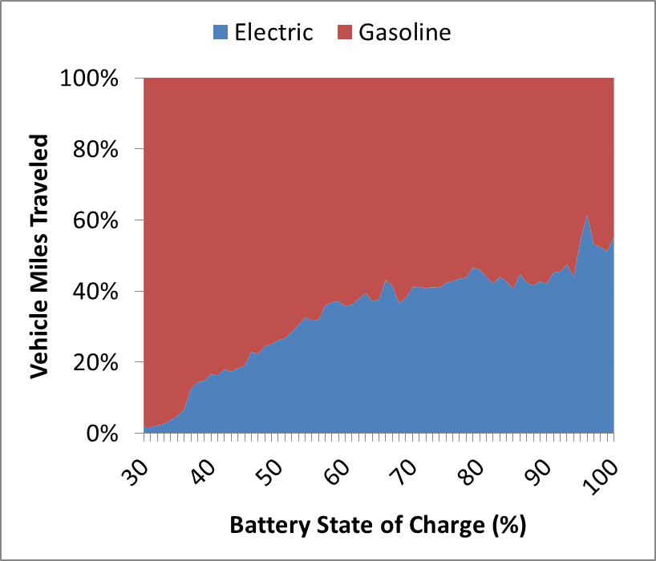
Plug-In Electric
Vehicles (PEVs)
SAMPLE DATA
Characterize PEV travel:
  PEV vehicle activities vs. typical vehicle
  Battery state of charge effects
  Total VMT vs. electric VMT (eVMT)
Characterize differences by secondary owner vs. 1st owner
Improve estimates of emission benefits and forecasts of emissions from the light-duty fleet
SAMPLE DATA
Notes:
Plug-in electric vehicles (PEV) are anticipated to become an increasing share of new light-duty vehicle sales and will play a major role in achieving the greenhouse gas and criteria pollutant reductions to meet both air quality and climate change goals in California. However, their environmental benefits will vary depending on consumer usage, vehicle charging behavior, and travel patterns. In order to improve estimates of emission benefits from PEVs in our next generation of mobile source emission inventory models, ARB has initiated several internal and external contracts to collect and analyze in-use vehicle activity data for a variety of vehicle types using PAMS. This will result in a comprehensive and highly resolved dataset that incorporates vehicle operational parameters and recharging/refueling information that will greatly improve our understanding of the current state of PEV travel and how vehicle operations and travel behaviors may affect emissions.
FIGURES ARE PENDING APPROVAL FROM JOSHUA CUNNINGHAM.

Slide 11
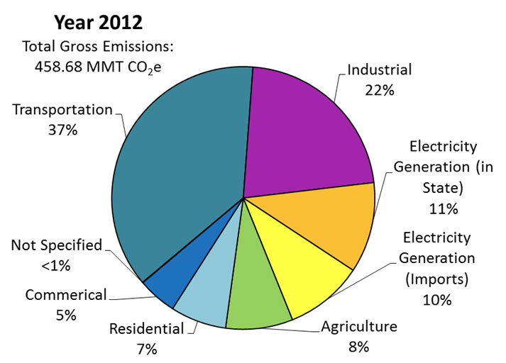
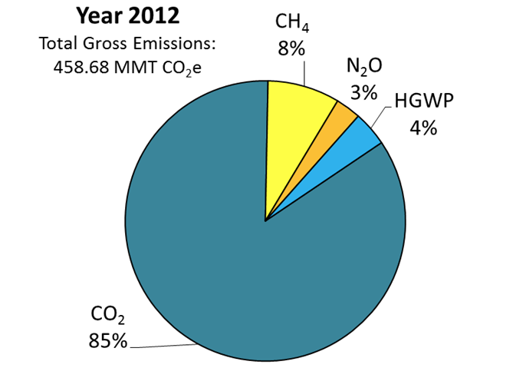
California emissions climate pollutants
2012 Emissions by Sector
2012 Emissions by GHG

Slide 12
GHG Measurement Program
ARB’s greenhouse gas measurement
program is designed to support
California’s GHG reduction efforts
Linking ambient measurements to study emission sources
Evaluate Source Emissions
Identify GHG Reduction Opportunities
Track Emission Reductions
Identify Specific Sources
Measurement Feedback
Notes:
Slide #1 - GHG Measurement Program
California is working to reduce greenhouse gas emissions across all sectors of the economy under the framework of Assembly Bill 32, the Global Warming Solutions Act. As California has implemented AB 32, we have worked to develop greenhouse gas monitoring capabilities to support our short- and long-term climate goals.
An ambient measurement program for greenhouse gases helps support AB 32 implementation in several ways.
[Advance Animation]
Greenhouse gas measurements can help identify sources, evaluate the emissions from these sources, help identify new emission reduction strategies, and help track progress in reducing emissions.
[Advance Animation]
An important goal of this research effort is to link ambient measurements to emission sources in California.

Slide 13
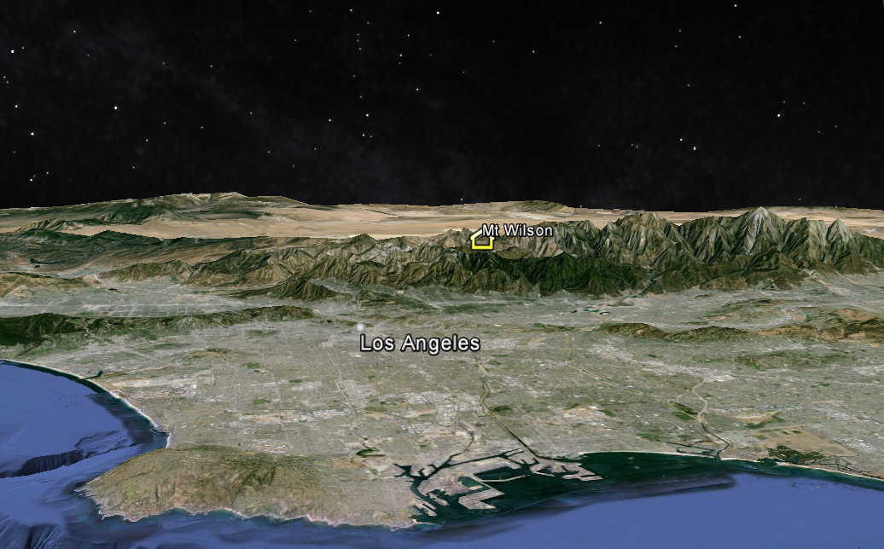
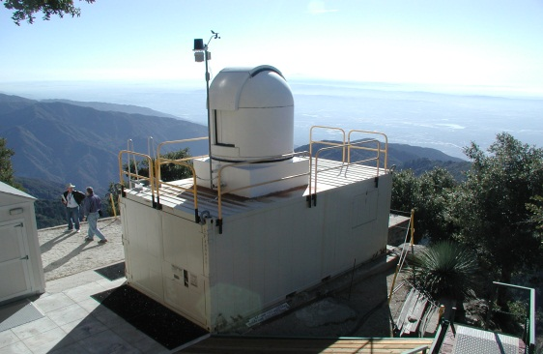
Mt. Wilson Observatory Station
Los Angeles County
Mt. Wilson Station
Prevailing Wind Direction
Atmospheric mixing
GHG Emissions
Notes:
Slide #8 - Mt. Wilson Observatory Station
Los Angeles is another important source region.
[Advance Animation]
As shown in the graphic, greenhouse gases in the region are emitted, and then diluted by atmospheric mixing. The daytime sea breeze pushes the well-mixed air up into the San Gabriel Mountains, carrying the dispersed emissions from the entire Los Angeles Basin. We installed equipment at the Mount Wilson Observatory to take advantage of this opportunity to study greenhouse gas emissions for the entire Los Angeles County using a single location.

Slide 14
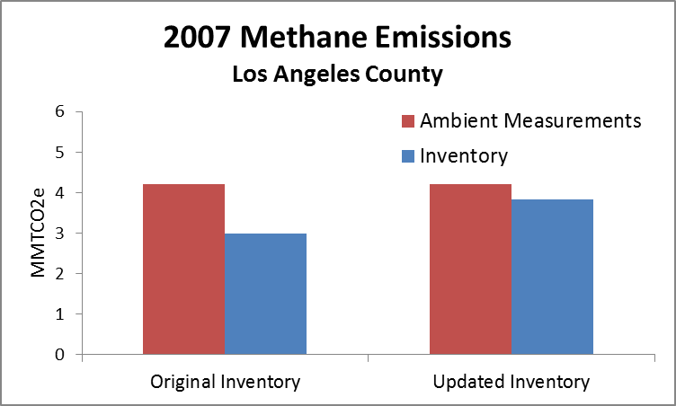
Methane Findings
Los Angeles County
2007 Mt. Wilson study suggested methane emissions were underestimated
ARB updated methods to develop regional methane inventory, as well as improved estimates for several sources
2014 methane emissions inventory and ambient measurements now well correlated
Reference: Hsu, et al. (2010) Atmospheric Environment, pp. 1–7
Notes:
Slide #9 - Methane Findings
The very first pilot study at Mt. Wilson started in 2007, and focused on methane emissions. Looking at the first bar chart, our ambient measurements, shown here in red, suggested that the Los Angeles County methane emissions were significantly underestimated as shown here in blue. These observations were further validated by studies from Caltech and other groups, and suggested that oil and gas sector emissions were underestimated. As shown in the second bar chart, the methane emissions inventory has been updated and now correlates well with ambient monitoring data.

Slide 15
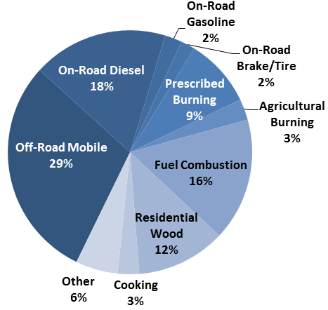
California’s Black Carbon
Emission Inventory
    Black carbon (BC) is a potent climate forcing pollutant
    ARB has developed a statewide BC inventory for the short-lived climate pollutant plan
Wildfires account for significant BC emissions but emission estimate has large year to year variability
2012 Black Carbon Emissions
Excluding Wildfire

Slide 16
Black Carbon Inventory development
    Inventory uses elemental carbon (EC) speciation factors as a proxy for BC
    Starting point was preliminary California-specific speciation factors developed as part of ARB air quality modeling efforts
    Speciation factors were verified using current literature and U.S. EPA recommendations
    Speciation factors were applied to existing PM_{2.5} inventory to create BC inventory

Slide 17
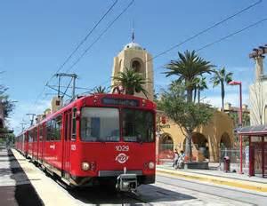


New challenges
Inventory needs of the future
New mobile source technologies and fleet mixes
  Plug-in electric vehicles
  Hybrid cars and trucks
  Zero-emission vehicles
New energy sources and production
  Biodiesel
  Hydrogen for fuel cells
Sustainable communities
  Changing land use patterns
  Increased use of transit options
Climate change
  Drought impacts
  Wildfires

