Slide 1
Template—Freight Sustainability and SmartWay Presentation
Feel free to use the slides in this deck to develop a presentation for your colleagues, executives, and suppliers about the importance of freight sustainability to your organization, and how EPA’s SmartWay program can help you achieve your goals.
Note: Go to “View” and “Notes View” to see talking points related to each template slide.

Slide 2
Why Freight Matters to Our Organization

Slide 3
Balancing our supply chain priorities means considering:
Reducing Costs
01
Improving Service
02
Streamlining Processes
03
Expanding Our Business
04
Reducing Our Environmental Impact
05
Notes:
Balancing our supply chain priorities means:
reducing costs;
improving service;
streamlining processes;
expanding our business; and
reducing our environmental impact.
Growing our business can conflict with our goals to reduce our environmental impact because of freight transportation unless we incorporate sustainability principles into our business practices.

Slide 4
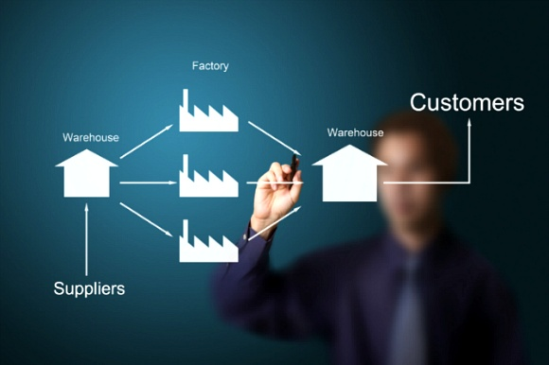
Freight transportation is:
The number one driver of supply chain costs
A major contributor to our environmental footprint
This Photo by Unknown Author is licensed under CC BY-NC-SA
This Photo by Unknown Author is licensed under CC BY-NC-ND
We have an opportunity to lower costs while still delivering on our other goals by developing a sustainable freight strategy.
Notes:
Freight transportation is:
the number one driver of supply chain costs. (Source: CSCMP 27th Annual State of Logistics Report)
a major contributor to our environmental footprint.
We have an opportunity to lower costs while still delivering on our other goals by developing a sustainable freight strategy.

Slide 5
A sustainable freight strategy helps us:
Reduce
reduce costs from inefficient freight movement;
Eliminate
eliminate waste in our supply chain;
Address
address consumer emphasis on sustainability;
Mitigate
mitigate risk associated with goods movement; and
Enhance
enhance our reputation as a “good corporate citizen.”
Notes:
A sustainable freight strategy helps us:
reduce costs from inefficient freight movement;
eliminate waste in our supply chain;
address consumer emphasis on sustainability;
mitigate risk associated with goods movement; and
enhance our reputation as a “good corporate citizen.”
For up to date statistics related to these points, visit: https://www.epa.gov/smartway/why-freight-matters-supply-chain-sustainability

Slide 6
How Our Organization Can Address Freight Sustainability

Slide 7
Launching a freight sustainability initiative allows us to:
Identify the environmental footprint of our current freight activities;
Benchmark performance of our existing freight carriers and decisions;
Measure the impact of our actions;
Identify opportunities to improve our performance on crucial environmental, energy and cost metrics;
Track our performance improvements over time; and
Enhance corporate social responsibility and other sustainability efforts.
Notes:
Launching a freight sustainability initiative allows us to:
identify the environmental footprint of our current freight activities;
benchmark performance of our existing freight carriers and decisions;
measure the impact of our actions;
identify opportunities to improve our performance on crucial environmental, energy and cost metrics;
track our performance improvements over time; and
enhance corporate social responsibility and other sustainability efforts.

Slide 8
Benefits of Launching a Freight Sustainability Initiative

Slide 9
Reduce our Environmental Impact
Establish
Establish our commitment to reduce the environmental impact of freight transportation.
Develop
Develop industry-standardized baseline or benchmark, track, report and reduce our Scope 3 emissions footprint.
Get
Get the metrics and data we need to make better decisions to reduce our impact
Notes:
Reduce our Environmental Impact
Establish our commitment to reduce the environmental impact of freight transportation.
Develop industry-standardized baseline or benchmark, track, report and reduce our Scope 3 emissions footprint.
Get the metrics and data we need to make better decisions to reduce our impact

Slide 10
Demonstrate our Corporate Social Responsibility
Showcase
Showcase our achievements to customers, clients, shareholders and other stakeholders who embrace sustainability in purchasing/contracting arrangements
Communicate
Communicate our efforts to a broad group of stakeholders.
Resonate
Resonate with a socially conscious millennial workforce.
Notes:
Demonstrate our Corporate Social Responsibility
Showcase our achievements to customers, clients, shareholders and other stakeholders who embrace sustainability in purchasing/contracting arrangements
Communicate our efforts to a broad group of stakeholders.
Resonate with a socially conscious millennial workforce.

Slide 11
Showcase our Leadership
Define
Define our leadership position in a world that expects corporate action on sustainability.
Develop
Develop strategic partnerships that help maximize our impact.
Influence
Influence our supply chain to drive efficiency as a priority.
Notes:
Showcase our Leadership
Define our leadership position in a world that expects corporate action on sustainability.
Develop strategic partnerships that help maximize our impact.
Influence our supply chain to drive efficiency as a priority.

Slide 12
Manage our Risk
Demonstrate
Prepare
Demonstrate sustainability leadership to investors.
Prepare for the future of environmental business risks and governance requirements, domestically and abroad.
Notes:
Manage our Risk
Demonstrate sustainability leadership to investors.
Prepare for the future of environmental business risks and governance requirements, domestically and abroad.

Slide 13
Gain Industry Recognition
Our peers are already taking advantage of SmartWay--and receive recognition as leaders.
When we become a SmartWay Shipper Partner, we will be listed on SmartWay’s website and may be eligible for SmartWay’s Excellence Awards.
Notes:
Gain Industry Recognition
Our peers are already taking advantage of SmartWay…and receive recognition as leaders.
When we become a SmartWay Shipper Partner, we will be listed on SmartWay’s website and may be eligible for SmartWay’s Excellence Awards.
(note: you can identify competitors or similar organizations by looking at the SmartWay partner list: https://www.epa.gov/smartway/smartway-partner-list

Slide 14
Barriers to Accounting for Our Organization’s Freight’s Impact

Slide 15
Assessing our supply chain footprint can be time-consuming and data intensive.
This Photo by Unknown Author is licensed under CC BY
Notes:
(note: your organization may experience challenges or barriers to tracking your freight impact, but the SmartWay program has tools to help address these barriers.
**select those that are accurate for your organization and leader’s concerns)
Assessing your supply chain footprint can be time-consuming and data intensive.

Slide 16
It is not always clear that the return on investment is worth the effort.
This Photo by Unknown Author is licensed under CC BY-NC
Notes:
(note: select those that are accurate for your organization and leader’s concerns)
It is not always clear that the return on investment is worth the effort.

Slide 17
We already have a lot of environmental accounting and disclosure responsibilities.
This Photo by Unknown Author is licensed under CC BY-ND
Notes:
(note: select those that are accurate for your organization and leader’s concerns)
We already have a lot of environmental accounting and disclosure responsibilities.

Slide 18
We do not know how to get started setting up a system.
This Photo by Unknown Author is licensed under CC BY-NC
Notes:
(note: select those that are accurate for your organization and leader’s concerns)
We do not know how to get started setting up a system.

Slide 19
We would need data about carriers’ activity.
This Photo by Unknown Author is licensed under CC BY-NC-SA
Notes:
(note: select those that are accurate for your organization and leader’s concerns)
We would need data about carriers’ activity.
Not clear how to work with/engage carriers to get information.
We are using a lot of different carriers and modes of freight movement.
Our carriers are using multiple scorecards for other clients.

Slide 20
How We Can Account for Freight

Slide 21
The US Environmental Protection Agency’s SmartWay Program:
streamlines accounting processes to make supply chain assessment less time-consuming for our team;
provides high-value data and business intelligence;
gives us the exact type of data needed to complete the environmental disclosure protocols for freight;
is an industry-standard system for evaluating, tracking and improving our performance on freight sustainability;
gives us tools and resources to work with our carriers to share information and collaborate to improve the efficiency of our freight supply chain; and
helps us respond to growing consumer emphasis on sustainability.
Notes:
The US Environmental Protection Agency’s SmartWay Program:
streamlines accounting processes to make supply chain assessment less time-consuming for our team;
provides high-value data and business intelligence;
gives us the exact type of data needed to complete the environmental disclosure protocols for freight;
is an industry-standard system for evaluating, tracking and improving our performance on freight sustainability;
gives us tools and resources to work with our carriers to share information and collaborate to improve the efficiency of our freight supply chain; and
helps us respond to growing consumer emphasis on sustainability.

Slide 22
SmartWay is a voluntary, market-based, public-private partnership that helps us:
Generate
generate emissions data with scientifically-based methods using EPA emission factors, methods, and tools;
Produce
produce consistent and comparable metrics for freight emissions across all industry sectors;
Streamline
streamline shipper and carrier reporting methodologies;
Assess
assess our US and Canadian freight supply chain;
Collaborate
collaborate with our freight carriers and establish shared efficiency goals;
Integrate
integrate SmartWay metrics into our freight procurements;
Integrate
integrate SmartWay data directly into our sustainability reports; and
Showcase
Showcase the work that we are already doing.
Notes:
SmartWay is a voluntary, market-based, public-private partnership that helps us:
generate emissions data with scientifically-based methods using EPA emission factors, methods, and tools;
produce consistent and comparable metrics for freight emissions across all industry sectors;
streamline shipper and carrier reporting methodologies;
assess our US and Canadian freight supply chain;
collaborate with our freight carriers and establish shared efficiency goals;
integrate SmartWay metrics into our freight procurements;
integrate SmartWay data directly into our sustainability reports; and
showcase work that we are already doing.

Slide 23
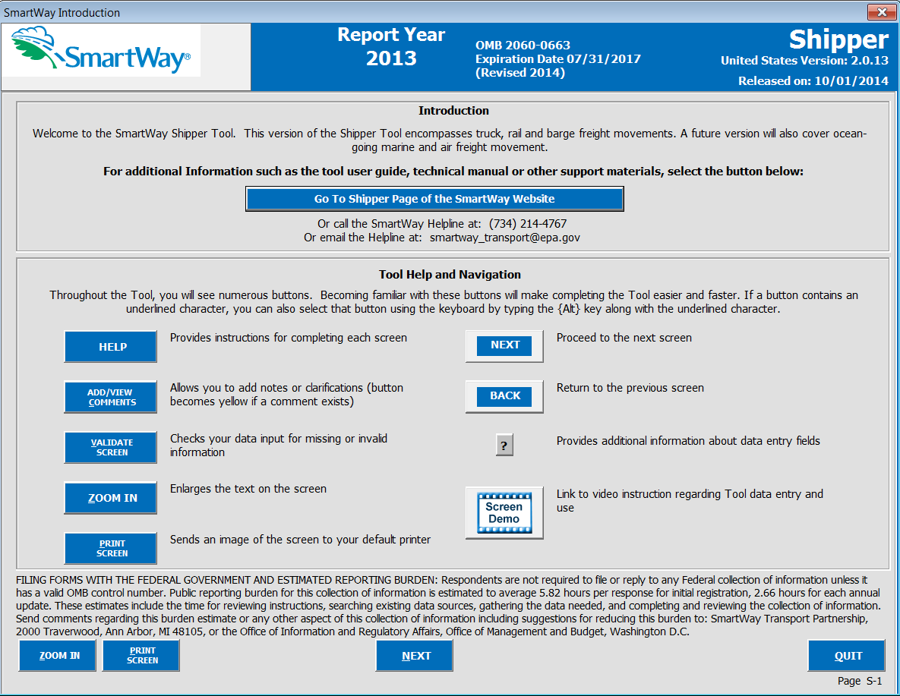
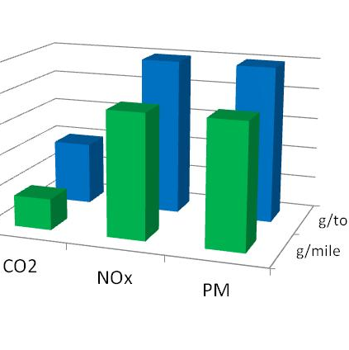
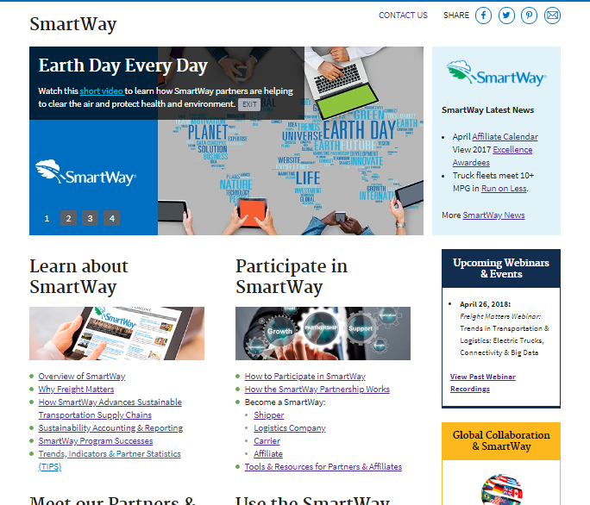
SmartWay makes it easy to start a freight sustainability program
Tools & Resources
Data & Reports
Recognition
Notes:
SmartWay has already developed tools in partnership with industry leaders and built the infrastructure to meet our carbon tracking goals
Visit the SmartWay website to download the latest tools: https://www.epa.gov/smartway/smartway-shipper-partner-tools-and-resources
SmartWay proactively reaches out to grow and meet evolving industry needs
Partnering with EPA and SmartWay can help us meet our goals.
Getting started is easy.

Slide 24
How SmartWay Works

Slide 25
How SmartWay Works
SmartWay has three categories of partners:
SmartWay Shipper Partners
Organizations that ship freight, including:
Fortune 500® companies.
Small and medium-sized businesses.
Local, state, tribal, and federal governments.
Colleges and universities.
SmartWay Carrier Partners:
Businesses that carry or move goods for shippers, including:
Truck carriers.
Rail carriers.
Barge carriers.
Air carriers.
Multimodal carriers.
SmartWay Logistics Company Partners:
Firms that hire freight carriers and manage freight shipments for shippers.
Notes:
SmartWay has three categories of partners:
SmartWay Shipper Partners
Organizations that ship freight, including:
Fortune 500® companies.
Small and medium-sized businesses.
Local, state, tribal, and federal governments.
Colleges and universities.
SmartWay Carrier Partners:
Businesses that carry or move goods for shippers, including:
Truck carriers.
Rail carriers.
Barge carriers.
Air carriers.
Multimodal carriers.
SmartWay Logistics Company Partners:
Firms that hire freight carriers and manage freight shipments for shippers.

Slide 26
How SmartWay Works
SmartWay helps shippers that improve supply chain sustainability and reduce costs by identifying efficient:
freight carriers
transportation modes
technical solutions and equipment
operational strategies
Notes:
SmartWay helps shippers that improve supply chain sustainability and reduce costs by identifying efficient:
freight carriers
transportation modes
technical solutions and equipment
operational strategies

Slide 27
How SmartWay Works
Carriers and logistics companies submit activity and equipment data.
Logistics firms hire carriers based on performance and help shippers optimize carrier selection to reduce carbon.
Notes:
Carriers and logistics companies submit activity and equipment data.
Logistics firms hire carriers based on performance and help shippers optimize carrier selection to reduce carbon.

Slide 28
How SmartWay Works
SmartWay publishes performance ranking from emissions data submitted by carriers and logistics firms.
Shippers hire carriers and logistics companies based on performance.
Shippers submit data about freight shipped with carriers and or logistics firms.
Notes:
SmartWay publishes performance ranking from emissions data submitted by carriers and logistics firms.
Shippers hire carriers and logistics companies based on performance.
Shippers submit data about freight shipped with carriers and or logistics firms.

Slide 29
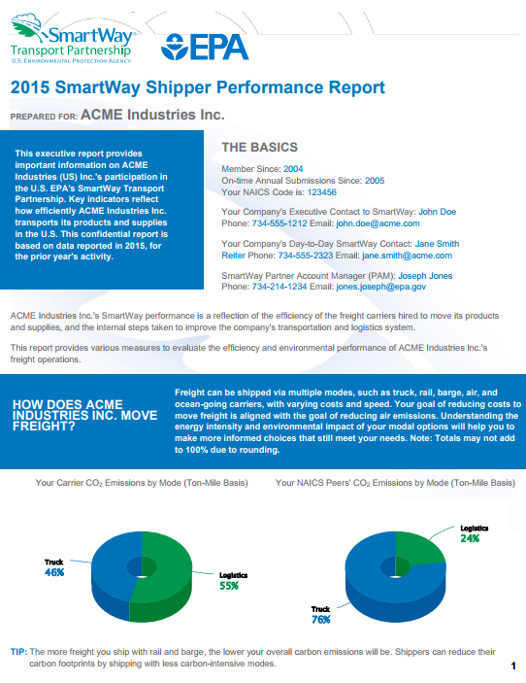
How SmartWay Works
Shippers Partners that provide activity data receive performance reports that tell them:
How are we doing?
How do we compare to our peers?
How do we improve our performance?
Notes:
Shippers Partners that provide activity data receive performance reports that tell them:
How are we doing?
How do we compare to our peers?
How do we improve our performance?

Slide 30
How Shippers can Participate in SmartWay

Slide 31
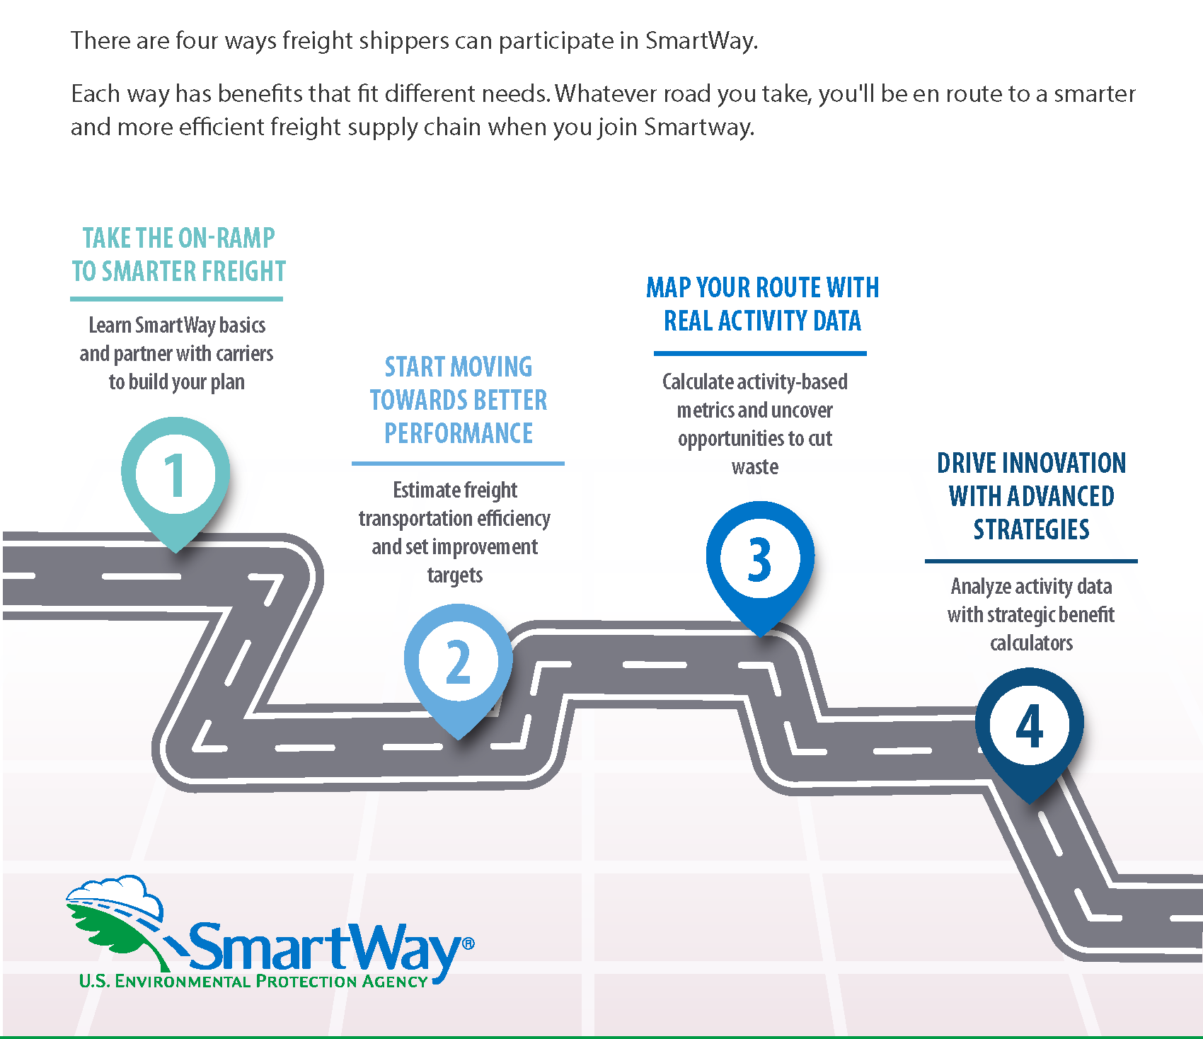
Shippers have four participation options
This Photo by Unknown Author is licensed under CC BY-SA

Slide 32
Shippers can get started on freight sustainability as SmartWay Shipper Candidates
Educate our carriers
Use our RFP or contracts process to create incentives
Set freight sustainability goals for our organization;
Collaborate with our carriers
Identify ways to improve
This Photo by Unknown Author is licensed under CC BY-SA
Notes:
As a Shipper Candidate we will be able to:
Educate our carriers about fuel efficiency and freight emissions;
Use our RFP or contracts process to create incentives for our carriers to register their data with SmartWay;
Set freight sustainability goals for our organization;
Collaborate with our carriers to set achievable efficiency goals; and
Identify ways to improve efficiency throughout our supply chain.
Becoming a SmartWay Shipper Candidate is a straightforward way to get started developing our organization’s freight sustainability strategy.
Whenever we are ready, SmartWay provides resources to start measuring, tracking and improving our performance on freight efficiency in preparation for registering as a SmartWay Shipper Partner.

Slide 33
Shippers also have three ways to account for environmental performance as SmartWay Partners:
Percent SmartWay
Measure the percentage of freight shipments carried by SmartWay Carriers vs non-SmartWay companies
Activity-Based Analysis
Use additional data about routing and operations to get a better understanding of performance
Activity Plus Strategy
Incorporate data about improvement strategies to qualify the impact of improvements.
Notes:
Any company or organization that ships freight can register with SmartWay as a SmartWay Shipper Partner.
Becoming a registered SmartWay Shipper partner helps us measure, track and improve our freight carbon footprint with the power of EPA data and technical support.

Slide 34
Recommendations and Next Steps

Slide 35
Options for Starting Our Freight Sustainability Strategy
Establish a freight sustainability team
Find out if our current carriers are in SmartWay
Look up our carriers and their performance levels on the SmartWay Carrier Performance Report
Send a letter to our carriers encouraging them to join SmartWay
Add SmartWay participation to our RFPs for transportation suppliers
Become a SmartWay Shipper Partner

