Slide 1
READ ME FIRST
This presentation introduces how water system partnerships can help water systems address challenges.
The slide deck is designed to address any of the following audience options:
A: Your water system’s management, after you attend a Water System Partnerships Workshop. Summarize what you learned and discuss potential partnership opportunities.
B: A variety of stakeholders (e.g., local politicians, other decision-makers, the public). Share how partnerships benefit the water system and community, and gain buy-in on a potential partnership.
C: Prospective Water System Partnerships Workshop attendees, to encourage their interest.
D: Other. Customize the presentation to fit your unique audience and goals.
You can present the slide deck as-is (using slides 2-20), or
You can customize the slide deck introduction (see slide 2 notes) and Next Steps (unhide one of the last four slides).
Optional discussion questions are listed in the slide 19 notes to engage the audience.
Be sure to add your contact information to slide 20.

Slide 2
Water System Partnerships: Stakeholders Brief
Office of Water, U.S. EPA
EPA’s Water System Partnerships website: https://www.epa.gov/dwcapacity/water-system-partnerships
Notes:
Welcome to today’s presentation. This presentation was developed under the U.S. Environmental Protection Agency Office of Water. The purpose of this presentation is to share the many opportunities and benefits of water system partnerships to improve the health and well being of a community.
If the speaker would like to customize the introduction to address a specific purpose, particular audience, or unique project, one of the following talking point “Options” can be added to the speaker notes (see the hidden slide #1 for more information):
Option A: I would like to summarize some of the high-level information I learned from the workshop I attended and begin discussing potential partnership opportunities that I identified for our water system.
Option B: I would like to share some exciting information I heard about water system partnerships. I think a partnership could be beneficial and we have one in mind for our water systems.
Option C: I would like to introduce you to water system partnerships and I hope you will join me in attending a full workshop soon.
Option D: [Customize as needed]

Slide 3
Agenda
Introduction
Partnership Examples And Benefits
Implementing Partnerships
Next Steps
Questions
Notes:
Here’s our agenda for this presentation. First, I’ll introduce what water system partnerships are. Then, I’ll review examples and benefits of partnerships. Then, we’ll learn the key elements of stakeholder support, planning, and funding to consider when implementing water system partnerships. Then, we’ll talk about next steps for partnership activities. And lastly, we’ll go over any final questions.

Slide 4
What Are Water System Partnerships?
Any informal or formal relationship or agreement that water systems engage in
Notes:
Let’s get started! “Water system partnerships” is an umbrella term for any informal or formal relationship or agreement that wastewater and drinking water systems engage in. Water system partnerships are designed to be mutually beneficial, symbiotic, win-win relationships. Partnerships can help water systems overcome a challenge and provide a wide range of opportunities to work together. It is important to note that not all types of water system partnerships are right for every water system. However, every water system can benefit from some type of partnership.

Slide 5
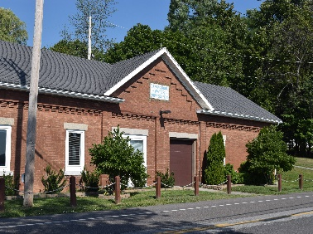
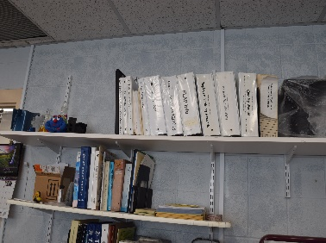
Partnerships Help Water Systems Overcome Challenges
Technical
Facility
Supply
Managerial
Management
Expertise
Financial
Demand
Rates
Water treatment system.
Water system office building.
Water system office space.
Notes:
[This slide contains animation – click to reveal information following the order below.]
Partnerships can help a water system overcome various types of challenges including physical and operational concerns and build technical, managerial, and financial capacity (often referred to as TMF capacity).
[CLICK]
Having adequate TMF capacity allows for water systems to overcome various challenges.
[CLICK]
For example, a water system lacking technical capacity, with inadequate or aging facilities could consider selling their water system to a neighboring water system. Water systems with limited or poor-quality water supply could connect to another water system to receive water.
[CLICK]
Water systems with limited management capacity could hire one contractor to help manage individual billing departments for a group of water systems. A water system whose operators don’t have the necessary expertise could bring in contract operators with the necessary certification or qualifications.
[CLICK]
Lastly, having financial capacity enables a water system to acquire and manage sufficient funds to achieve and maintain compliance. A water system experiencing an increase in demand could work with a nearby water system to provide back up supply, if needed. A water system with high water rates could merge with another water system to potentially reduce operational costs and therefore customer rates.

Slide 6
Partnership Examples and Benefits
Notes:
In the next few slides, we will look at activities that we could consider for partnerships and explore the potential benefits of partnerships. We will discuss the range of activities for partnerships starting with those that require less time and effort, working up to those that become increasingly complex.

Slide 7
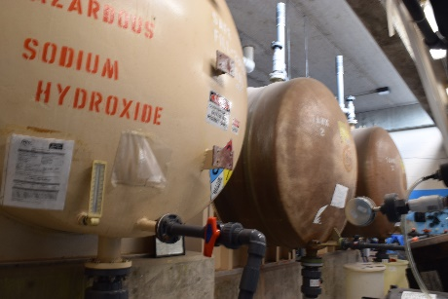
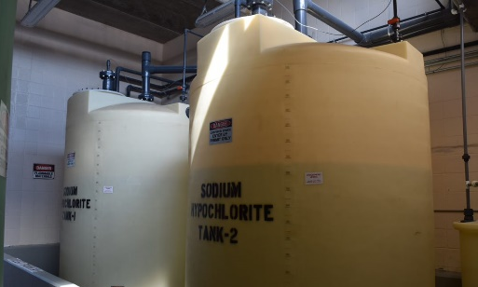
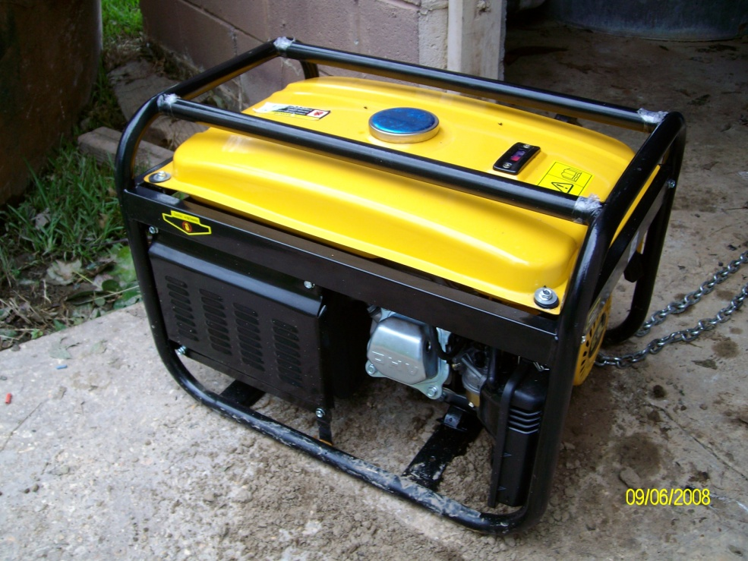
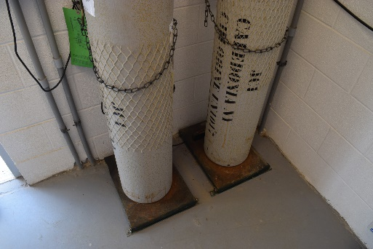
Partnership Examples
Informal Activities
Purchase in bulk
Share equipment
Emergency assistance
Share contacts
Sodium hydroxide tanks.
Sodium hypochlorite tanks.
A backup generator.
Chemical storage tanks.
Notes:
Many water systems engage in informal partnerships every day without recognizing them as partnerships.
Water system partnerships can be simple and informal including:
Purchasing chemicals or laboratory equipment in bulk,
Sharing equipment,
Agreeing to assist one another in emergency situations such as power outages or water system failures,
Sharing contacts to address common issues,
Exchanging information and resources concerning regulatory requirements,
And much more.
These activities are typically easy to implement, are beneficial, and are a way to start building relationships with other water systems or organizations. Informal partnerships can easily expand the pool of technical expertise and give operators, especially at small water systems, a network of supporting peers to turn to and rely on.

Slide 8
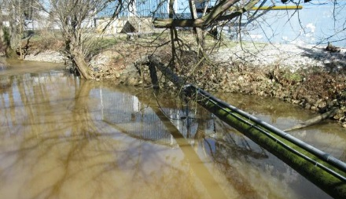
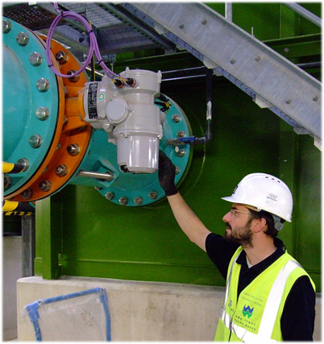
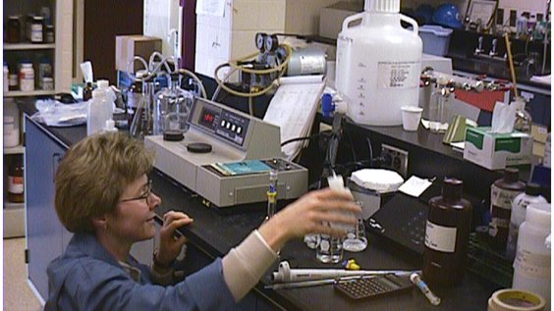
Partnership Examples
Contract Out Certain Functions
Purchase water
O&M
A pipe carries water.
Personnel run samples in a laboratory.
An operator inspects a feed system.
Notes:
Water system partnerships can be formalized with a written signed agreement. Contracts between water systems or with a service provider allow the water systems to remain independent.
Examples of functions that can be contracted include:
Purchasing water, or
Operations and maintenance.
Taking an informal activity and making it more formalized, with a written and agreed upon contract, is another way to think about potential contract-related partnerships. Depending on the type of activity, these partnerships can be an example of utilizing skilled and trained personnel with adequate expertise for the appropriate job which increases overall efficiency. Contractual Partnerships can be a great relief to a water system in providing legal security and defined roles between water systems.

Slide 9
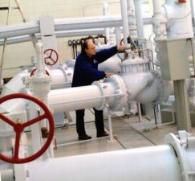
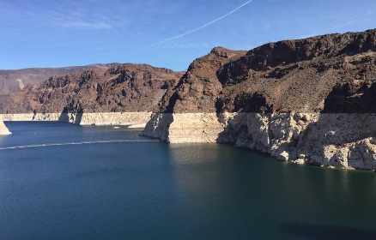
Partnership Examples
Create a New Entity
Share management
Share operators
Share source water
Source water: a multiple use reservoir.
Operator of a water system.
Source water: Lake Meade.
Notes:
Another example of a water system partnership is the creation of a new entity, sometimes referred to as a joint power agency, to serve the water systems that formed it. This type of partnership is often recognized as a Regional Water Authority. For example, the partnering water systems could share water system management, operators, and/or source water.
This type of partnership might require third-party facilitation but could help lower or avoid increasing rates, increase the pool of technical and managerial expertise available to each water system involved, solve a source water problem, or use economies of scale to address aging infrastructure.

Slide 10
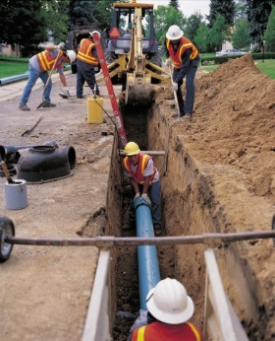
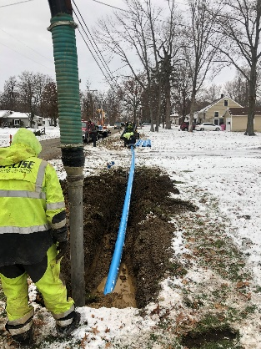
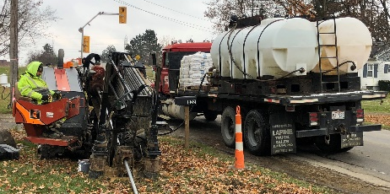
Partnership Examples
Merge
Physical interconnection
Water system acquisition
Workers observe a pit and lay new pipe.
Workers insert a section of pipe underground.
Workers make way for a new waterline.
Notes:
The last and typically the most complex type of water system partnership is where water systems engage in mergers and transfer of ownership.
For example, water systems could
Physically connect to another water system;
Acquire and remotely manage another water system; or
One water system could transfer ownership to another water system.

Slide 11
Partnership Benefits
For the water system
For the state program
For the customer
Economies of scale
Improved compliance
Improved water quality
Long-term savings
Potential reduction in number of regulated water systems
Increased reliability of supply
Improved customer service
Resource savings
Planning for future operations
Public health protection
Public health protection
Increased TMF capacity
Increased customer confidence
Increased community and economic development
Public health protection
Improved emergency response
Notes:
There are many benefits to participating in water system partnerships for not only the water systems involved, but also the state program and customers. Some benefits are immediate while others are more long-term.
Water systems that engage in partnerships can experience improved economies of scale, where the water systems are in a better position to negotiate for lower costs because they purchase larger volumes of supplies and equipment. This results in saving costs for all of the water systems involved.
In addition, when water systems alleviate immediate concerns and improve public health protection, they can better understand their existing operations and maintenance and capital improvement costs to plan for future operations. Other benefits to the water system include long-term savings, improved customer service, and increased TMF capacity.
When water systems engage in partnerships designed to overcome specific challenges, the state program might see enhanced compliance, a reduced number of regulated water systems, resource savings, improved customer relations, and enhanced public health protection across the state.
Finally, partnerships can provide the water system customers with improved water quality, more reliable water service, enhanced public health protection, greater customer confidence, increased community and economic development, and potentially lower rates.
Successfully implemented partnerships are a win-win for the whole community!

Slide 12
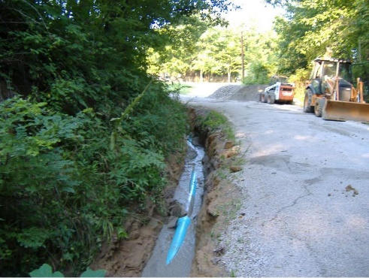
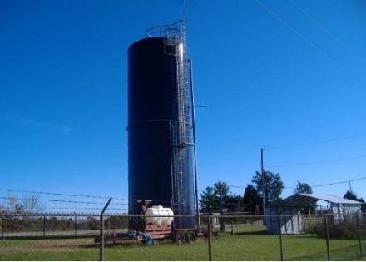
Dynamics of a Water System Partnership
Partnership Milestones:
1992: Jackson County Water shared office supplies with Vinton
2008: Vinton hired Jackson for operations due to challenges with
Source water contamination
Maintaining a certified operator
Low revenue streams
2009: Vinton sold its water system to Jackson
Benefits:
Improved water quality
Increased revenue
Infrastructure improvements
Enhanced local relations
Increased public health protection
Key Elements for Success:
Familiarity and trust
Gradual transfer of responsibility
Rate study
Jackson County waterline.
Case Study: Vinton County Water &
Jackson County Water
Southeastern Ohio
Jackson County storage tank.
Notes:
Water system partnerships are dynamic in nature and often change over time as water system needs and circumstances change. The partnership between the Vinton and Jackson County water systems is a good example.
Vinton and Jackson County were two water systems in rural Southeastern Ohio, about 80 miles south of Columbus. Jackson was significantly larger with 800 miles of water mains and 6,000 connections and served a much denser population. In contrast, Vinton County purchased treated water and had roughly 42 miles of water mains and 600 connections.
[CLICK]
The Vinton-Jackson partnership began informally in 1992 when Jackson shared office supplies with a fledgling Vinton. For the next 15 years the two water systems maintained their relationship, with Jackson County sharing equipment and an operator when needed. In 2008 Vinton hired Jackson for operations because they had been struggling with source water contamination, maintaining a certified operator, and low revenue streams. Jackson took over operations, and in 2009, Vinton sold its water system to Jackson.
[CLICK]
The benefits of the partnership include improved water quality for Vinton’s customers, increased revenue for Jackson, improvements in infrastructure, improved local relations, and increased public health protection.
[CLICK]
The key elements for success were the early existing foundation of trust between Vinton and Jackson, the progressive transfer of responsibility from Vinton to Jackson, and a rate study conducted by a third party technical assistance provider which helped assure customers that water rates would still be reasonable after the merger. Many partnership activities and solutions to challenges begin with a rate study.
The picture at the top shows the construction of the transmission line, which ultimately connected Vinton’s customers to Jackson’s water system.
View the full case study at this link: [TBD]
Presenters can replace this case study with a successful partnership that is similar to their potential partnership solution. More case studies can be found on EPA’s Water System Partnerships Case Study Map: https://epa.maps.arcgis.com/apps/Cascade/index.html?appid=a99dcae5390449e88ea74e4a7e3fcb07

Slide 13
Implementing Partnerships
Planning
Stakeholder support
Funding
Notes:
We’ll now discuss the key elements of stakeholder support, planning, and funding that should be considered and discussed when implementing activities for water system partnerships.

Slide 14
Implementing Partnerships
Implementation can take time
Implementation involves stakeholders, planning, and funding
Consider:
Buy-in and trust building
Developing a business plan
Obtaining necessary approvals
Construction-related plans
Regional planning activities
Securing funds
Notes:
Implementing a successful water system partnership often takes time.
Early stakeholder involvement, good planning, and maximizing funding makes the process more efficient and increases the likelihood of successful outcomes.
The initial steps to implement a partnership might involve
Buy-in and trust building, which are important to assure stakeholders that a partnership will result in mutual benefit and to get everyone on board early in the process;
Developing a business plan, which will help reduce redundancy of managerial and financial operations. The plan should provide guidance, resources, and tools to use in the partnership;
Obtaining necessary approvals from water system management, state legislatures, or other authorities, as needed;
Developing construction-related plans and specifications if there are engineering changes;
Coordinating with regional planning activities (e.g., with a council of governments) if the partnership is part of wider scale regional efforts; and
Securing funds to cover the costs of planning for and implementing the partnership activities.

Slide 15
Supporting Partnerships
Champions | Allies | Stakeholders
Keep momentum going from start to finish | Have an interest in the partnership’s success | Might be impacted by the partnership
Notes:
In every partnership there will be difficulties that arise and barriers to overcome. Partnerships need support throughout the entire planning, implementation, and operations process.
People who provide support are typically in these three categories.
Champions are groups or individuals that keep the momentum of the partnership going from start to finish. Champions are strong proponents of the project and will propose, endorse, encourage, and defend the partnership. Champions have a vision and they find ways to overcome barriers, get around obstacles, and resolve conflicts.
Allies are organizations or individuals who are supportive of the project and have an interest in the partnership’s success.
Stakeholders are customers or other groups who the partnership might impact. Stakeholders are not necessarily in favor of the partnership or project, but their early input and engagement is critically valuable.

Slide 16
Funding Partnerships
Free Resources
Technical assistance providers
State and County Water Programs
Federal Funding
SRFs
USDA (e.g., Rural Development Grants)
HUD (e.g., Community Development Block Grants)
Funding and Financing Resources
Water Finance Clearinghouse (web portal)
Finance Centers or Institutions
Notes:
Although partnerships can ultimately improve a water system’s financial capacity, partnerships may first need funding to implement the partnership and complete the steps we reviewed previously. There are several free resources that water systems can utilize when forming partnerships. Some of these resources include technical assistance providers, such as Rural Community Assistance Partnership (RCAP), Rural Community Assistance Corporation (RCAC), Rural Water Associations (RWA), and the Environmental Finance Centers (EFCs), to name a few. Local, state, and county water programs are valuable resources as well.
Additionally, there are several federal and state funding options that can support partnerships activities.
The Drinking Water State Revolving Fund (DWSRF) Program is used frequently for low interest loans and grants. Some states prioritize, award points to, or incentivize projects that include consolidation of water systems, regionalization, addressing compliance issues, or other supportive partnership activities such as planning, engineering design, and legal needs.
The Clean Water State Revolving Fund (CWSRF) Program funds a wide range of water infrastructure projects that address states’ highest priority water quality needs, including wastewater facilities and treatment systems.
In addition, the U.S. Department of Agriculture has Rural Development Loans and Grants, and the Department of Housing and Urban Development has Community Development Block Grants, both of which may support partnership activities at water systems.
There are other funding and financing resources that water systems, communities, and technical assistance providers might find helpful.
The Water Finance Clearinghouse is an easily navigable web-based portal to help communities locate information and resources including sources of funding for partnership activities.
Financial centers or institutions, including the Environmental Finance Centers, may also be able to direct you to relevant funding and financing options.
For help finding funding sources in your state, visit https://www.epa.gov/sites/production/files/2017-08/documents/water_system_partnerships_guide_0.pdf]

Slide 17
Next Steps
Notes:
We’ll now review the next steps for partnerships activities.

Slide 18
Next Steps
Consider how water system partnerships can address challenges and benefit your water system and community
See yourself as having an important role in the partnerships process
Continue the dialogue
Notes:
This presentation provided an overview of water system partnerships and their potential to positively address challenges.
Now, you can begin to discover ways that your water system and community could benefit from water system partnerships and envision yourself as an important part of the partnership process; either as Champion, Ally, or Stakeholder.
Water system partnerships can be a long and difficult journey with many obstacles along the way. Now it’s your turn to take the next step. Pick up the phone, send the e-mail, introduce yourself, exchange contact information, attend a workshop, or set up a meeting with interested parties to continue the partnerships dialogue.
Note to presenter:
If you wish to further individualize and customize your Next Steps message, consider using Option A, B, C, or D on the last four placeholder slides.

Slide 19
Questions?
Notes:
[Address any questions from the audience]
Note to presenter:
You may also decide to use this time to have an open discussion. For example:
Discuss specific challenges that could be improved at your water system(s)
Ask if anyone wants to share specific areas of capacity that could use improvement at their water system
Ask attendees to provide examples of partnerships that your water system(s) currently participate in
Discuss any funding sources to pursue or that you are considering for the potential partnership
Discuss any relevant state funding sources you could utilize
Brainstorm people or organizations you see as being key players, including champions, allies, or stakeholders

Slide 20
Thank You!
Contact Information:
EPA’s Water System Partnerships website: https://www.epa.gov/dwcapacity/water-system-partnerships
Notes:
[Add appropriate contact information to the slide.]
Thank you all for attending today’s presentation.

Slide 21
Next Steps [Option A]
[Next steps for implementing the activity(ies) identified, with help from your workshop action plan]
Schedule another meeting to continue the discussion
Notes:
[Option A presenters should revise this slide to fill in the red placeholder and to include any additional/potential/alternative next steps. Next steps might include setting up an informal call with the identified partner(s) to gauge their interest in the activity(ies) identified, conducting feasibility or rate studies.]
[Review the next steps for implementing the partnership activity(ies) you identified in the presentation]
[Discuss potential partnership opportunities for your water system]
I can schedule another meeting to continue the discussion we started today.

Slide 22
Next Steps [Option B]
[Next steps for implementing the partnership activity(ies) identified]
Find out how you can support our partnership by reaching out to us via [email or phone]
If you have funding in mind
If you have other partners in mind
Check for updates on our partnership by visiting [water system or municipal website] or contacting [email or phone]
Notes:
[Option B presenters should revise this slide to fill in the red placeholders and to include any additional/potential/alternative next steps.]
[Review the next steps for implementing the partnership activity(ies) you identified in the presentation]
If you’d like to support our partnership, please reach out to us directly. You can also check for updates on our partnership by visiting our website or by reaching out to us directly.

Slide 23
Next Steps [Option C]
Watch for an email from us with potential workshop dates and information
Reach out to us via [email or phone] if you are interested in attending
Reach out to other water systems to encourage them to attend, too
For more information, visit EPA’s Water System Partnerships website: https://www.epa.gov/dwcapacity/about-water-system-partnerships
Notes:
[Option C presenters should revise this slide to fill in the red placeholders and to include any additional/potential/alternative next steps.]
We plan to send an email to today’s attendees with more information on a potential upcoming workshop. We hope you’ll consider attending. Please reach out to us if you’re interested, and also reach out to other water systems who might be interested. In the meantime, you can find more information about water system partnerships at the website on the slide.
Additional resources:
Overview of Water System Partnerships:
https://epa.maps.arcgis.com/apps/Cascade/index.html?appid=cfccb8b4975d4d72869bd0770510c1b0
Resources for Beginning a Water System Partnership:
https://epa.maps.arcgis.com/apps/Cascade/index.html?appid=b66053d1b56747df9a66c1a4057afc1c

Slide 24
Next Steps [Option D, create your own]
Notes:
[Option D presenters can revise this slide to include any additional/potential/alternative next steps that coordinate with their presentation goals.]

