Slide 1
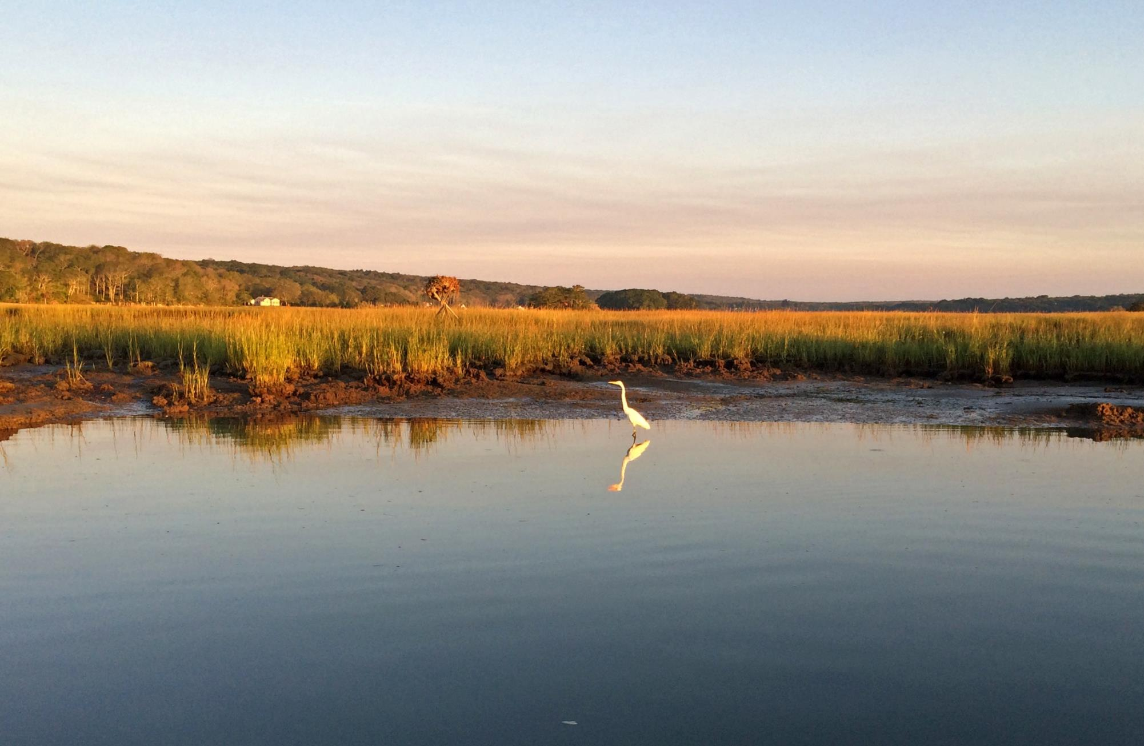
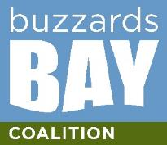
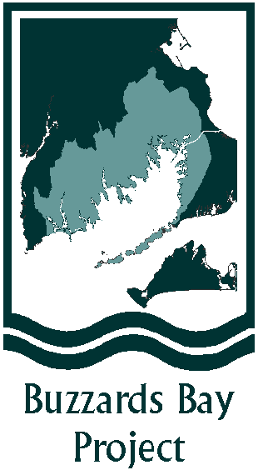
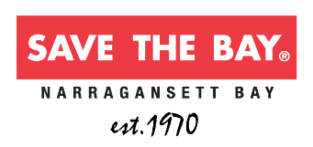
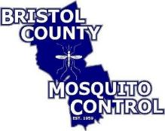
Evaluating Management Actions to Promote Salt Marsh Resilience
Rachel W. Jakuba, PhD, Buzzards Bay Coalition
SNEP Symposium, May 18, 2022
Project Team
Alice Besterman
Joe Costa
Linda Deegan
Wenley Ferguson
Diana Brennan
Neil Ganju

Slide 2
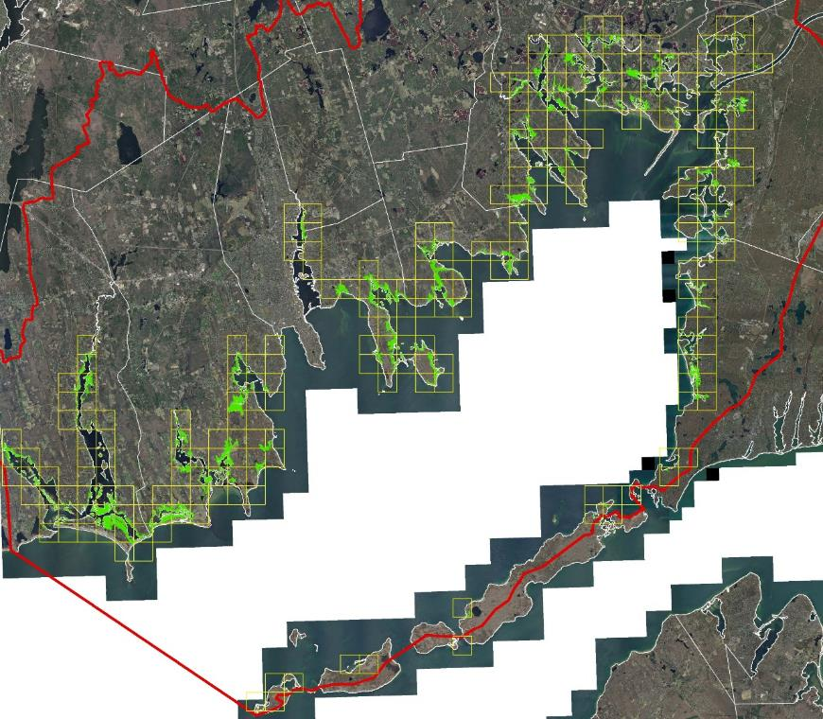
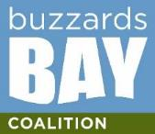
Salt Marshes in the Landscape
Very productive areas of estuaries (store carbon)
Act like ‘filters’ converting dissolved nutrients into vegetation
Provide physical barrier to buffer storm impacts, flooding, and coastal erosion
Valuable habitat for variety of organisms including mussels, crabs, shrimp, striped bass, osprey, etc.
savebuzzardsbay.org

Slide 3
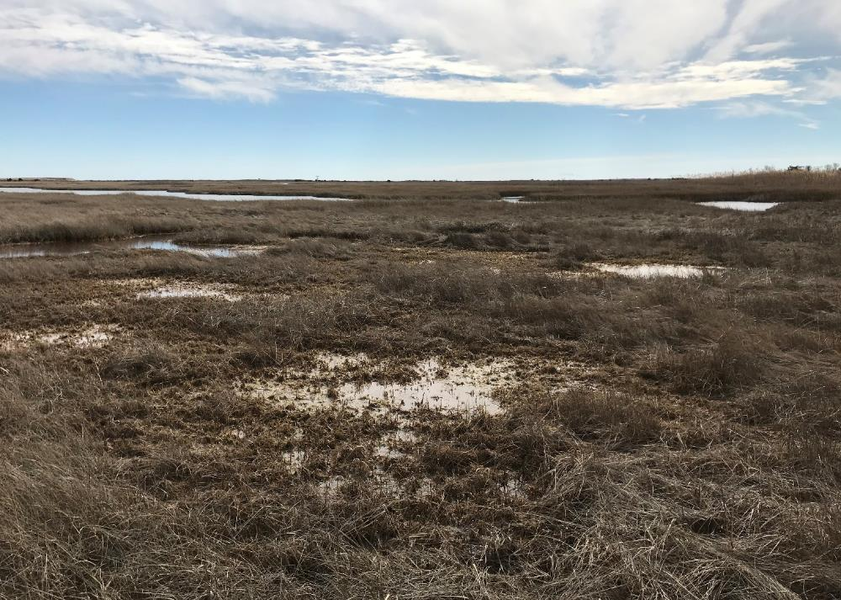
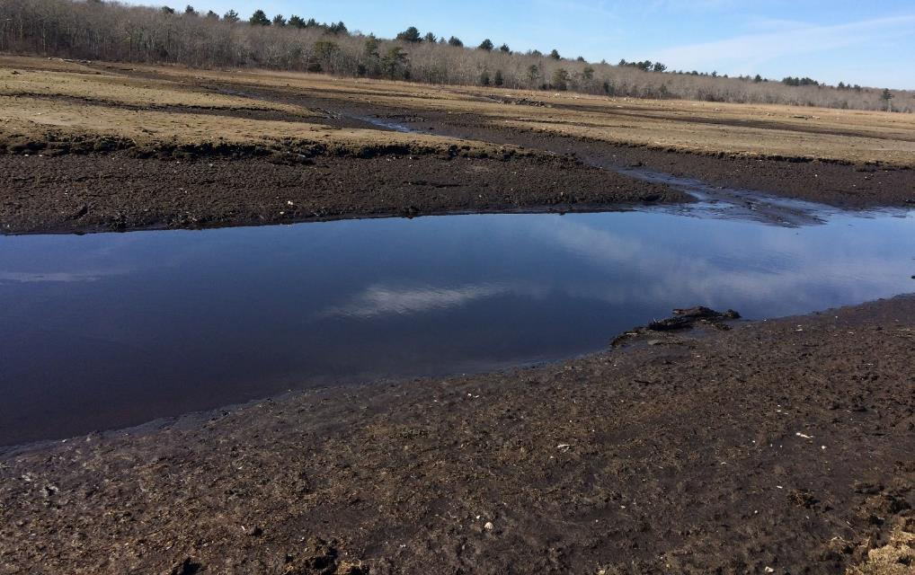
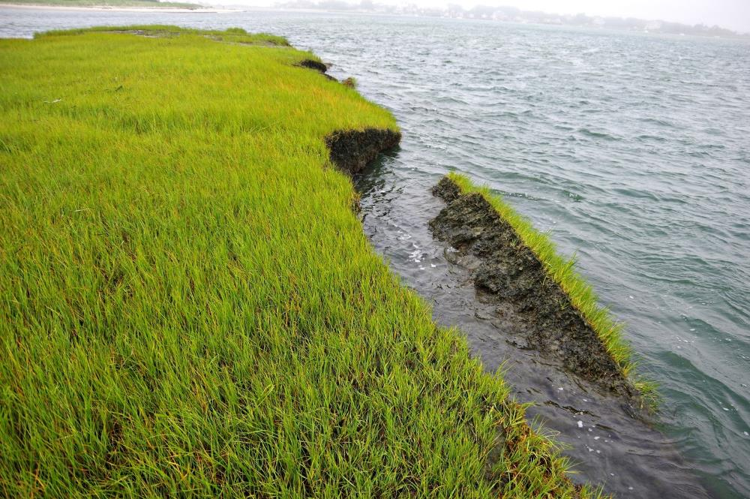
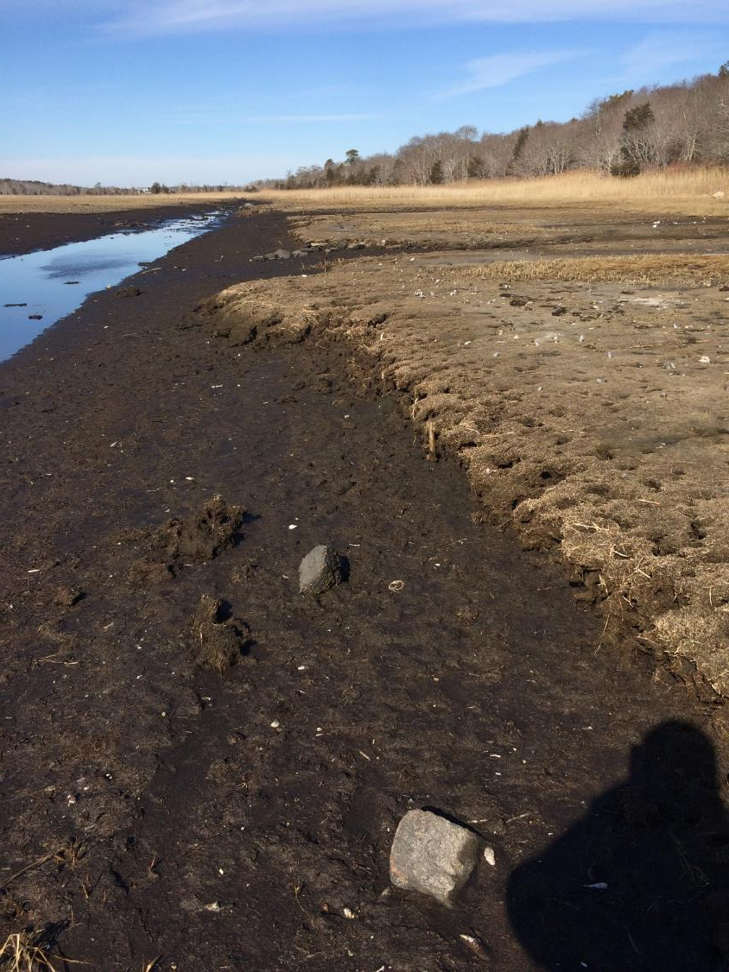
Marsh Loss around Buzzards Bay
Dartmouth
Mattapoisett
savebuzzardsbay.org
Westport River

Slide 4
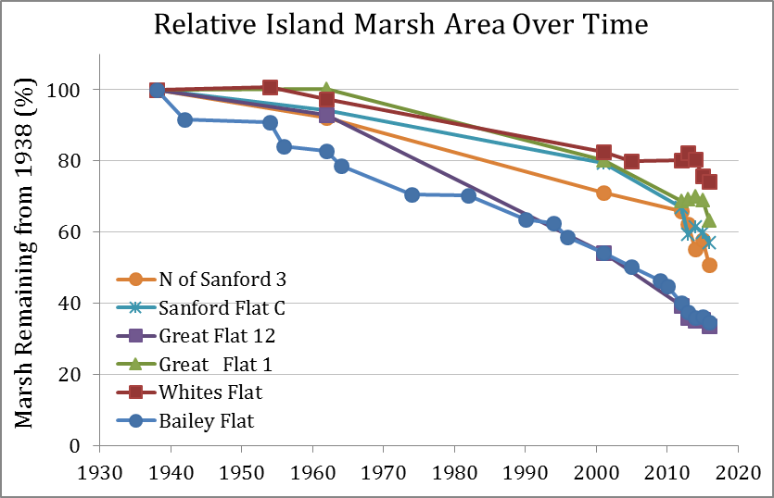
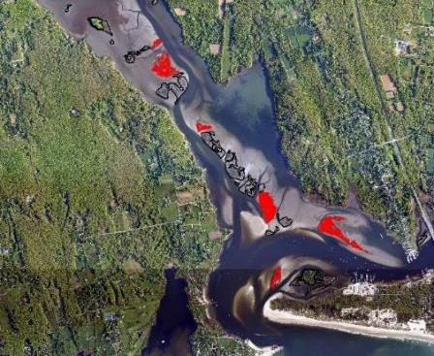
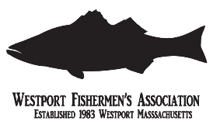
Understanding Buzzards Bay marsh loss
26 - 66% of salt marsh area lost between 1938 and 2016
Rate of loss increasing
On each island, much of the marsh areas lost were the lowest elevation parts of that island
Relatively low root density at all sites suggests vulnerability to loss due to nitrogen pollution
savebuzzardsbay.org

Slide 5
Community Concern for Marshes
From an email to the Buzzards Bay Coalition:
“The marsh grass is dying off in patches, leaving just mud that the water now flows into and is creating new smaller canals/rivulets when the tides are high.
The grass die-off is [a] …recent phenomenon, within the last year from what I've seen.
The shoreline itself, which my property abuts, has not changed or been affected yet, though once the marsh goes I would imagine that would soon follow.
This area has brought us so much peace and joy; we are willing to do quite a lot to save it.”
savebuzzardsbay.org

Slide 6
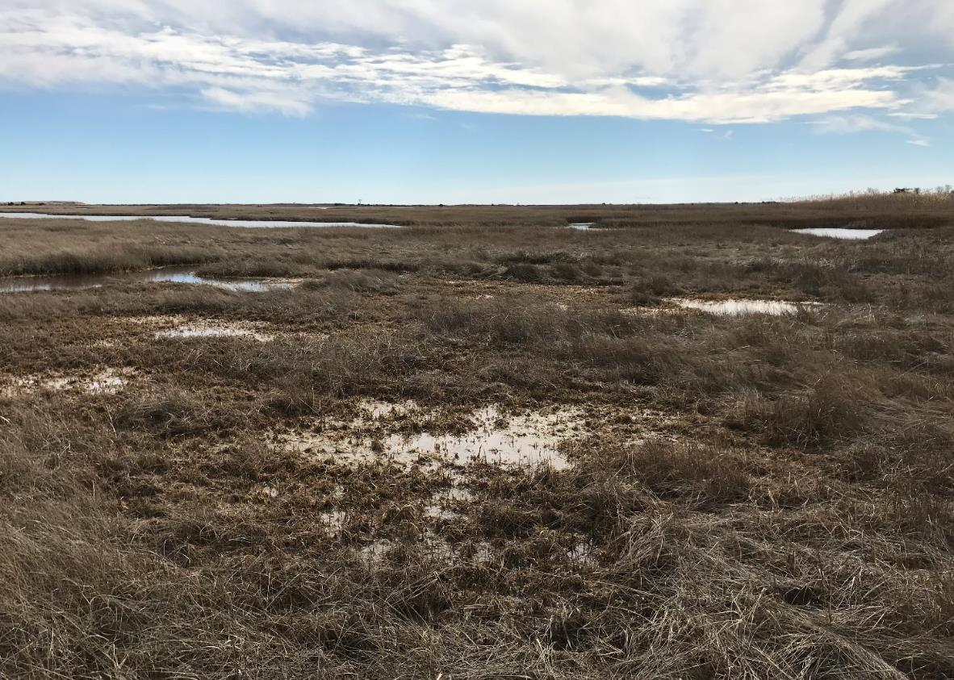
Marsh Loss around Buzzards Bay
Dartmouth
If the water stays on the marsh for too long, it drowns the plants. Shallow water areas have the potential to expand outward rapidly, killing vegetation and converting interior marsh platform into open water.
savebuzzardsbay.org

Slide 7
Runnels: Adaptation strategy catching speed
Runnels are small channels to create tidal connection between shallow water on the marsh surface and a creek or ditch, following topographical low areas or existing flow paths, and draining root zone
Wenley Ferguson, Save the Bay, RI began piloting runnels for salt marsh adaptation around 2010
savebuzzardsbay.org

Slide 8
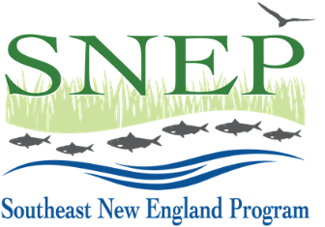
Project Goals
Synthesize and communicate existing knowledge on runnels
Test pilot runnels in Buzzards Bay
Identify where and when runnels are most effective in the context of marsh loss patterns and environmental conditions in Buzzards Bay
savebuzzardsbay.org

Slide 9
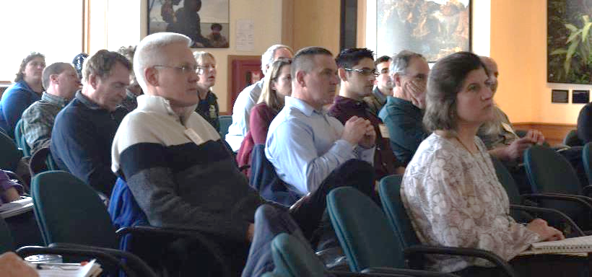
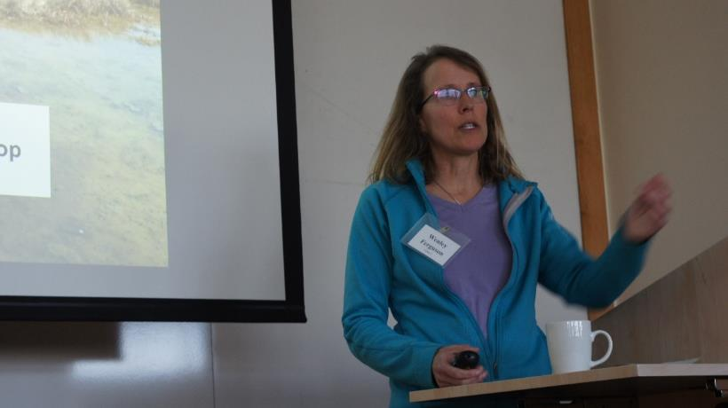
Runnel Workshop
More than 70 scientists, practitioners, resource managers, regulators and other stakeholders
Opportunity to develop common understanding of potential use for runnels in our region
Break out sessions to examine and rank potential runnel sites

Slide 10
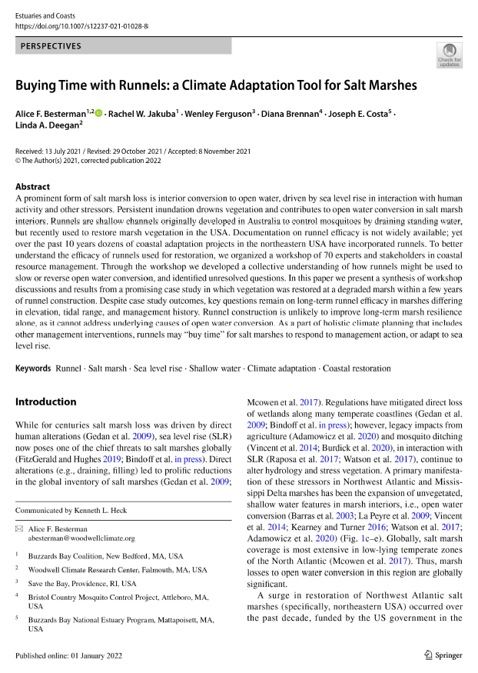
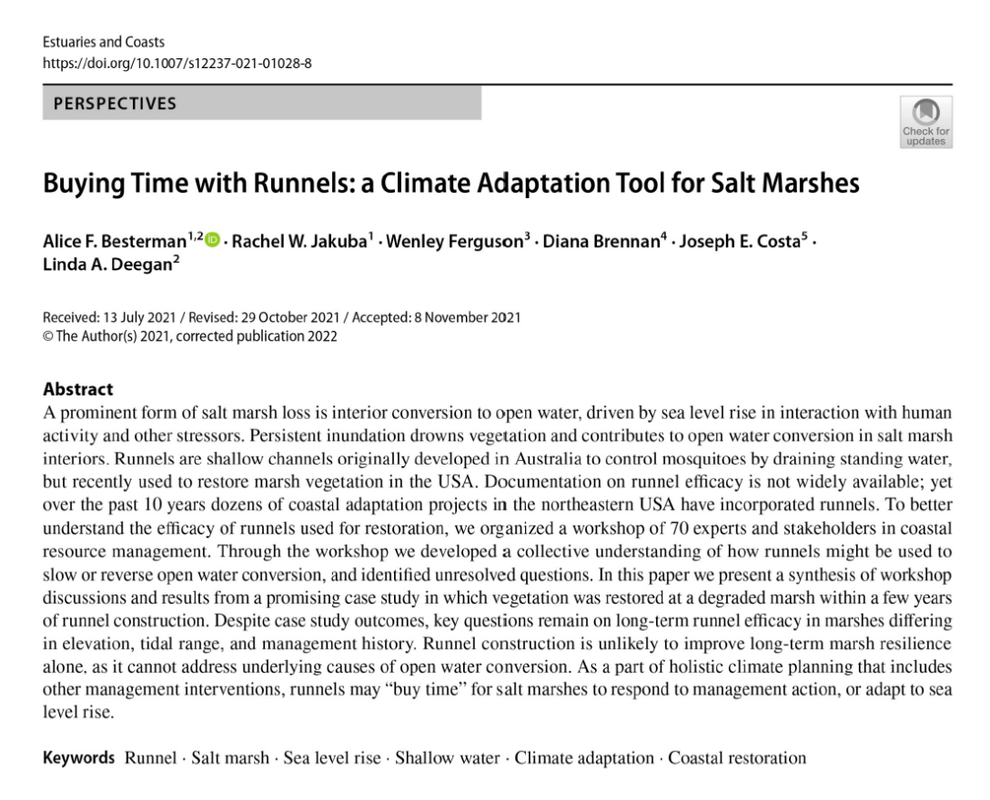
Journal article
Overview of the history and use of runnels
Case study from Winnapaug Marsh in Rhode Island
Highlights research questions that still need addressing
savebuzzardsbay.org

Slide 11
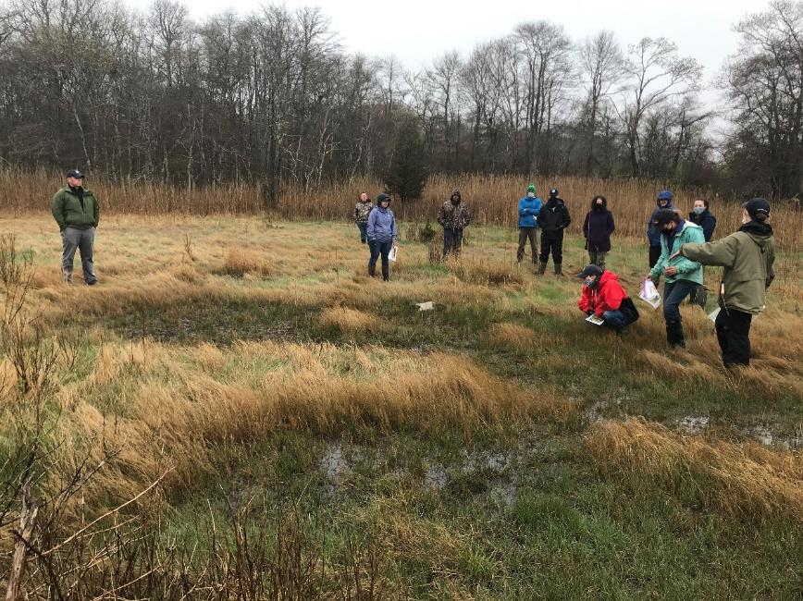
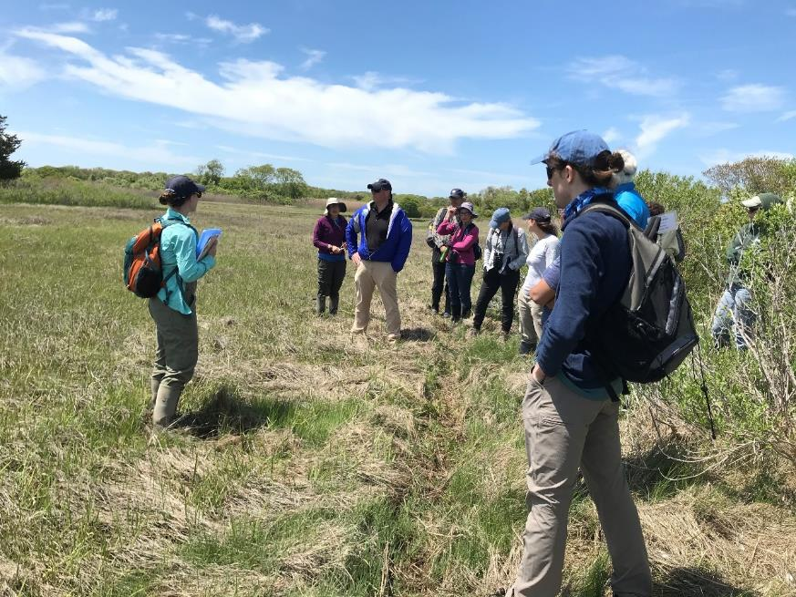
Site Visits to Runnels
Staff from all 3 regional mosquito control agencies to look at completed runnels and review the process used for site selection, runnel digging, and permitting.
Stakeholders from Allens Pond and non-profit staff actively engaged in restoration techniques around the watershed.

Slide 12
Project Goals
Synthesize and communicate existing knowledge on runnels
Test pilot runnels in Buzzards Bay
Identify where and when runnels are most effective in the context of marsh loss patterns and environmental conditions in Buzzards Bay
savebuzzardsbay.org

Slide 13
Buzzards Bay, Massachusetts

Slide 14
Buzzards Bay, Massachusetts
Replicated BACI-design
Each marsh:
5 experimental +
5 reference sites

Slide 15
Buzzards Bay, Massachusetts
Replicated BACI-design
Each marsh:
5 experimental +
5 reference sites
All sites (20)
Vegetation metrics
Photo stations

Slide 16
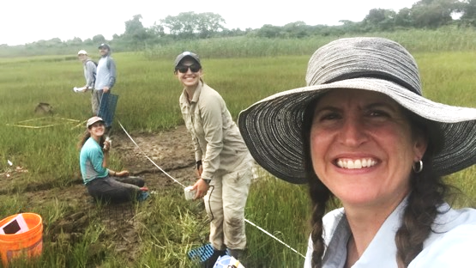
Buzzards Bay, Massachusetts
Replicated BACI-design
Each marsh:
5 experimental +
5 reference sites
All sites (20)
Vegetation metrics
Photo stations
Intensive Sites (12)
Elevation
Soil characteristics
Water level
Shear strength
Water quality + TSS
Decomposition
Other environmental variables

Slide 17
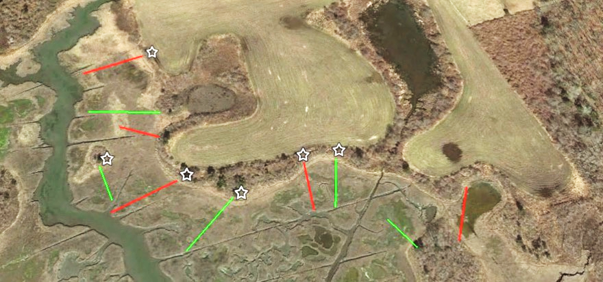
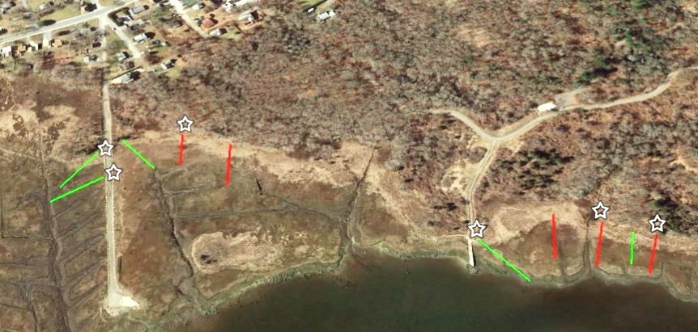
Pre-monitoring 2020
Runnels created Oct 2020 - Feb 2021
Monitor through 2023 at least
Ocean View
Little Bay
50 m
Experimental-runnel site
Reference site
Intensive site
50 m

Slide 18
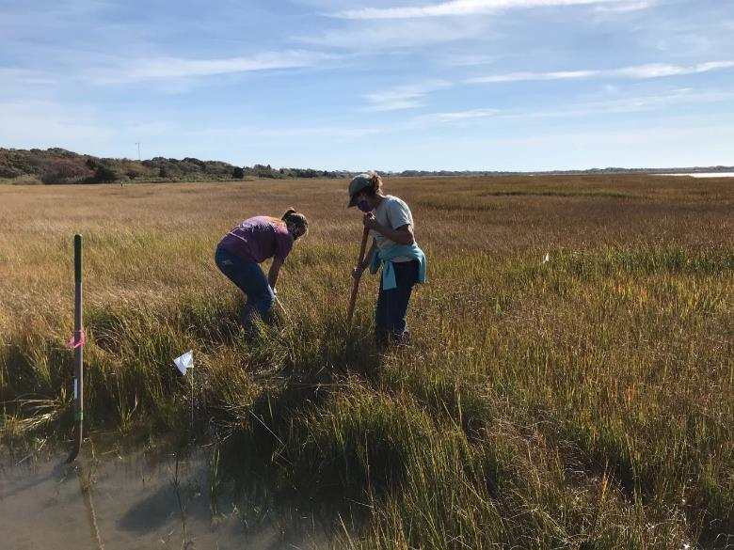
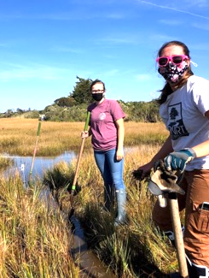
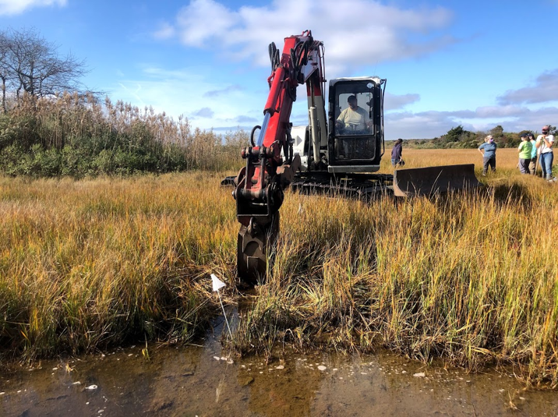
Installation

Slide 19
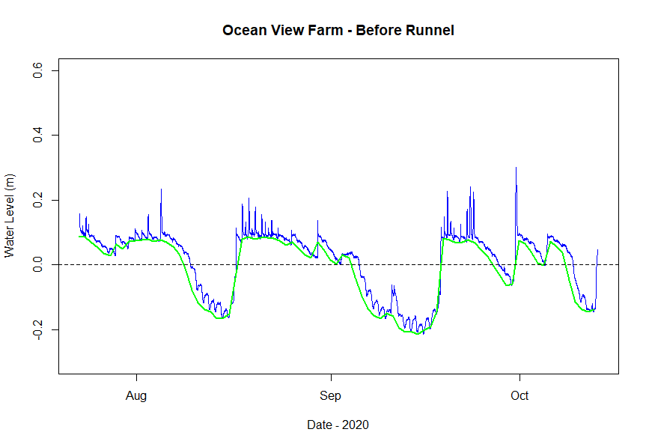
Initial runnel results
Marsh surface

Slide 20
Initial runnel results
Marsh surface
Before the runnel – extended periods of standing water

Slide 21
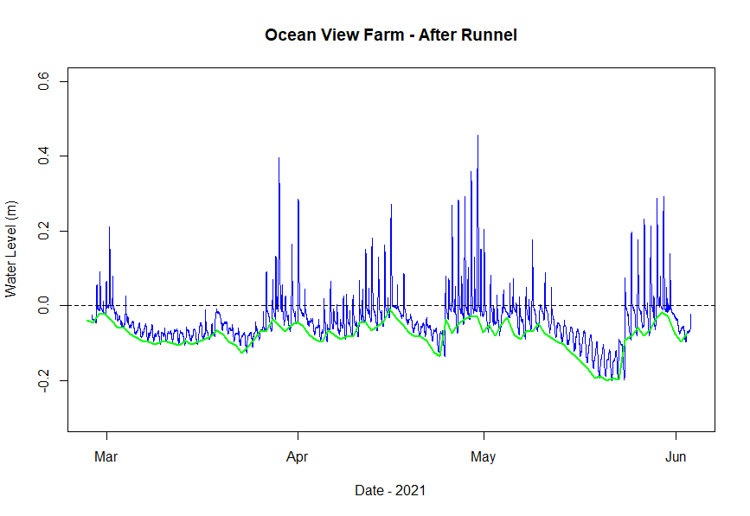
Initial runnel results
Marsh surface
After the runnel – tidal flooding but no standing water
Before the runnel – extended periods of standing water

Slide 22
Initial runnel results
Ocean View Farm
Before
Little Bay
Before
After
After
savebuzzardsbay.org

Slide 23
Project Goals
Synthesize and communicate existing knowledge on runnels
Test pilot runnels in Buzzards Bay
Identify where and when runnels are most effective in the context of marsh loss patterns and environmental conditions in Buzzards Bay
savebuzzardsbay.org

Slide 24
Lessons Learned
Small scale features that target specific areas of die-back.
Runnels are a valuable tool in an overall marsh management scheme.
Project design is still highly context-specific, so we recommend future runnel projects include individuals with training and experience using the technique, or similar hydrologic management tools.
Multiple partners provided key support.
Continued monitoring will be useful for characterizing potential sites.
savebuzzardsbay.org

Slide 25
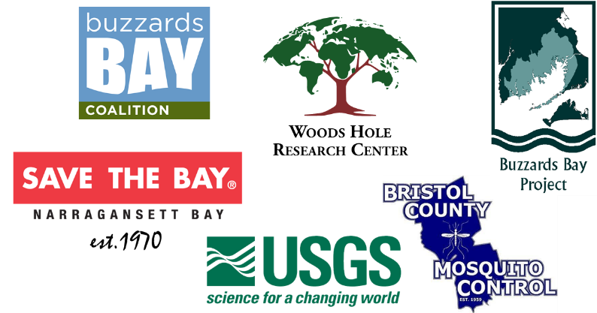
Acknowledgements
Alice Besterman
Joe Costa
Wenley Ferguson
Linda Deegan
Diana Brennan
Neil Ganju
Landowners, Collaborators, Students/Interns
Linda Vanderveer (Dartmouth Natural Resource Trust)
Whitney McClees (Town of Fairhaven)
Hillary Sullivan
Melissa Herring
Gizella Spencer
Julia Holtzer
Kara Falvey
Nico Gentile
Lillie Hoffart
Shea Stobaugh
Dawson Little Jennifer Sepanara
savebuzzardsbay.org

Slide 26
Marstons Mills River Headwaters Cranberry Bog Restoration Project
Casey D. Chatelain
cchatelain@bcleanwater.org
linkedin.com/in/caseydchatelain

Slide 27
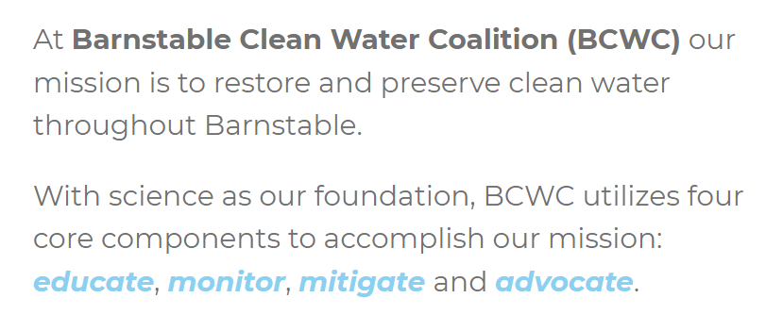

Slide 28
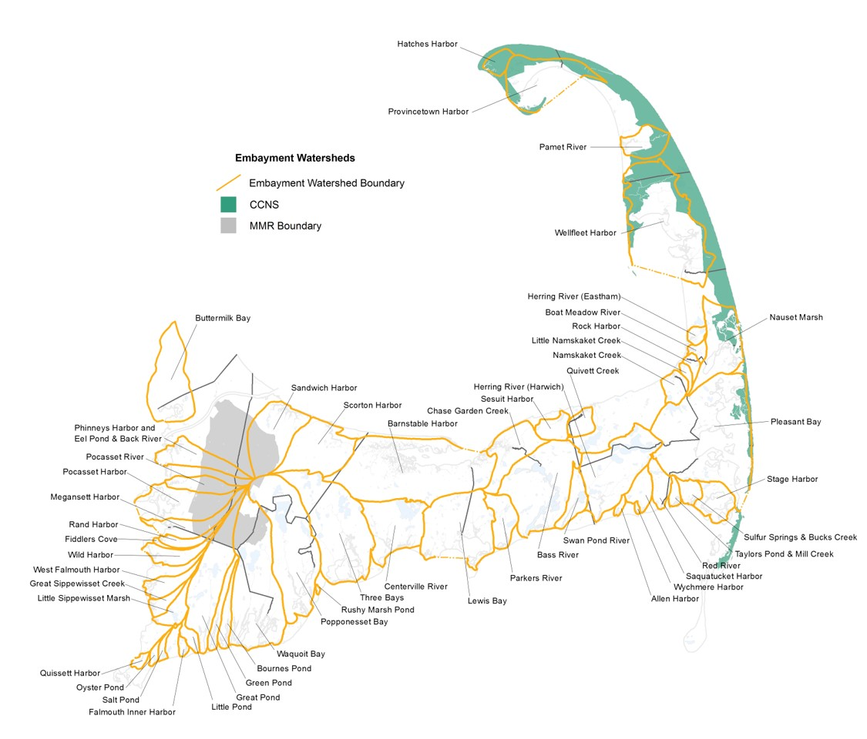

Slide 29
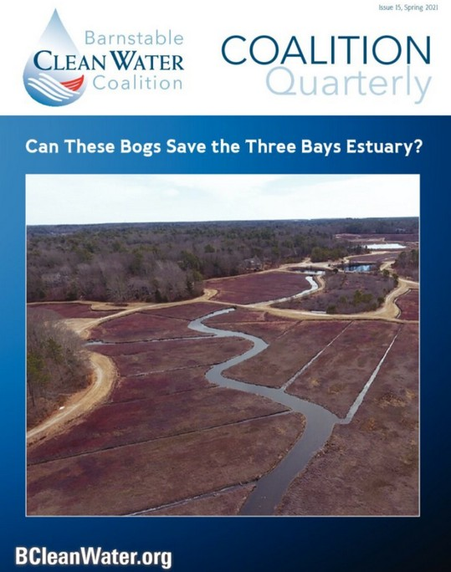
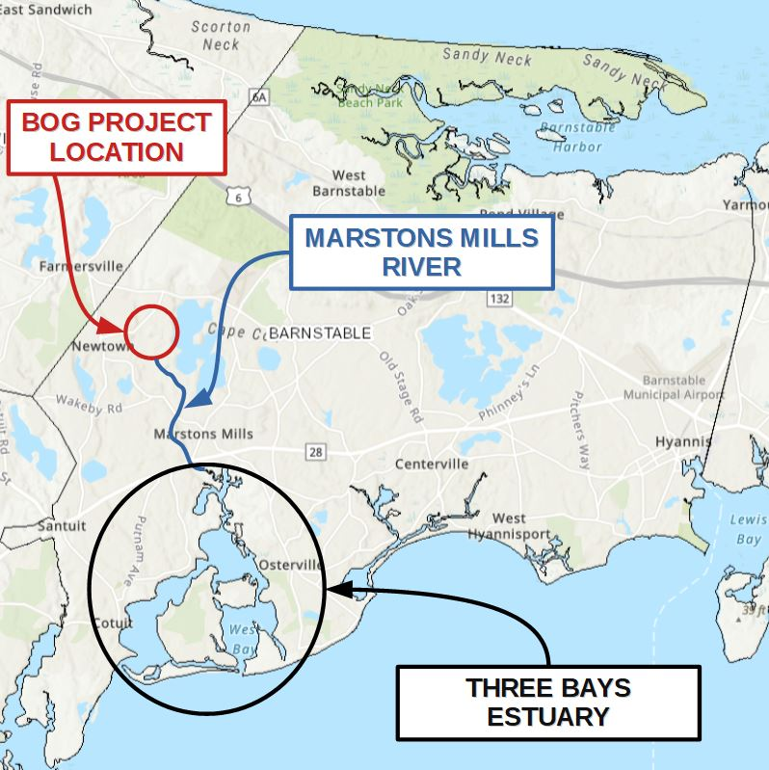

Slide 30
Current Attenuated Watershed Load
46,221 kg N
Reduction Required to Meet TMDL
20,578 kg N
Cranberry bogs
7,602 kg N
TMDL
25,643 kg N
Natural Ecosystem Function
Watershed Loading Data Courtesy of 2021 Town of Barnstable 208 Compliance Report; Cranberry Bog Data Courtesy of SMAST 2019 Technical Report and BCWC Data Collection

Slide 31
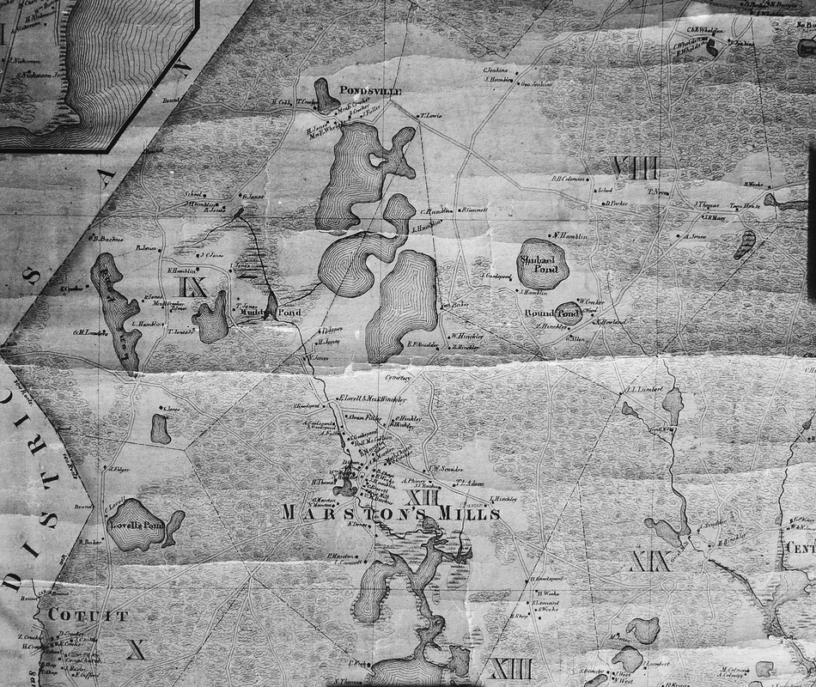
Map courtesy of Marstons Mills Historical Society

Slide 32
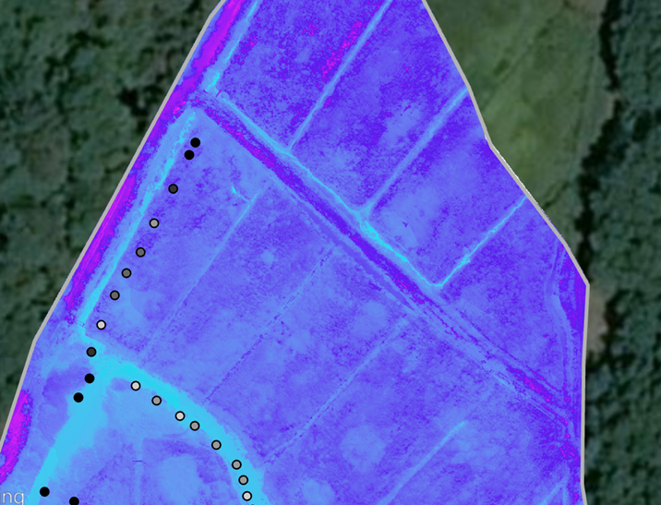
Thermal Imagery courtesy of EPA Region 1

Slide 33
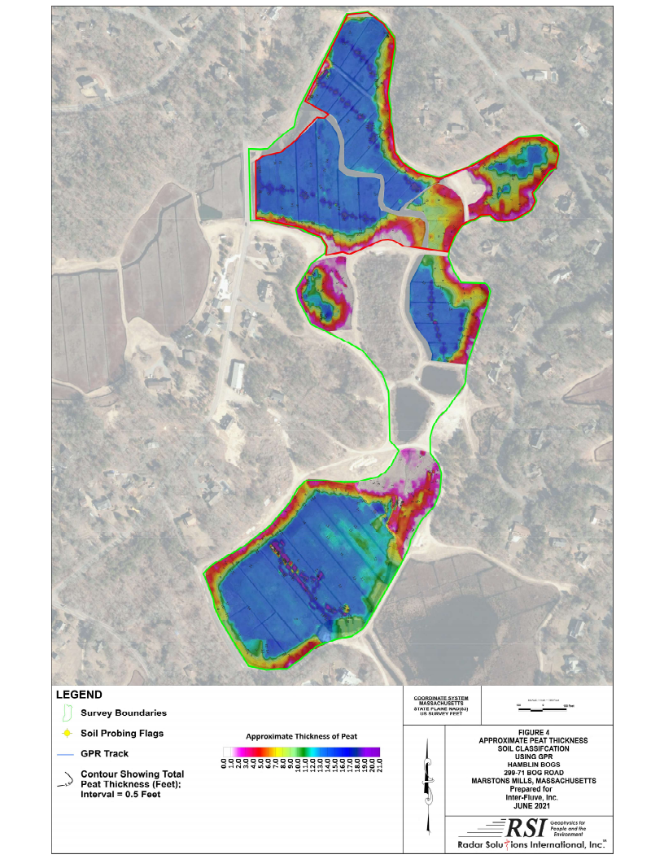

Slide 34
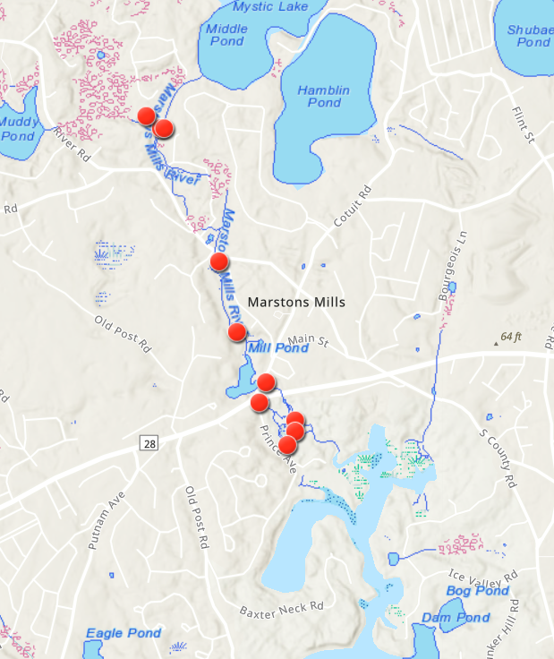

Slide 35
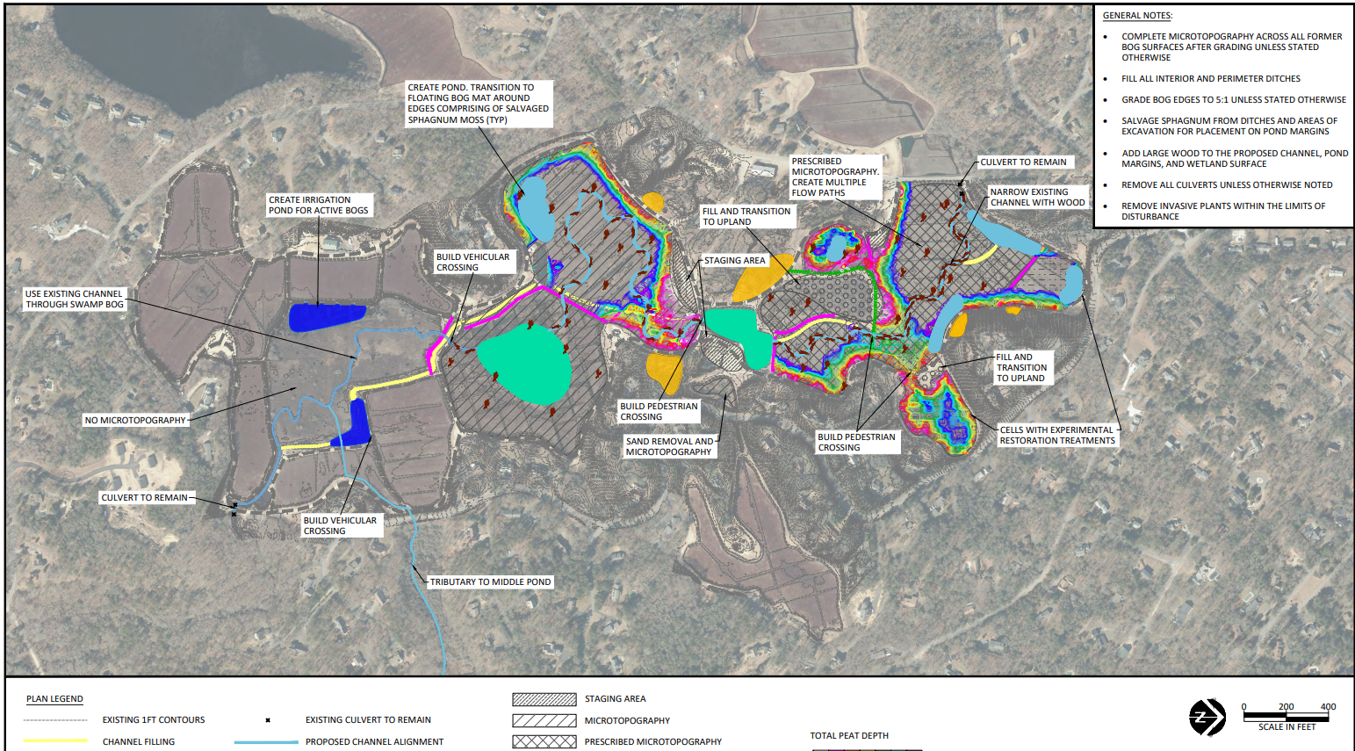

Slide 36
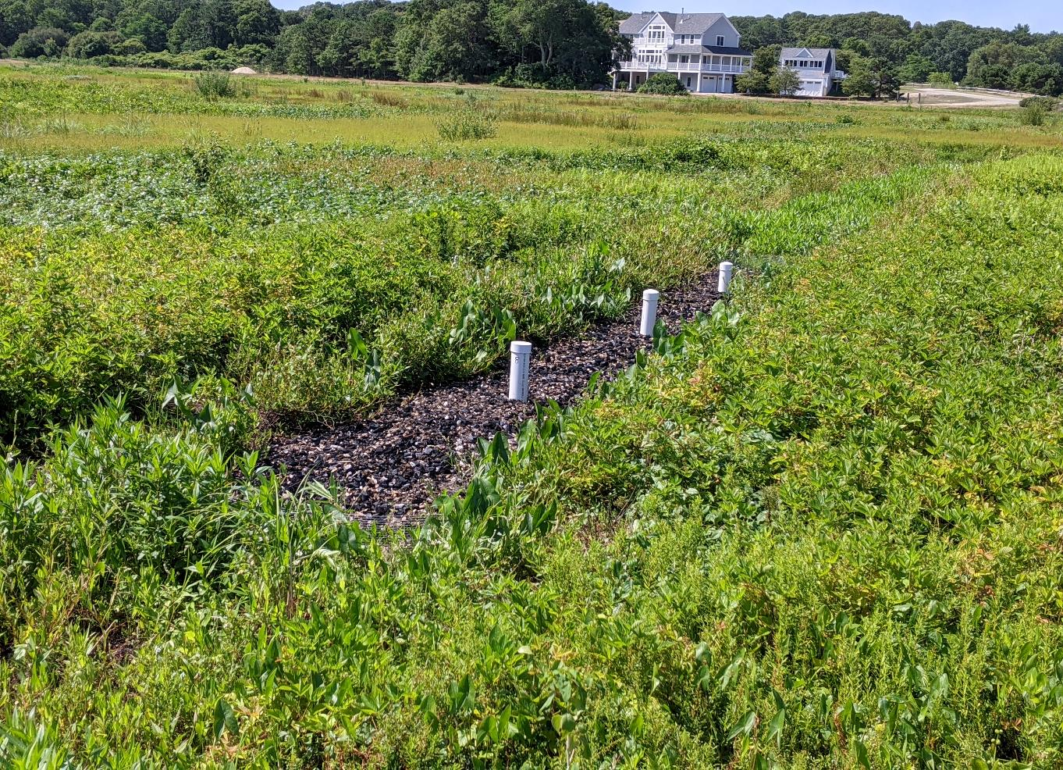

Slide 37
2021 | 2022 | 2023 | 2024 | 2025
QAPP Approval
Feasibility Study
Conceptual Design
 | Design and permitting
 |  |  | Construction
Monitoring

Slide 38
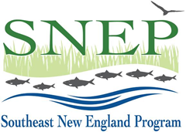
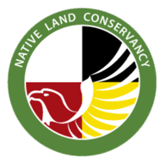
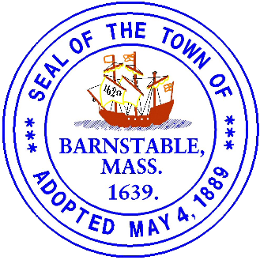
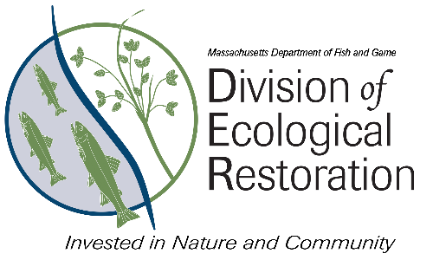

Slide 39
Marstons Mills River Headwaters Cranberry Bog Restoration Project
Casey D. Chatelain
cchatelain@bcleanwater.org
linkedin.com/in/caseydchatelain

Slide 40
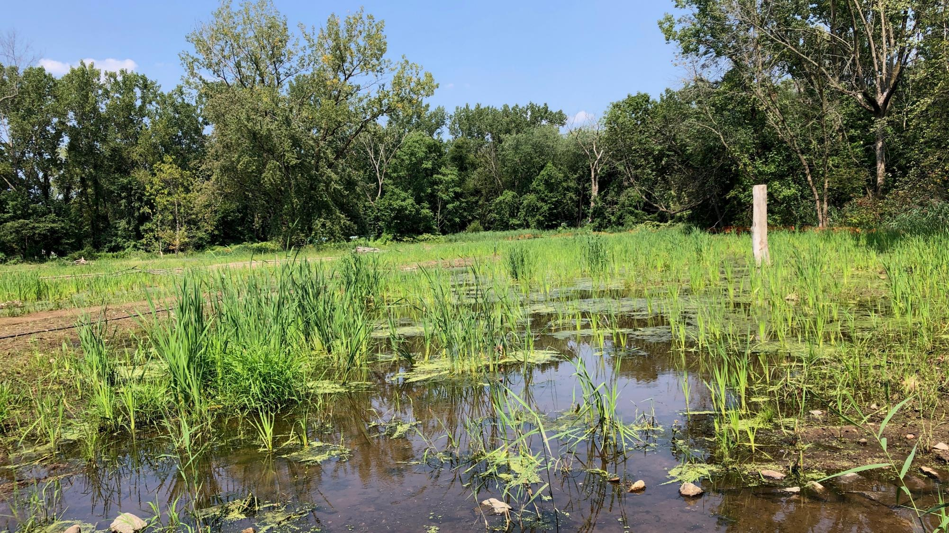
Teaneck Creek Park Habitat Restoration:
Regenerative Stormwater Conveyance &
Sand Seepage Wetlands
Southeast New England Program 2022 Symposium
Virtual
May 18, 2022
KEVIN DAHMS, PE
WATER RESOURCES ENGINEER
BIOHABITATS, INC.

Slide 41
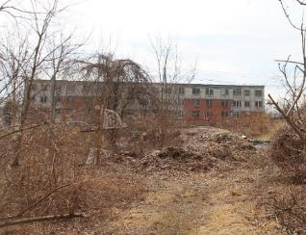
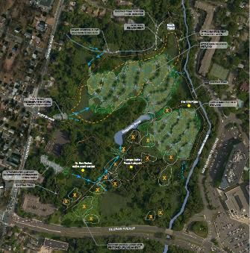
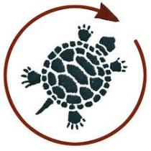
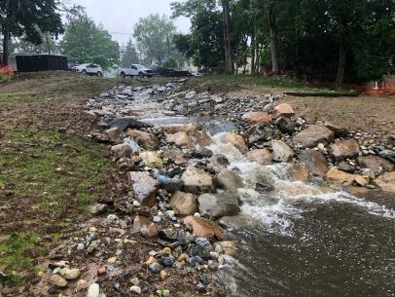
OVERVIEW
PROJECT BACKGROUND
PROJECT DRIVERS
PROJECT APPROACH
LESSONS LEARNED
OVERVIEW
41

Slide 42
PROJECT PARTNERS
CONSTRUCTION MANAGEMENT
PROJECT LEAD
DESIGN
CONTRACTOR
PARTNERS & FUNDING
PROJECT BACKGROUND
42

Slide 43
PROJECT LOCATION
Teaneck Creek Park, Teaneck, NJ
PROJECT BACKGROUND
43

Slide 44
PROJECT/SITE HISTORY
TCC Founded
Wetland Restoration Concept
Remediation Plan
Construction Complete (anticipated)
Habitat Restoration Design
Construction Started
New Trails & Outdoor Classroom
2001
2006
2008
2010
2018
2020
2022
PROJECT BACKGROUND
44

Slide 45
PRE-RESTORATION CONDITIONS
PROJECT BACKGROUND
45

Slide 46
PRE-RESTORATION CONDITIONS
Clay liner
Trail system
Art and educational programming
PROJECT BACKGROUND
46

Slide 47
PROJECT DRIVERS
Public experience: noise from adjacent roads, degraded paths, debris piles
Impaired water quality (Dragonfly Pond, Teaneck Creek)
Erosion from stormwater
Infestation of invasive species
PROJECT DRIVERS
47

Slide 48
PROJECT DRIVERS
Eroding brook
Eroding stormwater gullies
PROJECT DRIVERS
48

Slide 49
PROJECT DRIVERS
Poor WQ in Dragonfly Pond and Teaneck Creek
PROJECT DRIVERS
49

Slide 50
PROJECT DRIVERS
Invasive species (throughout)
PROJECT DRIVERS
50

Slide 51
PROJECT DRIVERS
Debris piles (throughout)
PROJECT DRIVERS
51

Slide 52
PROJECT DRIVERS
Noise from Degraw Ave
PROJECT DRIVERS
52

Slide 53
PROJECT DRIVERS
Eroding brook
Poor WQ in Dragonfly Pond and Teaneck Creek
Eroding stormwater gullies
Invasive species (throughout)
Debris piles (throughout)
Noise from Degraw Ave
PROJECT DRIVERS
53

Slide 54
PROJECT GOALS
Enhance the site’s natural resources
Increase biodiversity
Mitigate erosive forces of stormwater throughout the site
Improve public access and visitor experience
Improve community health and well-being
Educate the public about the park’s habitat and ecology
PROJECT DRIVERS
54

Slide 55
PROJECT METRICS
Over 20 acres of habitat restoration
430 linear feet of stormwater channel restoration
300 linear feet of trail realignment
16 debris piles removed or capped
PROJECT APPROACH
55

Slide 56
PROJECT PLANS
Regenerative stormwater conveyance
Sand seepage wetlands
Invasive species management (mechanical/chemical)
Native plantings
Trail rehabilitation
Debris pile removal
Lookout berm creation
PROJECT APPROACH
56

Slide 57
PROJECT PLANS
Regenerative stormwater conveyance
Sand seepage wetlands
Invasive species management (mechanical/chemical)
Native plantings
Trail rehabilitation
Debris pile removal
Lookout berm creation
PROJECT APPROACH
57

Slide 58
PROJECT DETAILS – REGENERATIVE STORMWATER CONVEYANCE
PROJECT APPROACH
58

Slide 59
PROJECT DETAILS – REGENERATIVE STORMWATER CONVEYANCE
PROJECT APPROACH
59

Slide 60
PROJECT DETAILS – REGENERATIVE STORMWATER CONVEYANCE
PROJECT APPROACH
60

Slide 61
PROJECT DETAILS – REGENERATIVE STORMWATER CONVEYANCE
Hillside RSC - Before
PROJECT APPROACH
61

Slide 62
PROJECT DETAILS – REGENERATIVE STORMWATER CONVEYANCE
Hillside RSC - After
PROJECT APPROACH
62

Slide 63
PROJECT DETAILS – REGENERATIVE STORMWATER CONVEYANCE
Hillside RSC - After
PROJECT APPROACH
63

Slide 64
PROJECT DETAILS – REGENERATIVE STORMWATER CONVEYANCE
Oakdene RSC - Before
PROJECT APPROACH
64

Slide 65
PROJECT DETAILS – REGENERATIVE STORMWATER CONVEYANCE
Oakdene RSC - After
PROJECT APPROACH
65

Slide 66
PROJECT DETAILS – SAND SEEPAGE WETLANDS
PROJECT APPROACH
66

Slide 67
PROJECT DETAILS – SAND SEEPAGE WETLANDS
PROJECT APPROACH
67

Slide 68
PROJECT DETAILS – SAND SEEPAGE WETLANDS
Upper Sand Seepage - Before
PROJECT APPROACH
68

Slide 69
PROJECT DETAILS – SAND SEEPAGE WETLANDS
Upper Sand Seepage - After
Photo Credit: SiteWorks
PROJECT APPROACH
69

Slide 70
PROJECT DETAILS – SAND SEEPAGE WETLANDS
Lower Sand Seepage - After
PROJECT APPROACH
70

Slide 71
PROJECT DETAILS – SAND SEEPAGE WETLANDS
Precedent Project - Maryland
Post-Earthwork
Post-Planting
10 Years After Construction
PROJECT APPROACH
71

Slide 72
LESSONS LEARNED
Communication to stakeholders
Understanding timeline and schedule
Collaboration between project partners
Phasing of large projects
Site stabilization and vegetation establishment
Multi-pronged invasive species control (and long-term stewardship)
Maintenance of structures
LESSONS LEARNED
72

Slide 73
Thank You
Questions?
Contact: kdahms@biohabitats.com
73

