Slide 1
Welcome
Thank you for joining us.
We will be getting started momentarily.

Slide 2
Webinar Reminders
Disconnect from any VPN for the best audio/video quality.
If you have audio/video issues, ‘leave’ the meeting and then re-enter.
Please mute your microphone throughout the meeting.
If you have a question, please ask through the chat. We will do our best to answer any questions at the end of the session.
If you have any other technical difficulties and cannot access the chat, please email Chloe Durand at durand.chloe@epa.gov

Slide 3
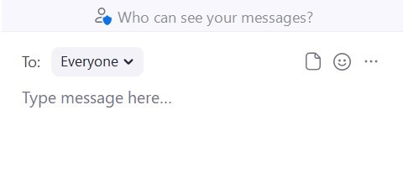
Accessing Chat
1. Click “Chat” at any point to open the chat box to ask questions.
2. Type message
and send.

Slide 4
Mute Audio and Video
Microphone muted
Video off

Slide 5
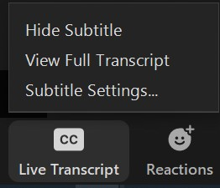
Turn on Closed Captioning (CC)
Click on the icon to open a menu
Select preference

Slide 6
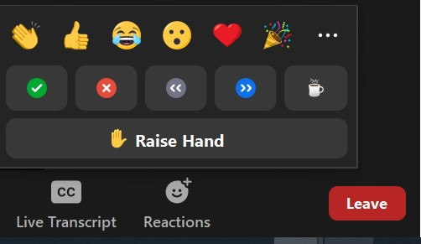
Using Reactions
Click on the icon to open a menu

Slide 7
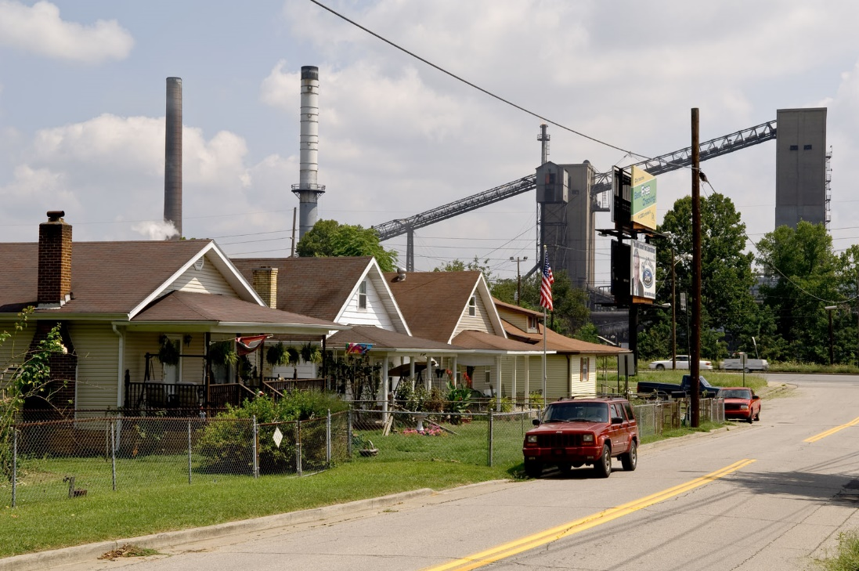
Accessing and Using the Toxics Release Inventory (TRI) Preliminary Data

Slide 8
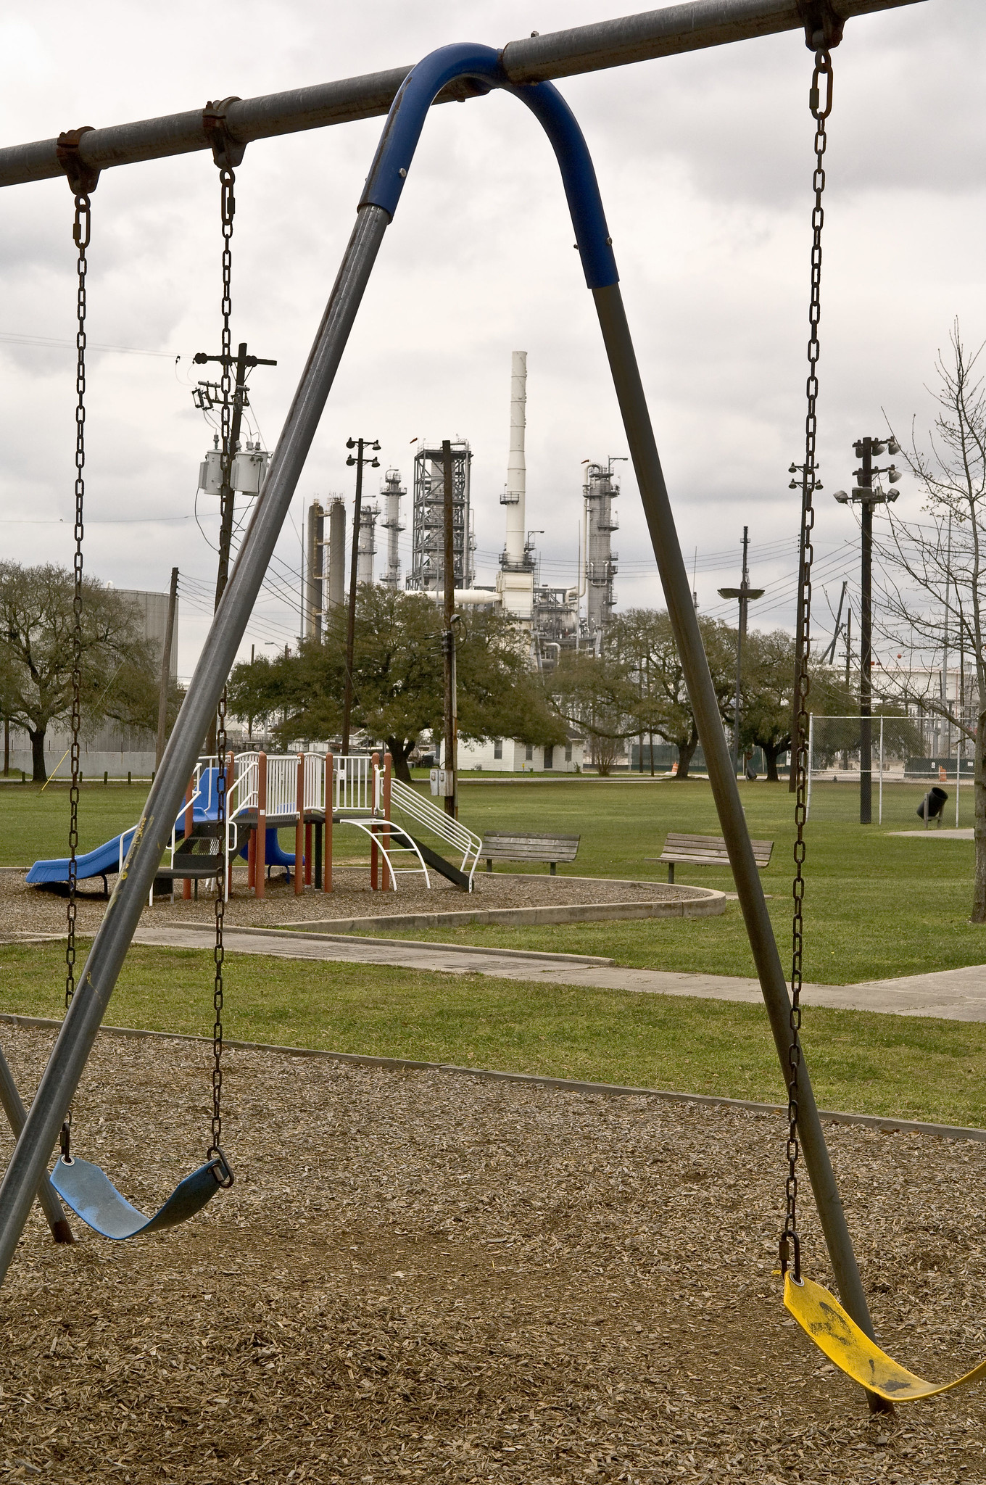
What is the TRI?
An information resource about toxic chemical waste management at certain industrial and federal facilities across the U.S.
Created by the Emergency Planning and Community Right-to-Know Act
Helps people make more informed decisions about toxic chemicals that impact human health and the environment
Facility-reported data on chemical releases to air, water, and land, plus pollution prevention practices, all in one place.
EPA makes these data available through multiple online tools, many of which add context to help make the reported data more understandable.
Annual reporting makes it one of EPA’s most current datasets

Slide 9
What are TRI Preliminary Data?
Refers to the most recent data reported by federal facilities and certain industrial facilities about their chemical waste management and pollution prevention activities that occurred during the past calendar year.
Example: Data reported by July 1, 2023, cover January 1 to December 31, 2022.
Also includes revisions or late submissions for prior reporting years.
Considered “preliminary” while EPA conducts additional data quality checks.
Available each summer, usually within 4 weeks of the July 1 TRI reporting deadline.
Accessible through three types of downloadable data files and five TRI-specific searches in Envirofacts.

Slide 10
Annual TRI
Data Collection, Publication, and Analysis
Cycle
January 1
Facilities begin to prepare and submit reporting forms covering waste management activities that occurred during the previous calendar year (e.g., RY22)
July 1
Reporting forms due to EPA (e.g., RY22)
Late July
Preliminary dataset available (e.g., RY22)
July-October
Ongoing data processing and data quality checks (e.g., RY22)
Late October
Verified data are made available in all TRI tools and National Analysis preparation starts. (e.g., RY22)
January - March
EPA publishes TRI National Analysis, based on dataset from last October (e.g., RY21)
Notes:
Mention that the data are preliminary during the summer; in October, the preliminary dataset is no longer available, because EPA publishes the National Analysis dataset, which is then the most current TRI dataset available.

Slide 11
Why Does EPA Make Preliminary Data Available?
EPA has published the preliminary data since 2009, to:
be responsive to requests from the public
allow community members and others access to the most recent TRI data prior to the publication of the dataset used for the TRI National Analysis
allow facilities to see how their recently submitted data are presented to the public

Slide 12
How Can You Use This Dataset?
Determine if a particular facility has reported for the most recent calendar year.
Determine what chemicals a particular facility is releasing into the environment or otherwise managing as waste, and how they are managed.
Find out if a particular facility initiated any pollution prevention activities in the most recent calendar year.
Access the most current TRI data on a facility-by-facility basis

Slide 13
Important Considerations
Data for a certain facility may change if that facility revises its data after the reporting deadline. EPA updates the preliminary data several times in August and September.
Data have not undergone the complete TRI data quality process.
There are many quality-checks built into the TRI-MEweb reporting software.
The TRI Data Quality webpage has more details.
Preliminary data aren’t available in other online TRI tools until October.
See Factors to Consider When Using TRI Data for more details.

Slide 14
Accessing the Preliminary Data: Walkthrough

Slide 15
Resources
Factors to Consider When Using TRI Data
Plain-language TRI glossary
Look Inside a TRI Facility
Resources and contact information include:
tri.help@epa.gov
Basic data files documentation
Basic Plus data files documentation
TRI TEQ Data File Documentation
TRI Reporting Forms & Instructions

