Slide 1
20 Years Of Progress Closing LUST Sites
Percentage Of LUST Sites Closed (Cumulative) By State
U.S. Environmental Protection Agency December 2023
Office of Underground Storage Tanks
www.epa.gov/ust

Slide 2
The Problem
Contamination from leaking underground storage tank sites threatens groundwater, the source of drinking water for nearly half of all Americans. Addressing the backlog of LUST sites remaining to be cleaned up continues to be a high priority for EPA and our state, territorial, and tribal partners.
Good News
The national Underground Storage Tank program has cleaned up over 515,000 LUST sites over the 35-year history of the program (as of September 2023).
Recognizing 20 Years of Progress
The EPA and our partners have reduced the backlog of LUST sites from over 136,000 in 2003 to under 58,000 in 2023*. The maps on the following slides show progress each state and territory made closing LUST sites over the past 20 years. The maps display the percentage of sites closed in 5-year intervals. As of September 2023, 38 states have closed over 90 percent of their LUST sites.
*U.S. EPA’s UST Performance Measures Reports; www.epa.gov/ust/ust-performance-measures
EPA Office of Underground Storage Tanks, December 2023

Slide 3
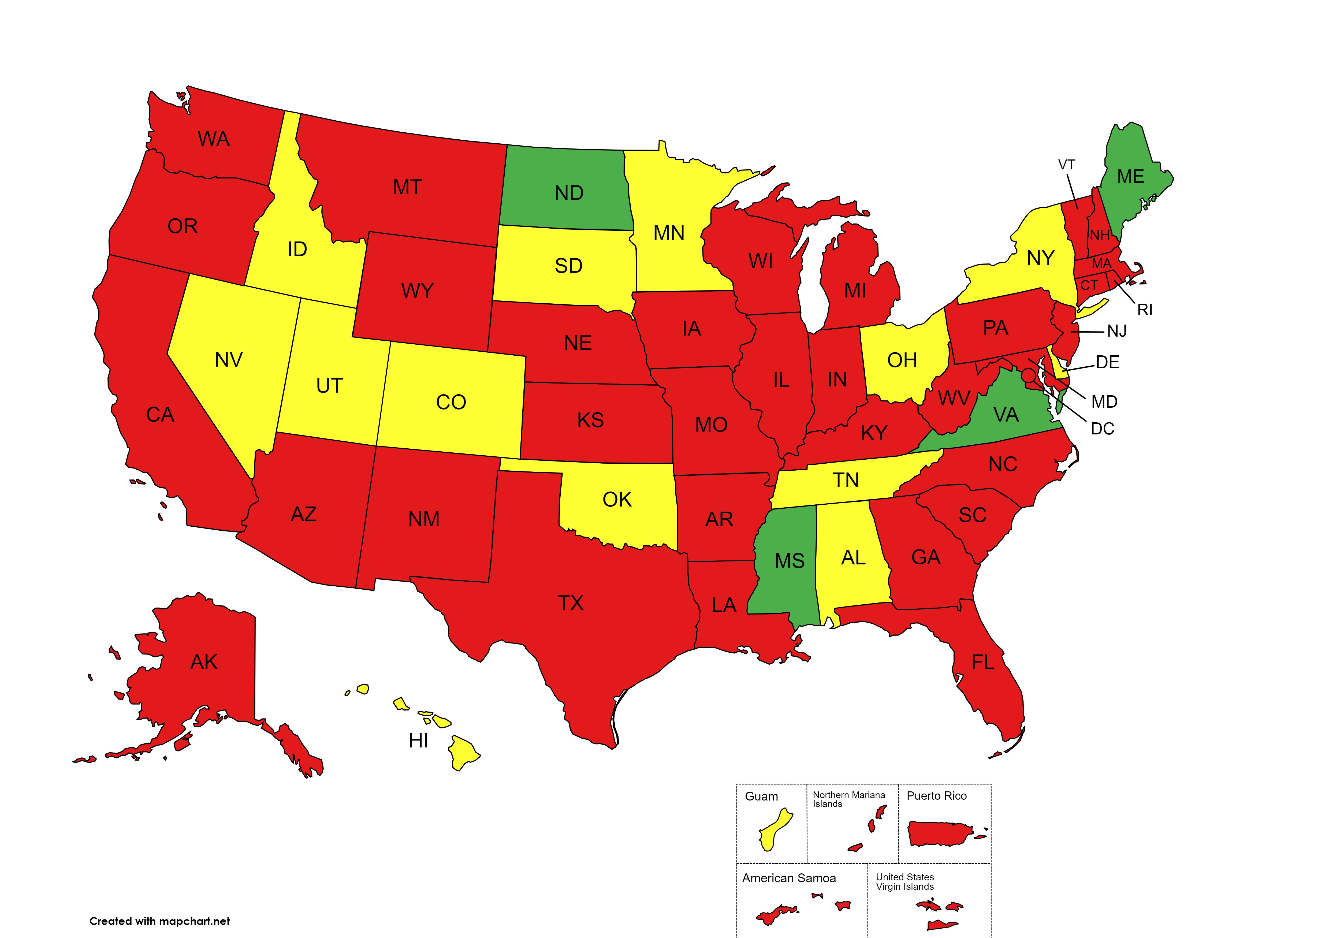
2003
% Backlog Reduction
≤79%
80-89%
90-100%
EPA Office of Underground Storage Tanks, December 2023

Slide 4
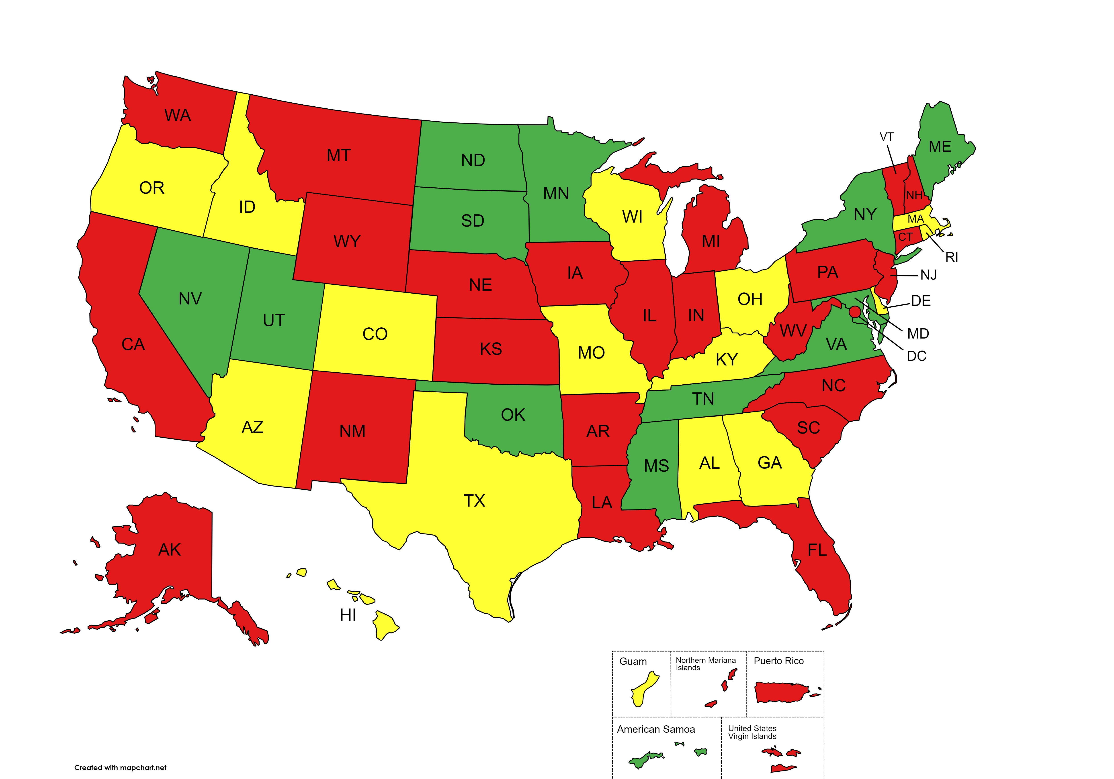
2008
% Backlog Reduction
≤79%
80-89%
90-100%
EPA Office of Underground Storage Tanks, December 2023

Slide 5
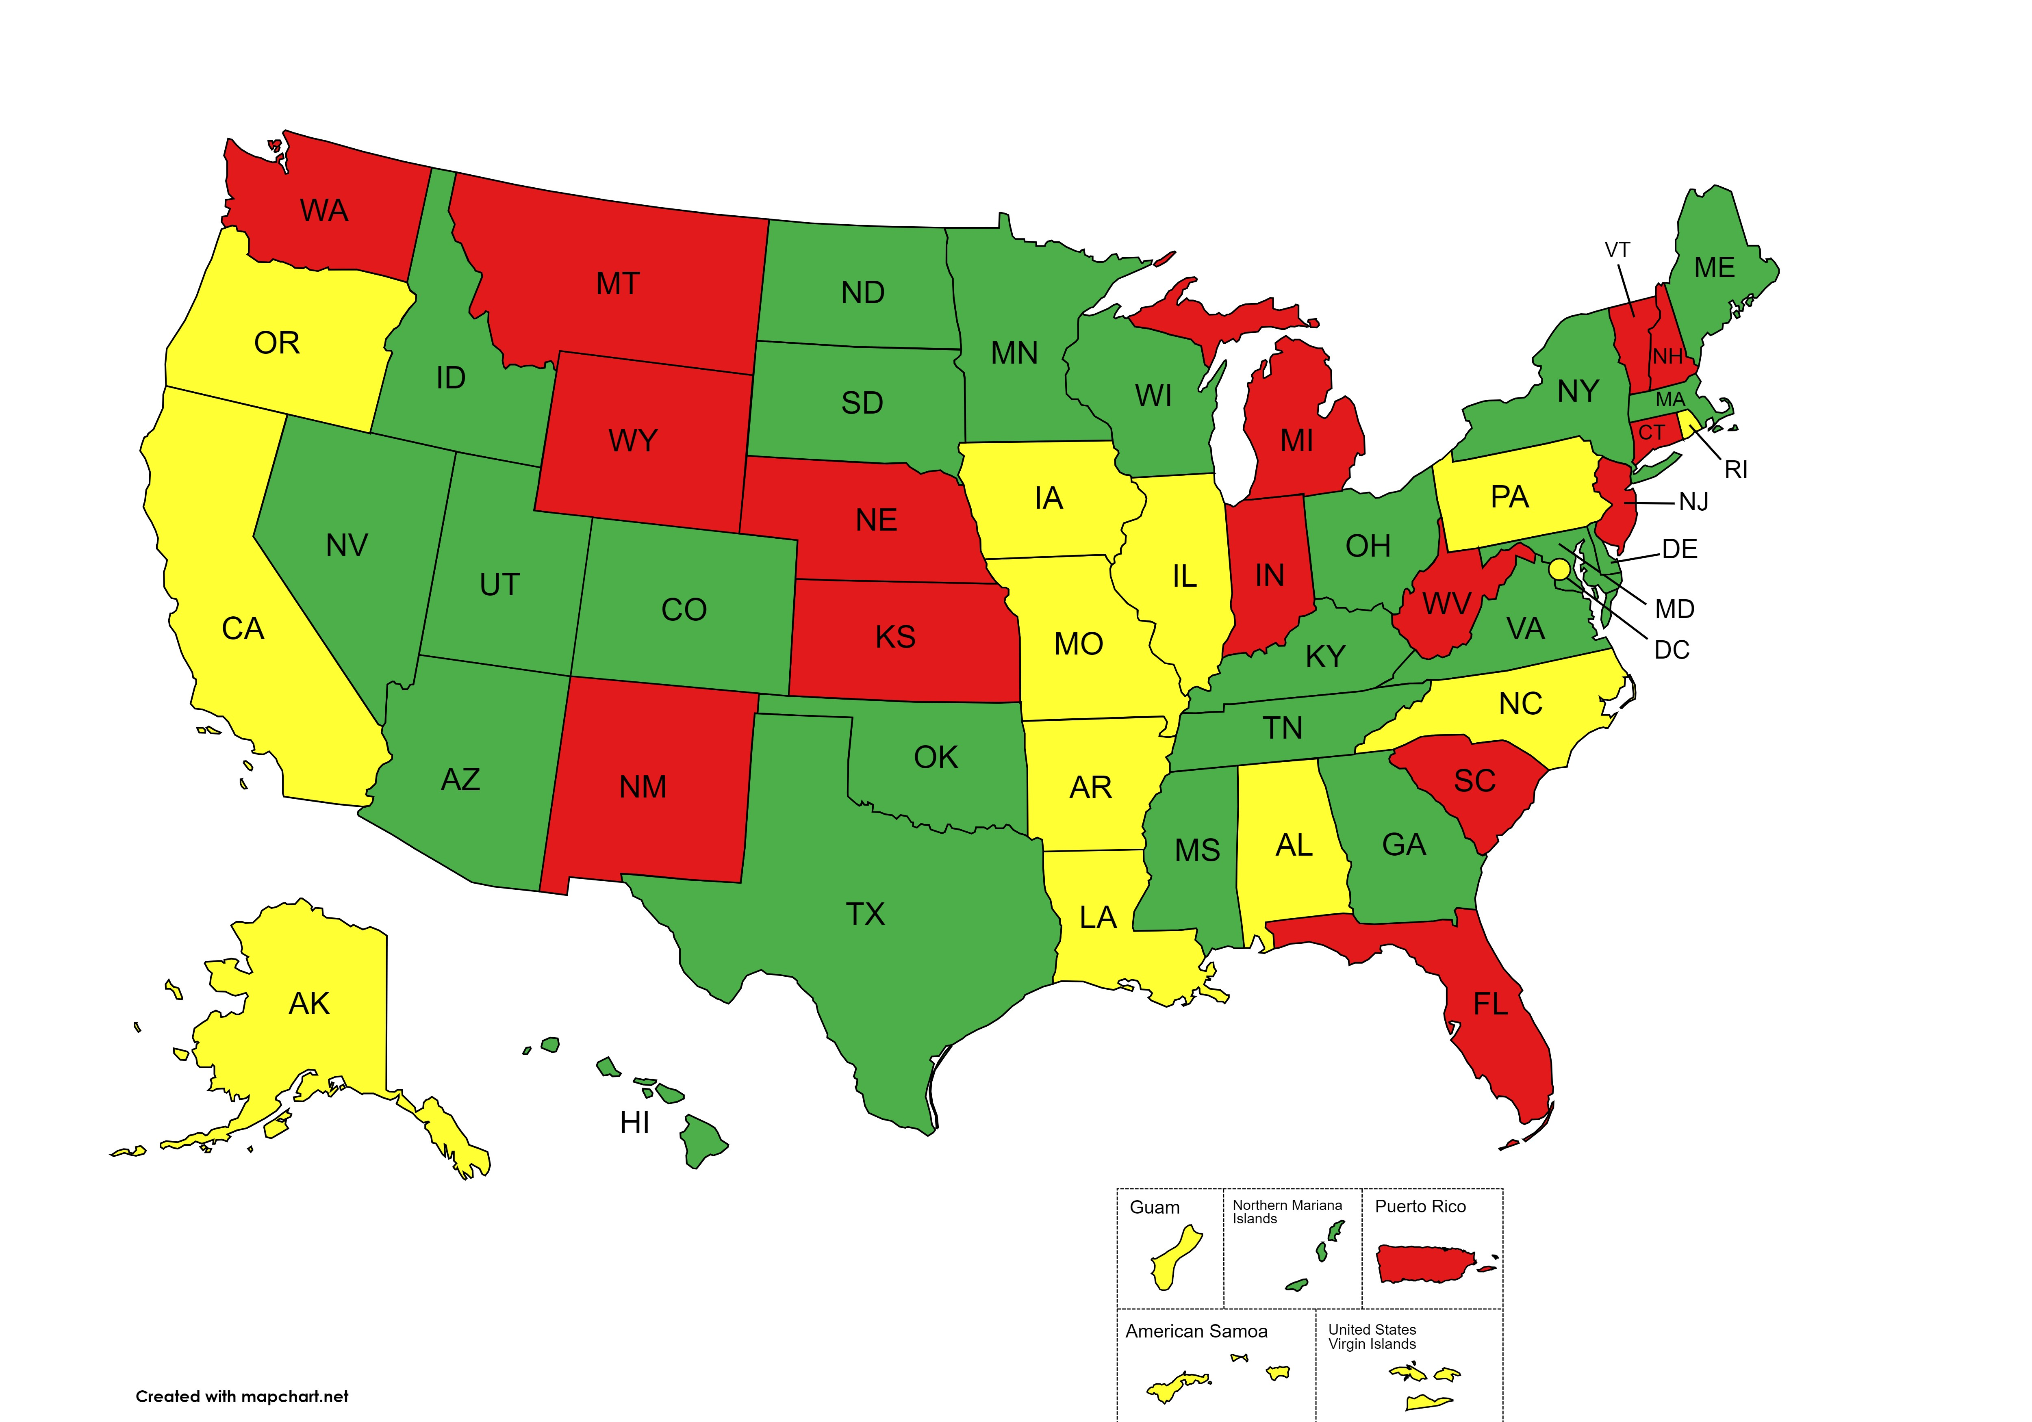
2013
% Backlog Reduction
≤79%
80-89%
90-100%
EPA Office of Underground Storage Tanks, December 2023

Slide 6
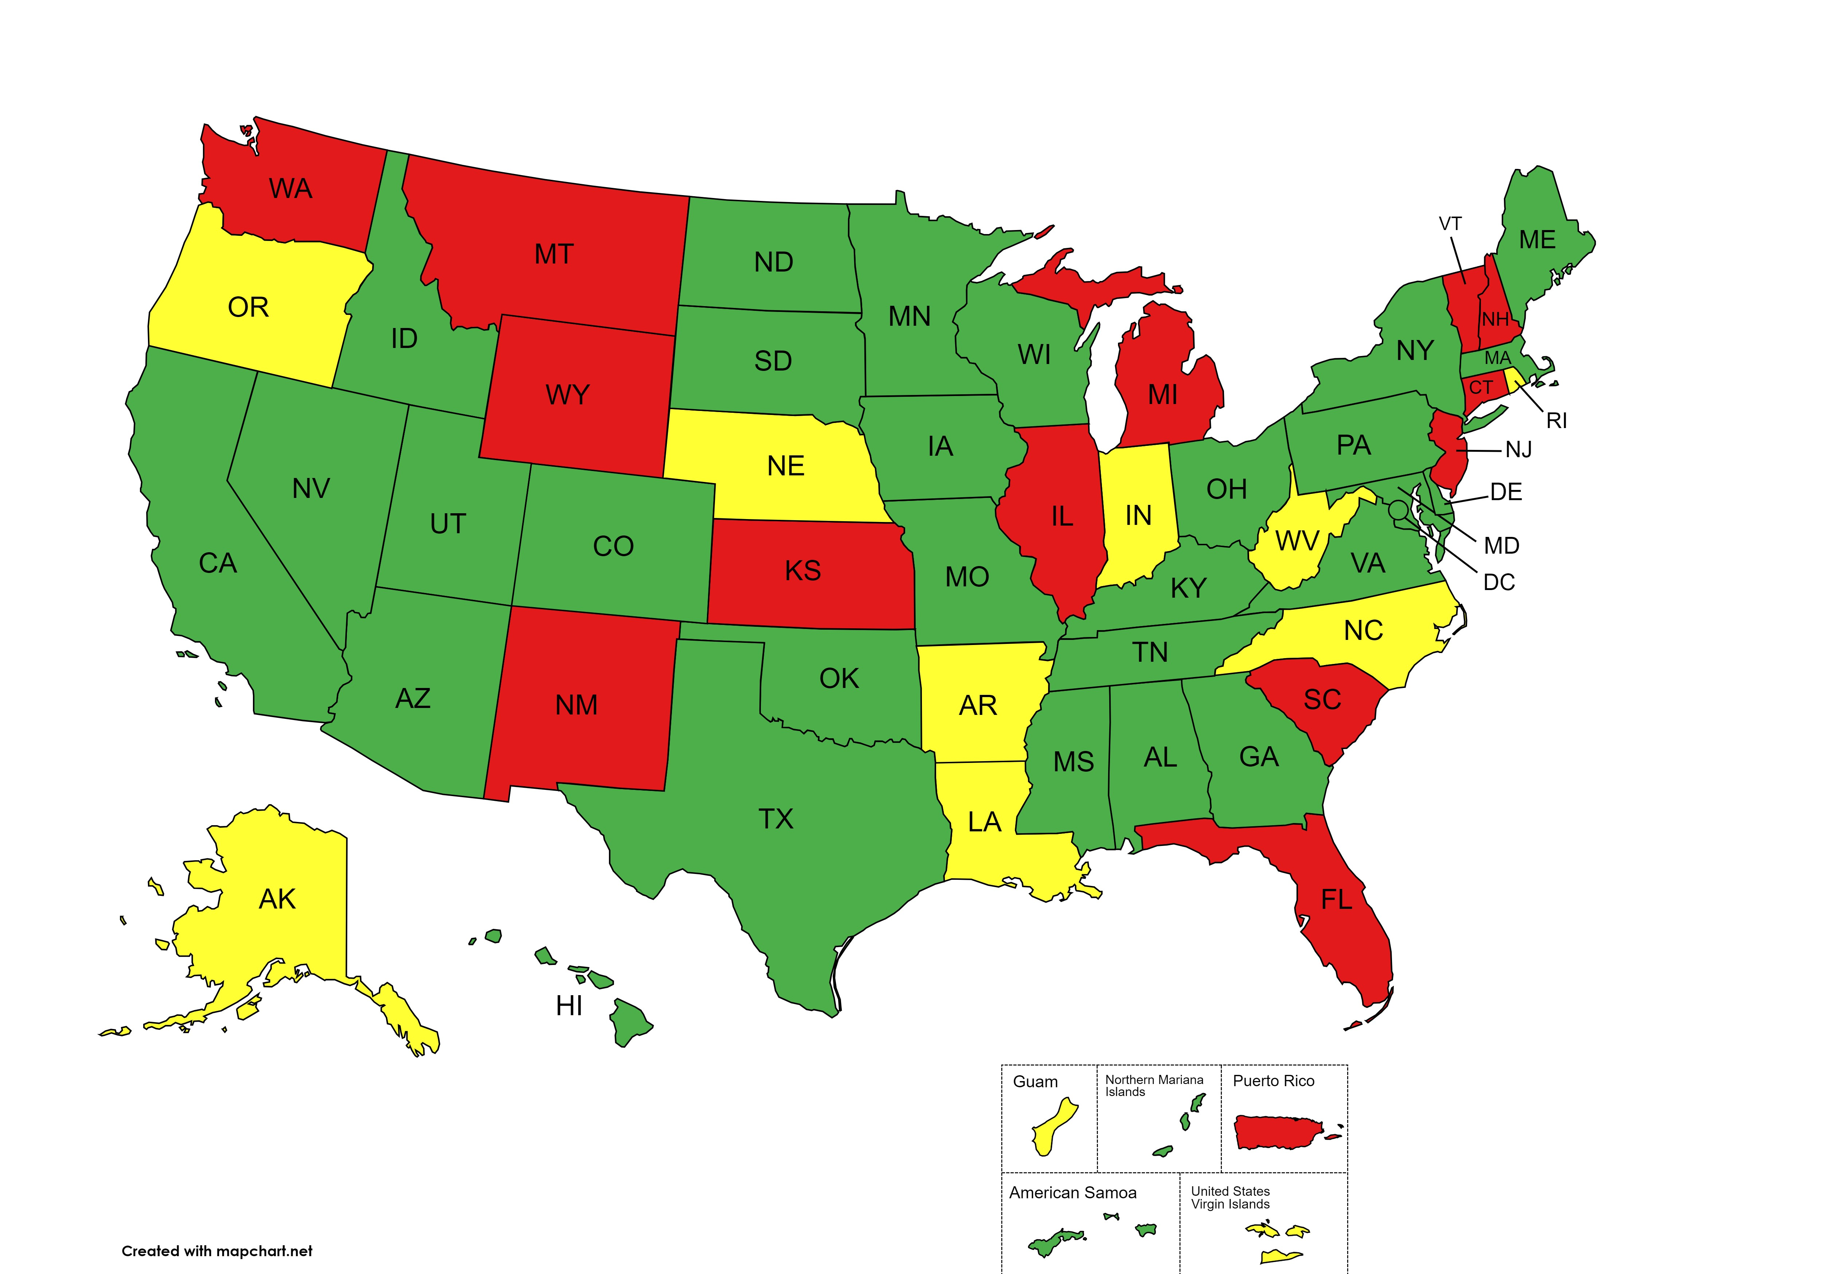
2018
% Backlog Reduction
≤79%
80-89%
90-100%
EPA Office of Underground Storage Tanks, December 2023

Slide 7
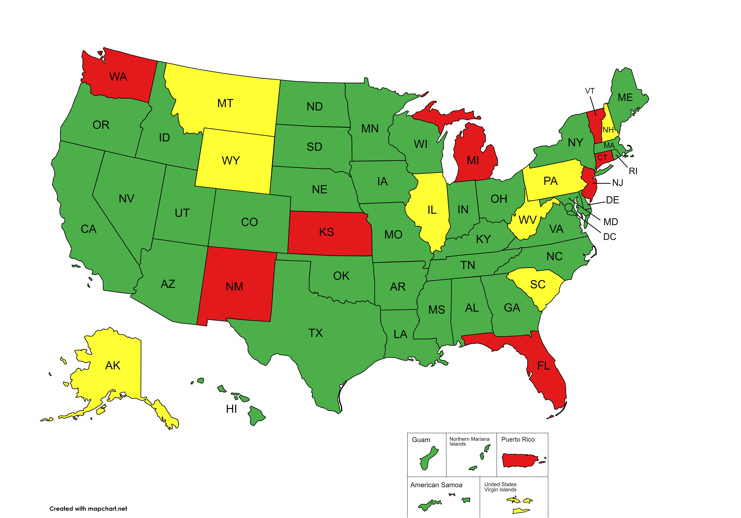
2023
% Backlog Reduction
≤79%
80-89%
90-100%
EPA Office of Underground Storage Tanks, December 2023

Slide 8
20 Years Of Progress
2003
% Backlog Reduction
≤79%
80-89%
90-100%
2023
EPA Office of Underground Storage Tanks, December 2023

