Slide 1
FLINT AIR QUALITY LEARNING SESSION
Tuesday, April 25, 2023
5:00 PM - 8:00 PM

Slide 2
Welcome!
Goals
Learn about clean air topics and interact with agency staff.
Identify priority topics for future meetings.
Confirm roles and responsibilities for next steps.
Roles
Take care of yourself and others.
Meet new people
Interact
Notes:
Ambient air monitoring is taking measurements of outdoor air pollutants near neighborhoods, schools, parks, and off-site from industry.
“Provide air pollution data to the general public in a timely manner”
- Helps To provide data to evaluate the air quality in an area or region
2. To comply with other US EPA monitoring rules and requirements “Support compliance with ambient air quality standards and emissions strategy development.”
- Helps to show we are meeting the standards for the criteria pollutants
3. “Support for air pollution research studies.”
From Appendix D: Monitoring Objectives. The ambient air monitoring networks must be designed to meet three basic monitoring objectives. These basic objectives are listed below. (a) Provide air pollution data to the general public in a timely manner. (b) Support compliance with ambient air quality standards and emissions strategy development. Data from FRM, FEM, and ARM monitors for NAAQS pollutants will be used for comparing an area's air pollution levels against the NAAQS. Data from monitors of various types can be used in the development of attainment and maintenance plans. SLAMS, and especially NCore station data, will be used to evaluate the regional air quality models used in developing emission strategies, and to track trends in air pollution abatement control measures' impact on improving air quality. In monitoring locations near major air pollution sources, source-oriented monitoring data can provide insight into how well industrial sources are controlling their pollutant emissions. (c) Suppor

Slide 3
Interact
What is clean air to you?
Notes:
Ambient air monitoring is taking measurements of outdoor air pollutants near neighborhoods, schools, parks, and off-site from industry.
“Provide air pollution data to the general public in a timely manner”
- Helps To provide data to evaluate the air quality in an area or region
2. To comply with other US EPA monitoring rules and requirements “Support compliance with ambient air quality standards and emissions strategy development.”
- Helps to show we are meeting the standards for the criteria pollutants
3. “Support for air pollution research studies.”
From Appendix D: Monitoring Objectives. The ambient air monitoring networks must be designed to meet three basic monitoring objectives. These basic objectives are listed below. (a) Provide air pollution data to the general public in a timely manner. (b) Support compliance with ambient air quality standards and emissions strategy development. Data from FRM, FEM, and ARM monitors for NAAQS pollutants will be used for comparing an area's air pollution levels against the NAAQS. Data from monitors of various types can be used in the development of attainment and maintenance plans. SLAMS, and especially NCore station data, will be used to evaluate the regional air quality models used in developing emission strategies, and to track trends in air pollution abatement control measures' impact on improving air quality. In monitoring locations near major air pollution sources, source-oriented monitoring data can provide insight into how well industrial sources are controlling their pollutant emissions. (c) Suppor

Slide 4
Community Grounding
Why is this meeting important?
Mona Munroe-Yunis
Environmental Transformation Movement of Flint
https://www.etmflint.org/
Nayyirah Shariff
Flint Rising
https://flintrising.com/

Slide 5
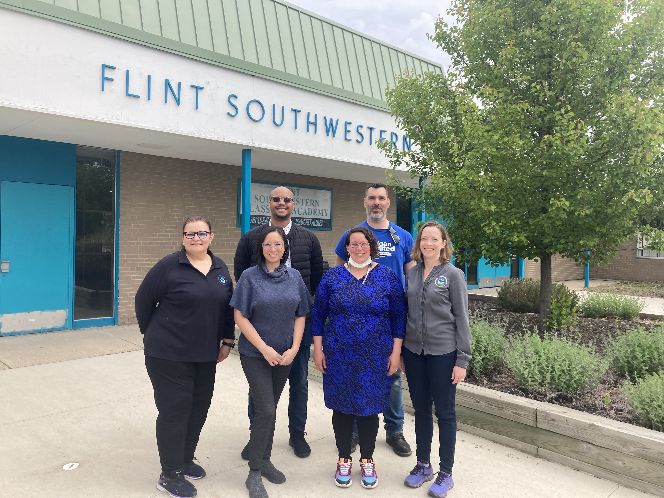
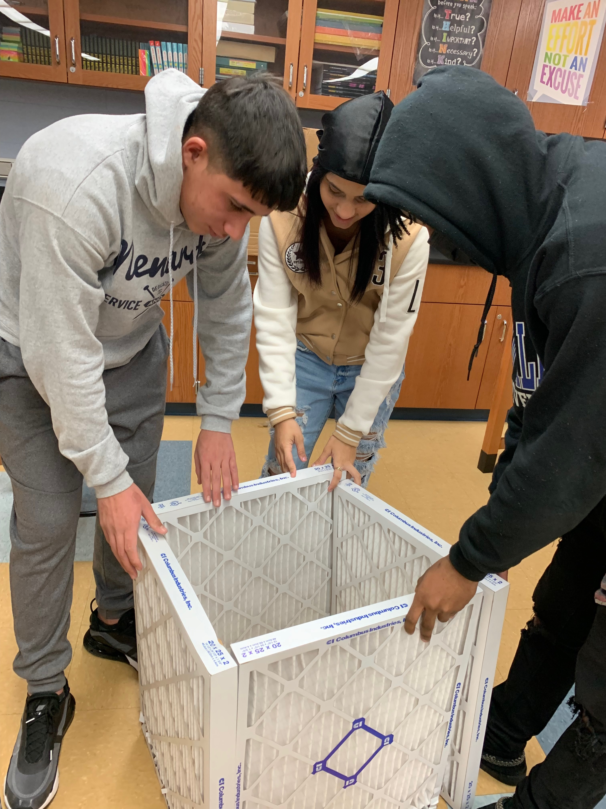
Flint Air Progress
What is the Flint Air Quality Initiative?
Monica Paguia
US EPA

Slide 6
Air Quality 101
Camden Ogletree
Project Officer
U.S. EPA Region 5
Air and Radiation Division
Notes:
Air Quality Division
Air Monitoring Section

Slide 7
Air 101 Topics
Definitions of air quality and air pollution
Sources of air pollution
History of air pollution
Regulation of air pollution in the U.S. & MI
Common questions
Why and when air pollution can be higher and lower?
How to tell what the air quality is and where to find information?

Slide 8
Air Pollution and Air Quality
Air Pollution A contaminant or mixture of contaminants in the air that can harm humans, plants, animals, and the environment.
Air Quality
Describes how much pollution is in the air.
Notes:
Environment: includes property (houses, buildings, etc.), materials (statues, monuments), water bodies (lakes, rivers, streams, oceans, etc.)
Quantitative vs Qualitative measurements

Slide 9
Air Pollution and Air Quality
Good air quality = Less pollution
Poor air quality = More pollution
Notes:
Environment: includes property (houses, buildings, etc.), materials (statues, monuments), water bodies (lakes, rivers, streams, oceans, etc.)
Quantitative vs Qualitative measurements

Slide 10
Types of Air Quality
Indoor Air
Air within and around buildings and structures,
Especially as it relates to the health and comfort of building occupants
Outdoor Air/Ambient Air
The air that is accessible to the general public; i.e., outside:.
Notes:
Environment: includes property (houses, buildings, etc.), materials (statues, monuments), water bodies (lakes, rivers, streams, oceans, etc.)
Quantitative vs Qualitative measurements

Slide 11
Interact
Where do think ambient air pollution comes from?
Notes:
Environment: includes property (houses, buildings, etc.), materials (statues, monuments), water bodies (lakes, rivers, streams, oceans, etc.)
Quantitative vs Qualitative measurements

Slide 12
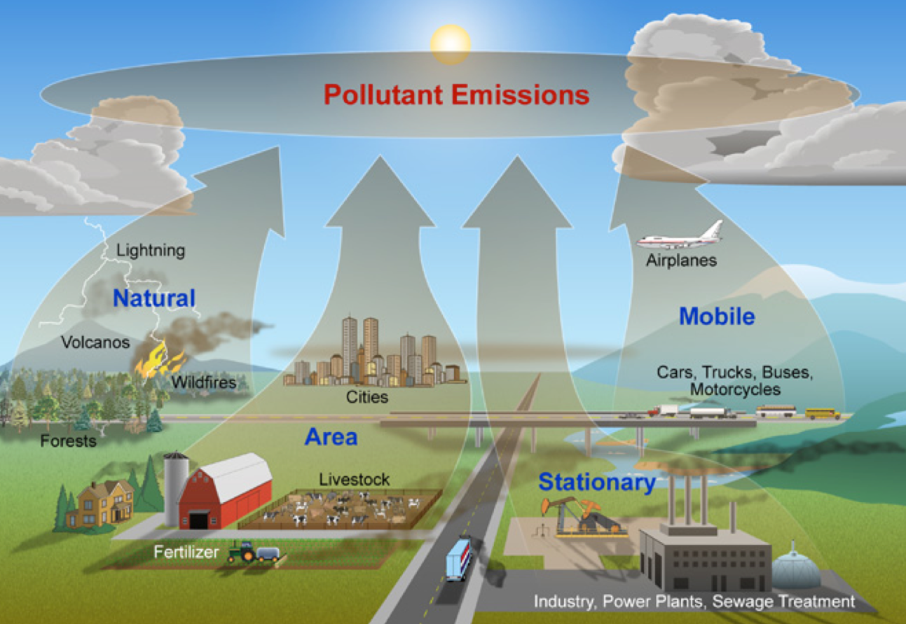
Sources of Ambient Air Pollution
Natural sources
Animals
Soil dust
Wildfires/forest fires
Weather (wind, dust storms)
Volcanoes
Human sources
Mobile sources (cars, planes)
Burning wood, leaves, or vegetation
Fossil fuel burning (coal, oil)
Industries, power plants, factories
Meat cooking/barbequing
Source: https://www.nps.gov/subjects/air/sources.htm
Notes:
Pollution comes from both natural and human-made sources
There are four main types of air pollution sources:
mobile sources – such as cars, buses, planes, trucks, and trains
stationary sources – such as power plants, oil refineries, industrial facilities, and factories
area sources – such as agricultural areas, cities, and wood burning fireplaces
natural sources – such as wind-blown dust, wildfires, and volcanoes

Slide 13
Why and When Can Air Pollution Levels be Higher or Lower?
Emissions from Sources
Weather Conditions
Temporal Variation (changes over time)
Time of the day or week
Higher levels during rush hour.
Less pollution on weekends.
Sunlight
Heat from the sun can cause chemicals that cause pollution.
Rain
Rain washes pollution out of the air.
Seasons
Concentration levels of pollutants created by sunlight are higher in summer and lower in winter.
Other pollutants.
Levels may also depend on sources. For example, burning wood for heat increases PM in cooler months.
Wind
Pollution stays around in stagnant conditions. On windy days, pollution is spread around.
Temperature Inversions
A warm layer ‘sandwiched’ between cooler layers in the atmosphere can trap pollution near the surface.
Notes:
Normally, air temperature becomes colder higher above the ground.
During a temperature inversion, a warm layer is ‘sandwiched’ in between cooler layers. Pollution can be trapped, causing higher pollution levels where we live!

Slide 14
Interact
Why do we care about air pollution?

Slide 15
Air Episodes
An air pollution episode is an unusual combination of emissions that gives creates a high level of air pollution over a large area.
Many air pollution episodes resulted in regulations to help protect human health and the environment.

Slide 16
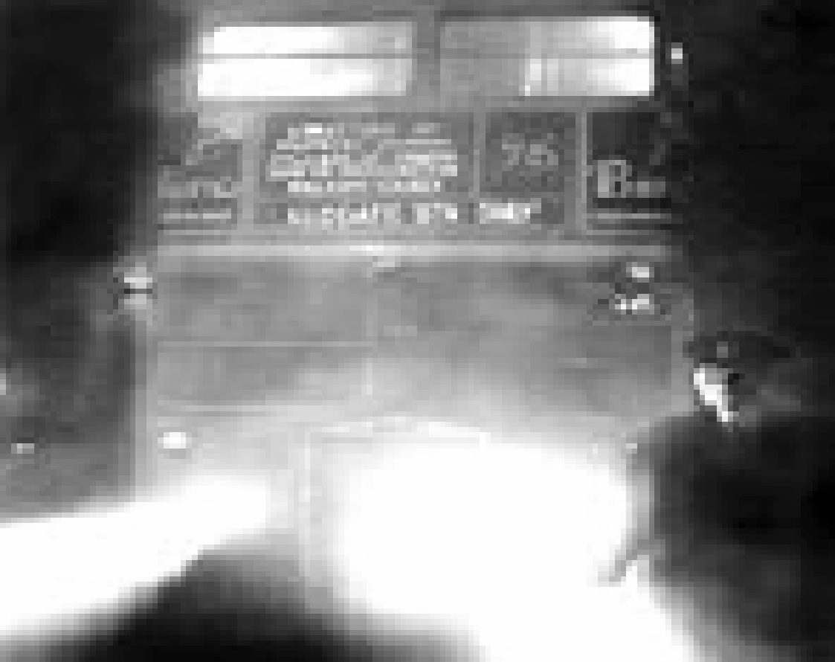
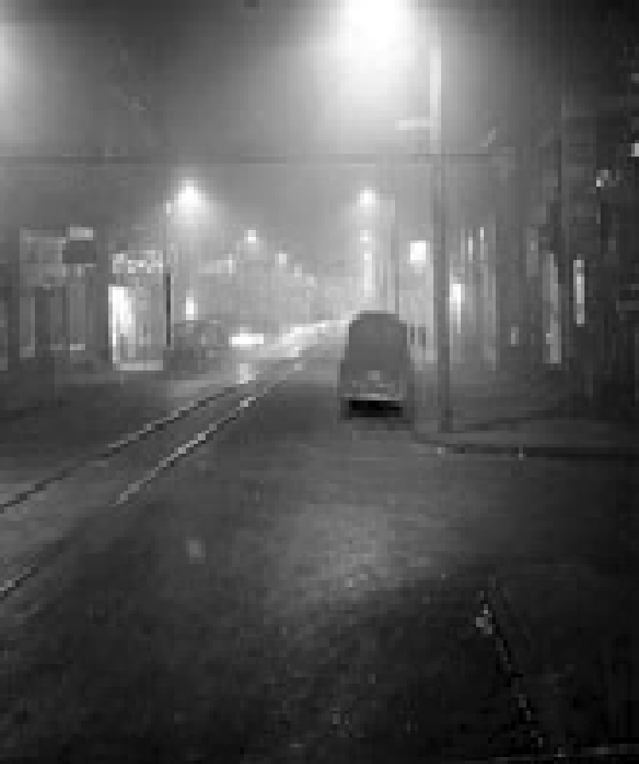
A Few Episodes…
Donora, Pennsylvania
October 1948: Smog Episode
Toxic emissions from a local steel plant.
20 people died
6,000 people suffered illness
…out of population of 14,000
London, England
December 1952: Smog Episode
High sulfur dioxide emissions.
Approximately 4,000 people died.
City of Donora on October 29 at 12pm
Bus escorted by lanterns at 10:30am

Slide 17
Air Pollution Regulation in the U.S.
Clean Air Act (CAA) was signed into law in 1970 with major changes in 1990.
U.S. Environmental Protection Agency (EPA) is required to set National Ambient Air Quality Standards (NAAQS) for 6 criteria pollutants under the CAA.
Criteria Pollutants – Common pollutants around the U.S. & known to be harmful to public health and the environment. These include:
Carbon Monoxide (CO)
Lead (Pb)
Nitrogen Dioxide (NO₂)
Ozone (O₃)
Particulate Matter (both PM_{2.5} and PM₁₀)
Sulfur Dioxide (SO₂)
Notes:
We could mention ground level ozone here
Mention health effects for PM and Ozone here
Mention why these criteria pollutants are important

Slide 18
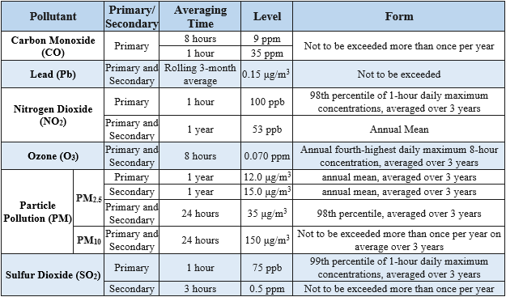
National Ambient Air Quality Standards (NAAQS)
NAAQS for Criteria Pollutants:
Primary Standard
protects public health, including "sensitive" populations such as asthmatics, children, & the elderly.
Secondary Standard
protects public welfare, including against decreased visibility and damage to animals, crops, vegetation, & buildings.
NAAQS Table: https://www.epa.gov/criteria-air-pollutants/naaqs-table
Notes:
NAAQS are updated every 5 years for EACH pollutant.
Updates represent the current science and knowledge on health and environmental effects from research studies

Slide 19
Non-criteria Pollutants in the Ambient Air
Hazardous Air Pollutants (HAPs):
HAPS or Air Toxics - Pollutants that are known or suspected to cause cancer or other serious health effects.
Clean Air Act currently regulates 188 toxic air pollutants.
Toxic air pollutants are regulated in two phases:
Phase 1 – Using Maximum Achievable Control Technology (MACT) standards
Phase 2 – Performing a Residual Risk assessment
Urban Air Toxics
HAPs are regulated under a different part of the Clean Air Act. https://www.epa.gov/haps
Notes:
Ex: Benzene (gasoline), perchloroethylene (dry-cleaning facilities), and methylene chloride (paint stripper).
The Clean Air Act requires the EPA to regulate toxic air pollutants, also known as air toxics, from categories of industrial facilities in two phases.
The first phase is “technology‑based.” This is where EPA develops standards for controlling the emissions of air toxics from sources in an industry group called “Maximum Achievable Control Technology (MACT) standards which are based on emissions levels that are already being achieved by the controlled and low‑emitting sources in an industry.
The second phase – Residual Risk -- is known as a “risk-based” approach. In this phase EPA determines whether more health-protective standards are necessary and is conducted within 8 years of setting the MACT standards. EPA will assess the remaining health risks from each industry group to determine whether the MACT standards provide an ample margin of safety and protect against adverse environmental effects.
Many different types of pollutants in the air – these are some of the most common ones.
This presentation focuses on the NAAQS Criteria pollutants

Slide 20
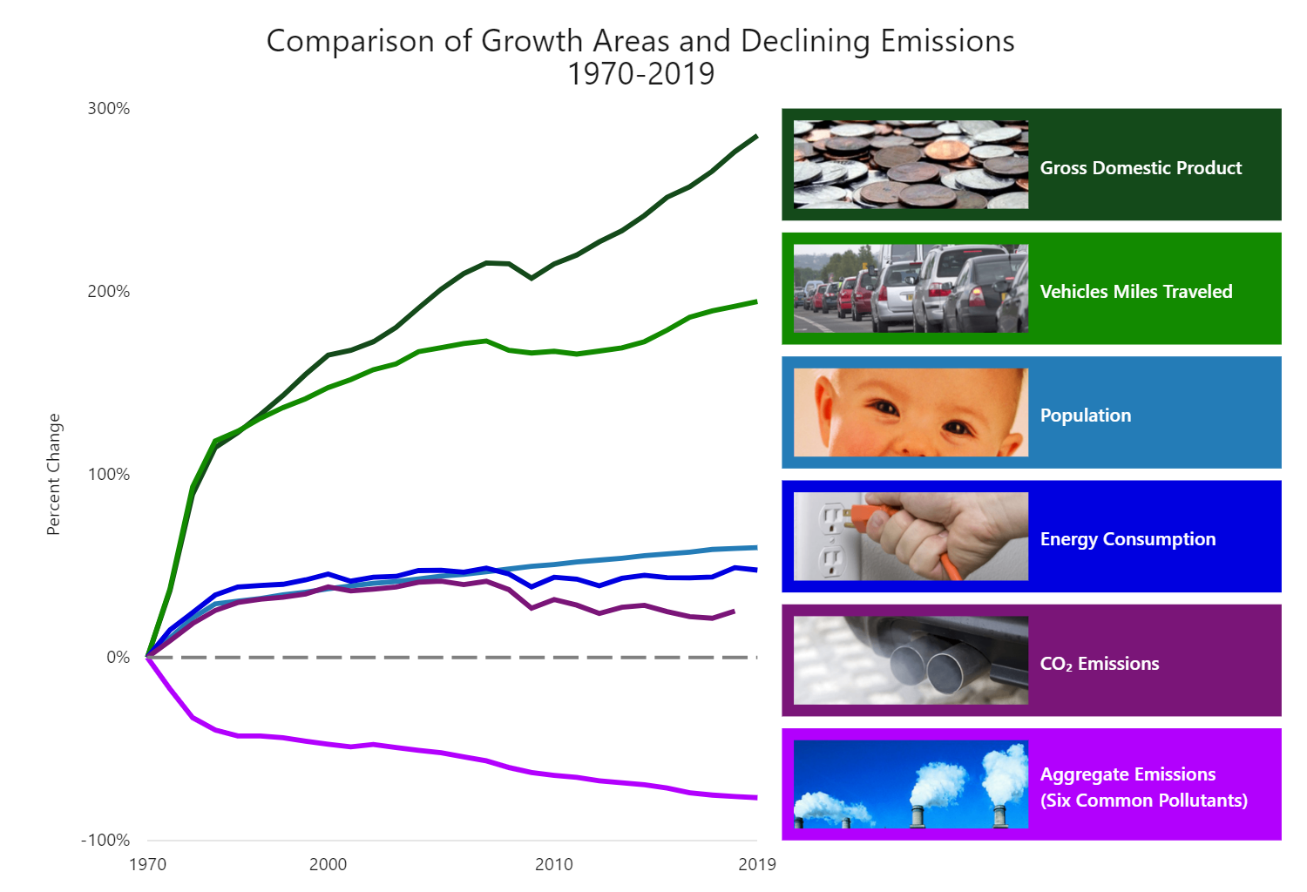
Economic Strength with Cleaner Air
https://gispub.epa.gov/air/trendsreport/2022/#growth

Slide 21
Summary
We learned about….
Definitions of air pollution and air quality
History of air pollution
Regulation of air pollution in the U.S.
Sources of air pollution
Common questions
Why and when air pollution can be higher and lower?
How to tell what the air quality is and where to find information?
Notes:
Recapping topics discussed

Slide 22
Questions?

Slide 23
Ambient Air Monitoring in Michigan
Erica Wolf, J.D.
Air Monitoring Section
Air Quality Division
Michigan EGLE
WolfE1@Michigan.gov
Notes:
Air Quality Division
Air Monitoring Section

Slide 24
U.S. EPA and EGLE Ambient Air Monitoring
Roles of U.S. EPA and EGLE
Why We Monitor Ambient Air
What We Monitor
How We Monitor
Where We Monitor
Where to Find Information

Slide 25
ROLES OF U.S. EPA AND MICHIGAN EGLE IN AMBIENT AIR MONITORING

Slide 26
EPA v EGLE Roles
U.S. EPA
Michigan EGLE
Creates Standards for Criteria Pollutants
Creates Requirements for Ambient Air Monitoring System
Creates Annual Air Monitoring Plan
Builds and Maintains Air Monitoring Network
Reviews Data to Ensure Accuracy and Completeness
Reports Data to U.S. EPA and Public
Supports States Through Funding and Expertise
Oversight
Notes:
EPA:
- Establish standards for criteria pollutants
Creates requirements - Mandates that states have an ambient air monitoring network
Michigan:
Creates annual air monitoring plan in accordance with regulations
Submits for 30 day public comment period (website link later)
EPA:
Oversight
Reviews and approves state monitoring plans after public comment
Audits network
MI:
Installs and maintains the network based on that plan in accordance with regulations
EPA:
Supports
Michigan:
Reviews data to ensure accuracy and completeness
reports to EPA and public
EPA:
- Reviews accuracy and completeness

Slide 27
WHY WE MONITOR THE AMBIENT AIR

Slide 28
Why do you think we monitor air?
Interact

Slide 29
What is Ambient Air?
Why Do We Monitor It?
The ambient air is the air that is accessible to the general public; i.e., outside:
Provide Data to Public
Comply with Regulations
Neighborhoods
Schools
Provide Support for Research
Parks
Industry
Notes:
Ambient air monitoring is taking measurements of outdoor air pollutants near neighborhoods, schools, parks, and off-site from industry.
“Provide air pollution data to the general public in a timely manner”
- Helps To provide data to evaluate the air quality in an area or region
2. To comply with other US EPA monitoring rules and requirements “Support compliance with ambient air quality standards and emissions strategy development.”
- Helps to show we are meeting the standards for the criteria pollutants
3. “Support for air pollution research studies.”
From Appendix D: Monitoring Objectives. The ambient air monitoring networks must be designed to meet three basic monitoring objectives. These basic objectives are listed below. (a) Provide air pollution data to the general public in a timely manner. (b) Support compliance with ambient air quality standards and emissions strategy development. Data from FRM, FEM, and ARM monitors for NAAQS pollutants will be used for comparing an area's air pollution levels against the NAAQS. Data from monitors of various types can be used in the development of attainment and maintenance plans. SLAMS, and especially NCore station data, will be used to evaluate the regional air quality models used in developing emission strategies, and to track trends in air pollution abatement control measures' impact on improving air quality. In monitoring locations near major air pollution sources, source-oriented monitoring data can provide insight into how well industrial sources are controlling their pollutant emissions. (c) Suppor

Slide 30
POLLUTANTS WE MONITOR IN THE AMBIENT AIR

Slide 31
EGLE Monitors Many Pollutants
Criteria Pollutants
Air Toxics and Other Parameters
Carbon Monoxide (CO)
Nitrogen Dioxide (NO₂)
Sulfur Dioxide (SO₂)
Ozone (O₃)
Lead (Pb)
Particulate Matter: PM₁₀ and PM_{2.5}
VOCs (contributes to ozone)
Carbonyls
PAHs (Poly-Aromatic Hydrocarbons)
Metals
PM_{2.5} Speciation
Carbon Black
Diesel Particulate Matter
Meteorological Data
Notes:
Criteria Pollutants –
7 Pollutants that EPA has created standards (acceptable levels) for, based on known health effects of the pollutants.
Air Toxics And Others:
Polycyclic aromatic hydrocarbons (PAHs) are a group of over 100 different chemicals that are formed during the incomplete burning of coal, oil and gas, garbage, or other organic substances like tobacco or charbroiled meat.
Some differences b/t these two on next slide

Slide 32
Criteria Pollutants vs Air Toxics
Criteria Pollutants
Air Toxics
U.S. EPA establishes air quality standards that are health protective.
If standards are met, then the area is “in attainment” for that pollutant.
If standards not met, then area can be “nonattainment”.
Meeting or not meeting the standard is not usually based on one measurement.
Emissions are regulated for hazardous air pollutants
Ambient air monitoring is not always mandated.
No U.S. EPA standard, instead health-based exposure limits.
Air toxics monitoring via the NATTS and PAMS Program.
Notes:
NATTS = National Air Toxic Trends Stations
PAMS = Photochemical Assessment Monitoring Stations (only partially funded)
“One measurement or monitoring location” does not usually determine meeting the standard
From EPA's website (https://www3.epa.gov/airtoxics/eparules.html), The Clean Air Act requires EPA to regulate emissions of hazardous air pollutants from a published list of industrial sources referred to as "source categories." As required under the Act, EPA has developed a list of source categories that must meet control technology requirements for these toxic air pollutants. The EPA is required to develop regulations (also known as rules or standards) for all industries that emit one or more of the pollutants in significant quantities. see also slide #4 on https://www.epa.gov/sites/default/files/2019-08/documents/air_toxics_101_webinar_slides.pdf

Slide 33
WHERE IS MONITORING DONE IN MICHIGAN

Slide 34
Choosing Air Monitoring Locations
1
2
3
Most required monitoring is for criteria pollutants (ozone, PM2.5, etc), not toxics​
Regulatory requirements for monitoring locations based on pollutants
Usually based on population and expected highest concentration
Notes:
EPA sets the requirements for regulatory monitoring, including where and how many each type of pollutant must be monitored

Slide 35
EGLE Ambient Air Monitoring Locations
Interactive web map available online:
Air Monitoring (michigan.gov)
Monitor near:
Population Centers
Roadways
Industrial Sources
Rural Background
Special Study Areas
Notes:
Areas we monitor throughout the state are in direct relation to our regulatory requirements set forth by EPA. We have to have a certain number of monitors for each of the criteria pollutants, in addition requirements for near-road monitors, PAMS (ozone related), national air toxics trend sites (Dearborn). We try to do other monitoring as funding allows.
Also recently purchased sensors. Still working on incorporating them into our monitoring plans. * more on sensors in a bit.
Visit Flint on website

Slide 36
HOW IS AMBIENT AIR MONITORED IN MICHIGAN

Slide 37
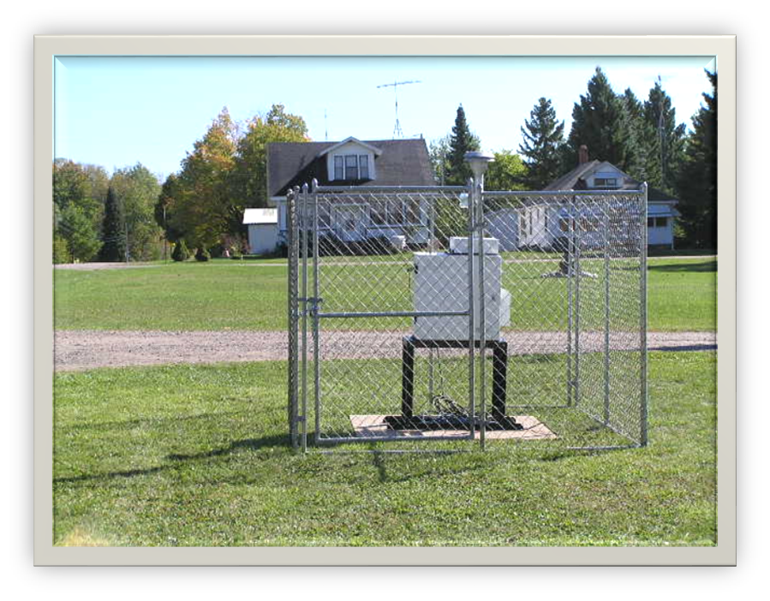
How are Air Pollutants Measured?
Notes:
Measure multiple pollutants, some continuous, other manual. Manual methods (PM sampler) require not only operator maintenance but laboratory analysis. Long time, sometimes months, before sample value is known
Bunker, PM sampler (continuous, 3- and 6-day samples)

Slide 38
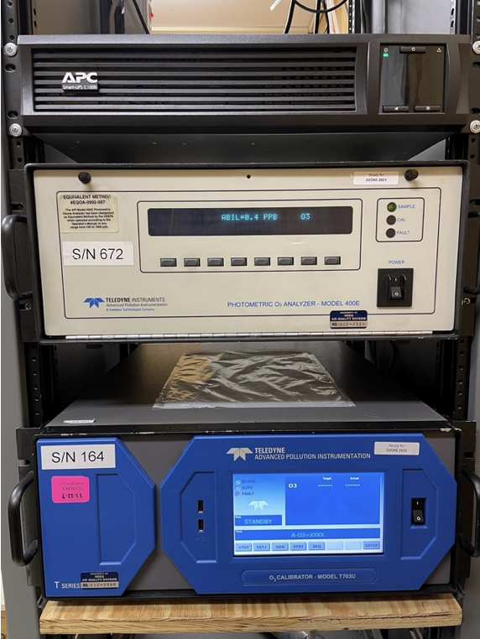
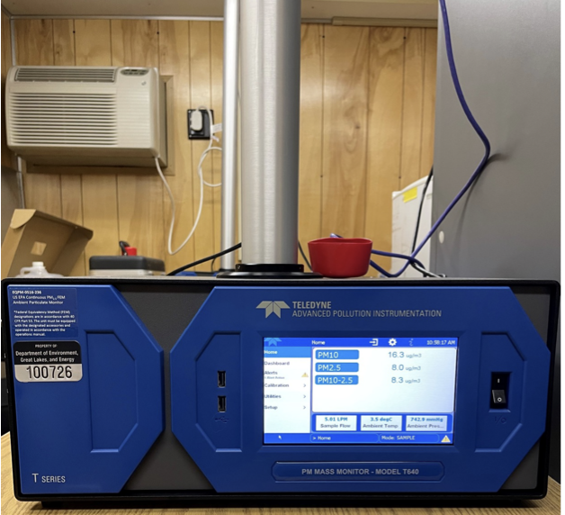
Measuring Devices
Notes:
Another example of manual samplers.
Also measure using continuous samplers. Example of T640, talk about gases as well. Advantage of continuous is near-real time reporting of data to public. (more on that later)

Slide 39
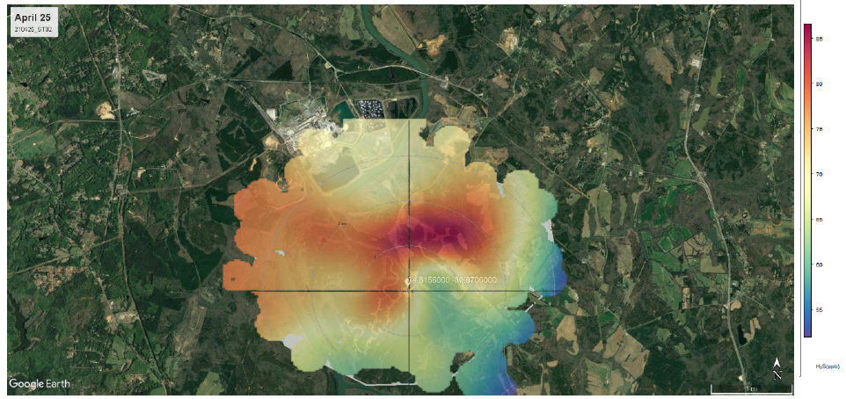
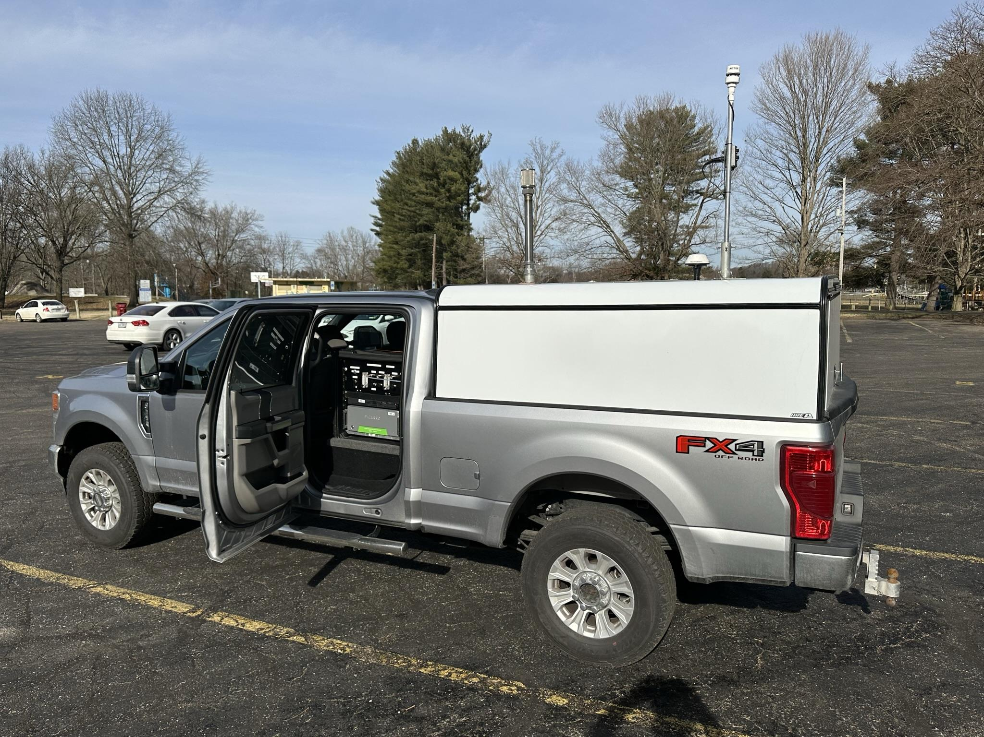
Geospatial Monitoring of Air Pollution (GMAP)
U.S. EPA Program
Real-time monitoring of:
air toxics
wind speed and direction
Mapping of the monitoring location
Notes:
Hydrogen sulfide, methane, benzene, toluene
Allows visualizations of pollutant plumes
Good for short-term studies

Slide 40
Air Sensors
Real-time monitoring
Not regulatory
Data may not be as accurate as air monitoring stations
U.S. EPA Loan Program
Rachel Kirpes, kirpes.rachel@epa.gov 312-886-0221
EGLE Classroom Loan Program
Eileen Boekestein, boekesteine@michigan.gov
616-403-1615
Notes:
**Show sensor
non-regulatory technology
lower in cost, portable, and generally easier to operate than regulatory monitors.
EPA – variety of sensors to loan for Individuals, community groups, schools, and other interested organizations
EGLE Classroom, AirBeam sensors for loan to schools for projects & lesson plans

Slide 41
Use for All Air Monitors
HIGH
HIGH
Quality of Data
Cost of Monitor
LOW
LOW
LOW
Area Covered by Monitor
HIGH
Notes:
There is a use for all air monitors
Regulatory ambient air monitoring – at air stations, is expensive and give a lower area covered, but sufficient to determine general air quality per EPA regulations.
GMAP and other real-time mobile monitors – cover wider areas but are expensive and must be continually operated by people (high labor costs)
Sensors – extremely low cost, can cover wider areas when grouped together, but data quality not as good
Use for Sensors:
Research
Personal Exposure Monitoring: An individual having a clinical condition increasing sensitivity to air pollution wears a sensor to identify when and where he or she is exposed to pollutants potentially impacting their health.
Supplementing Existing monitoring: A sensor is placed in an area between regulatory monitors to better characterize the concentration gradient between the different locations.
Source Identification: A sensor is placed downwind of an industrial facility to monitor variations in air pollutant concentrations over time.
Education: Sensors are provided to students to monitor and understand air quality issues.
Information/Awareness: A sensor is used to compare air quality at people’s home or work, in their car, or at their child’s school.

Slide 42
Sensor Data
Sensor Data:
None of the previous requirements for regulatory monitoring
No studies to support 1-minute ozone and PM_{2.5} health effects messaging
Sensor Data ≠ AQI or NAAQS
Notes:
While air sensors are useful for providing general information about air quality, air sensors have a number of limitations that could include occasionally reporting questionable data points and a bias that may result in data that systematically over- or under-estimates the actual pollutant concentration.

Slide 43
Example of Sensor Data and Joint Sensor and Monitor Data
Real-Time Air Quality Map | PurpleAir
Open Map - Clarity Movement
Fire and Smoke Map (airnow.gov)
Notes:
Go through maps (Clarity, if time)

Slide 44
FINDING AIR MONITORING RESULTS AND PUBLIC COMMENT OPPORTUNITIES
Notes:
Before I share some data from the Flint area with you, I want to share how you can find air monitoring information.

Slide 45
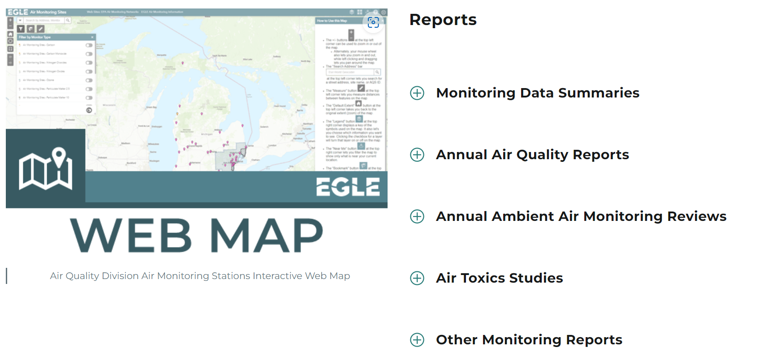
Information on Air Monitoring Webpage
Air Monitoring (michigan.gov)
Public comment opportunity
Air Quality Public Notice (michigan.gov)
Notes:
Annual Ambient Air Monitoring Review is put out for public comment every May.
Sign up for list-serve via public notice webpage.

Slide 46
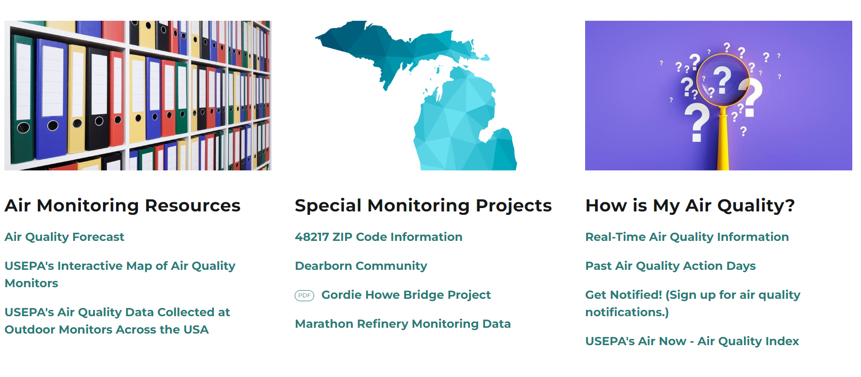
Finding Air Monitoring Results Online
Notes:
Screen shot of further down on EGLE webpage; highlight a few things:
Air Quality Forecast – completed every 1-2 weeks by EGLE meteorologist. Discusses details of forecast statewide with emphasis on particulate matter and ozone pollution.
Real-Time Air Quality – displays near-real time data from continuous monitors throughout the state. Gives Air Quality Index (AQI) report value.
**go to site and walk through
Get Notifications – can also access from Real-Time Air Quality; sign up to get notifications daily
(AQI next slide)

Slide 47
Note on Air Quality Index
Notes:
Fine particles and ground-level ozone are the pollutants most likely to control the AQI. AQI is a snapshot of current air health levels.
The AQI numbers are not the same as those from the continuous monitors.
**Who has smart phone? Go to weather app or maps app – Air Quality section = AQI , info from cont. monitors

Slide 48
Do you think the particulate pollution in Flint is worse than 10 years ago?
Interact
Let’s look at the data!

Slide 49
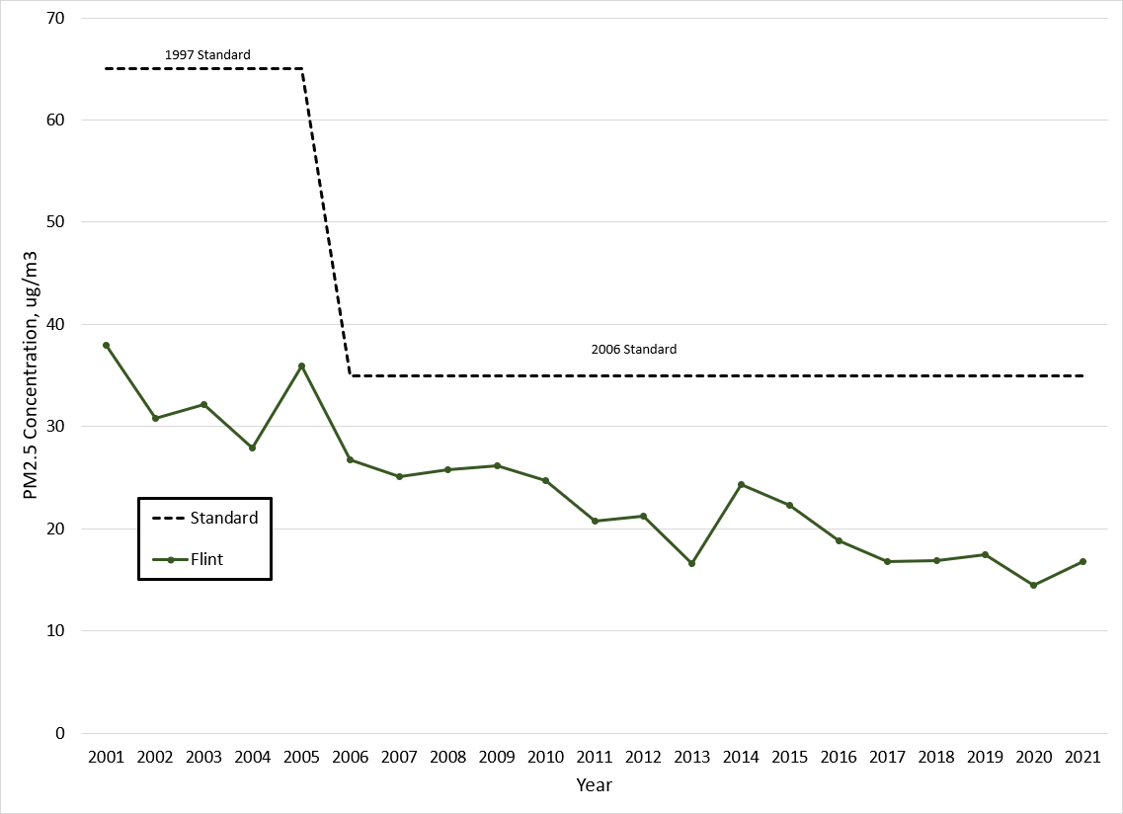
24-hour PM_{2.5} Trend in Flint
Notes:
20-year trends

Slide 50
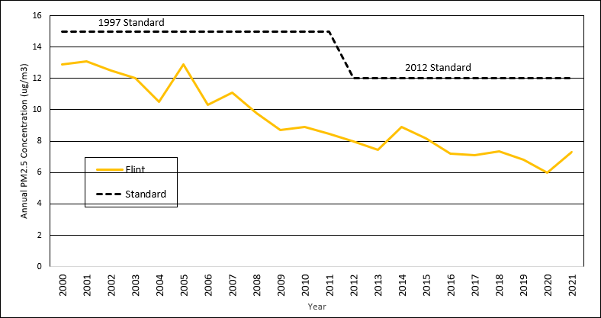
Annual PM_{2.5} Trend in Flint

Slide 51
Questions?

Slide 52
Handout Resources for Air Monitoring
EGLE Air Monitoring Website - https://www.michigan.gov/egle/about/Organization/Air-Quality/air-monitoring
Sign up for public notices - https://www.michigan.gov/egle/about/organization/air-quality/public-notice
Sign up for AQI Notifications - http://www.deqmiair.org/notify.cfm
Sensors:
U.S. EPA Air Sensor Toolbox - https://www.epa.gov/air-sensor-toolbox
U.S. EPA Loan Program (Rachel Kirpes, kirpes.rachel@epa.gov or 312-886-0221)
EGLE Classroom Loan Program - https://www.michigan.gov/egle/public/egle-classroom/environmental-lending-station (Eileen Boekestein, BoekesteinE@michigan.gov or 616-403-1615)

Slide 53
Air Permitting
Chuku Oje
EGLE AQD, Permit Engineer
OjeC@Michigan.gov
Michael Langman
USEPA Region V
Langman.Michael@epa.gov
Notes:
Air Quality Division
Air Monitoring Section

Slide 54
Interact
When you hear “air permit”
what do you think of?
Notes:
Meant to be call and response. Last no longer than 1 minute. Or call two to three people from the audience. If we have time after pptx, come back to this slide.

Slide 55
Who We Are
State agency within EGLE that regulates facilities emitting to the air in Michigan.
Given authority by USEPA to regulate facilities.
Performs various activities, including:
Air quality monitoring
Inspections and enforcement
Reviewing permit applications
Definitions
USEPA – United States Environmental Protection Agency
EGLE – Michigan Department of Environment, Great Lakes, and Energy
AQD – Air Quality Division
Notes:
Chuku & Michael

Slide 56
USEPA’s Air Permitting Role in Michigan
Federal agency implementing and overseeing Clean Air Act permit programs
Process permit program revisions
Provide permit policy and technical support
Review air permits
Answer questions about air permitting
Definitions
USEPA – United States Environmental Protection Agency
Notes:
Michael & Chuku

Slide 57
The Permitting Process
Facility plans to install or modify equipment
AQD receives application
Permit Application review process
AQD decision on the permit
Review and evaluation of comments
Public comment
Notes:
Chuku

Slide 58
An Example: Spray Paint Booth
Furniture company (makes chairs, desks, etc.)
Wants to install new paint spray booth
Installation requires permit application
Notes:
Chuku

Slide 59
The Permitting Process
Facility plans to install or modify equipment
AQD receives application
Permit Application review process
AQD decision on the permit
Review and evaluation of comments
Public comment
Notes:
Chuku

Slide 60
The Permit Application
The company prepares a permit application
Includes description of the spray booth, calculations, data sheets for paints, etc
The company submits a permit application
Notes:
Chuku

Slide 61
The Permitting Process
Facility plans to install or modify equipment
AQD receives application
Permit Application review process
AQD decision on the permit
Review and evaluation of comments
Public comment
Notes:
Chuku

Slide 62
The Permit Application Review
The permit engineer will determine whether the spray booth complies air quality rules
If so, the permit engineer will create a draft permit for the spray booth
The draft permit will go through multiple layers of review
Notes:
Chuku & Michael

Slide 63
The Permitting Process
Facility plans to install or modify equipment
AQD receives application
Permit Application review process
AQD decision on the permit
Review and evaluation of comments
Public comment
Notes:
Chuku

Slide 64
Public Comment
Once the draft permit has undergone review and a hold a public comment period may be held
Public comment period is meant to get public feedback on the permit
A hearing may also be held
Notes:
Chuku & Michael

Slide 65
Interact
Who here has seen an air permit?
Notes:
Show of hands to see who’s seen and reviewed a draft permit. Could show a template of a general permit (or part of one).

Slide 66
The Permitting Process
Facility plans to install or modify equipment
AQD receives application
Permit Application review process
AQD decision on the permit
Review and evaluation of comments
Public comment
Notes:
Chuku

Slide 67
Review of Public Comments
All comments on the permit will be reviewed
Comments received may lead to changes in the permit
A response document will also be prepared
Notes:
Chuku & Michael

Slide 68
The Permitting Process
Facility plans to install or modify equipment
AQD receives application
Permit Application review process
AQD decision on the permit
Review and evaluation of comments
Public comment
Notes:
Chuku

Slide 69
The Final Decision
A final decision on the permit will be made
The response will be published along with the decision
Possible decisions:
Issue the permit as is
Issue the permit with changes
Deny the permit
Notes:
Chuku

Slide 70
Permits & Zoning
Specific rules require that new installations or modifications obtain a permit
A permit does NOT mean that a facility can immediately start operating
Local zoning will have an impact on whether a facility can operate
Notes:
Chuku

Slide 71
Questions?

Slide 72
EPA, EGLE, and the Community
Jenine Camilleri
MI AQD Enf Unit Supervisor
camillerij@michigan.gov
Valeria Apolinario
U.S. EPA Region V
Apolinario.valeria@epa.gov
Notes:
Air Quality Division
Air Monitoring Section

Slide 73
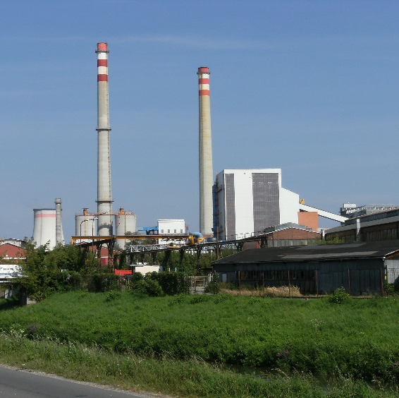
Common Objectives
Regulate sources of air pollutants to protect human health and the environment
Conduct inspections of industrial sources of air pollutants for compliance with rules and permits
Respond to citizen complaints
Notes:
Introduce, multiple AQD staff involved in this case. I am going to start with an overview of the Air Quality Division and enforcement process, then go into proposed consent order and enforcement action against Stellantis,
The AQD regulates sources of air pollutants to protect human health and the environment.
AQD has the authority to regulate stationary industrial sources, which we also call regulated facilities.
The AQD has many different roles in regulating air quality, and
One of our primary roles is to conduct inspections of regulated facilities to make sure they are following the air quality rules and regulations during their operations.
Enforcement falls under the compliance umbrella, and we work closely with AQD staff that inspect the regulated facilities.

Slide 74
State & Federal Relationship
EPA and MI are independent and cooperative
EPA has oversight authority
EPA can do independent inspections and enforcement
Joint actions by MI and EPA possible
Refer certain cases to US Dept of Justice or MI Dept of Attorney General if settlement cannot be reached

Slide 75
Enforcement Process
Inspection Performed
Violation Notice
Enforcement Notice
Enforcement Meetings
Public Comment Period (EGLE)
Issue Consent Order
Notes:
Overview of enforcement process from the beginning when a violation is found
Inspection = physical inspection , we can request records for review, inspect bc of complaints
If a violation is found, we send a VN, Company has opportunity to respond to say how they fixed or are going to fix the violations
If we decide the violations should be escalated to enforcement, district writes an enforcement referral
Send enf notice to request an initial meeting
Enf notice lets company know they will have to resolve the violations through the legal process
Usually through a document called a consent order which I will describe a bit later
Then have discussions with the company about what the plan will be to resolve the violations
Once agreement -> PN&C period, ppl can submit comments, 30+ days
Hold a hearing if requested, or if a high-profile case
After PN&C period over, AQD addresses all substantive comments
If there is demand from the public on an item in the CO that AQD is able to change, we may go back to company and propose changes to CO
If no changes or agree on changes, company and AQD sign CO -> company legally required to complete requirements of CO

Slide 76
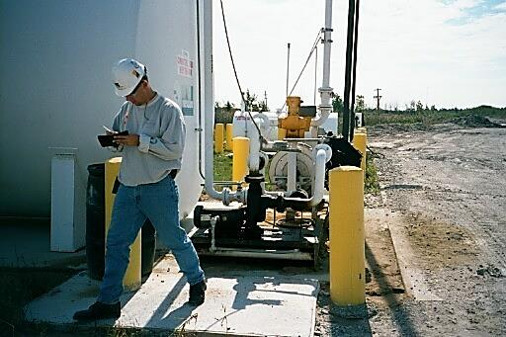
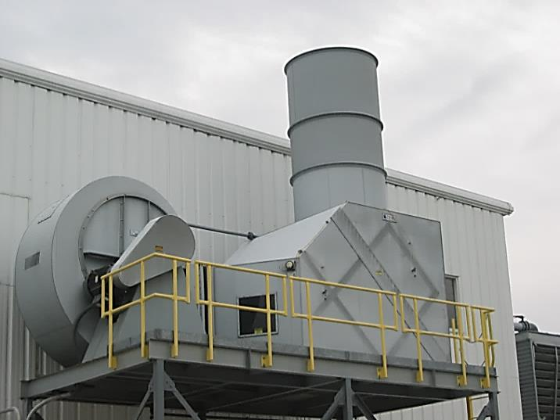
How are facilities chosen for inspections?
Follow EPA Compliance Monitoring Strategy and State Targets
Targeting
Inspector Initiated
Citizen complaints
Air monitoring stations
Can be Unannounced or Scheduled
Limitations

Slide 77
Community-Based Inspections
Working with ARD to target and inspect sources in targeted geographical EJ areas
Flint, NE Detroit, SE Chicago have been completed
Looking at all sources in geographical area
Work with community groups and environmental groups to identify biggest sources of concern
Potential coordination with state agency

Slide 78
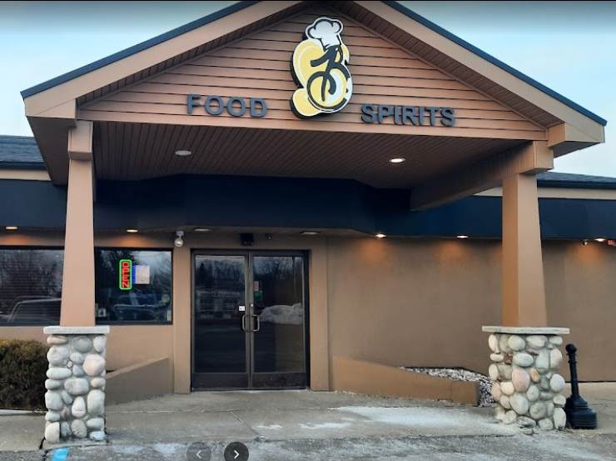
U.S. EPA-EGLE Flint CAA Inspections 4/2022
8 U.S. EPA + 4 EGLE inspectors, 15 Facilities
Targeting
Citizen Complaints
Prior U.S. EPA and EGLE Activity
Inspections
Violation Notices
Enforcement Actions
Air Emissions

Slide 79
Citizen Complaints
AQD and EPA respond to and investigate complaints
Process and limitations
The more details, the better
You are our eyes and ears in your community
Notes:
Highlight that complaints should be made to both EPA and EGLE.
If you are a community member and smell something, please continue to call us
This enforcement action was a result of community complaints, so if there are more community complaints it will help us hold Stellantis accountable
We will continue to investigate complaints to the best of our ability

Slide 80
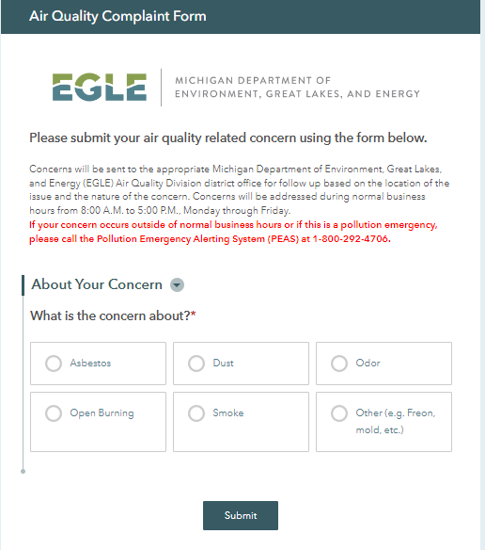
EGLE Complaint Submission
Pollution Emergency Alerting System
(PEAS)
1 - 800 - 292- 4706
Notes:
Talk with Jennifer: if there are other media concerns, what forms should be used?

Slide 81
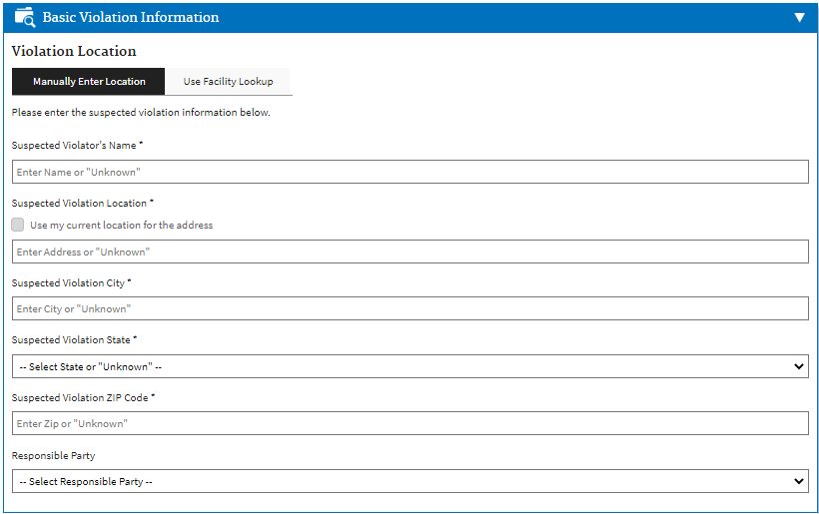
EPA Complaint Submission

Slide 82
Enforcement Process
Inspection Performed
Violation Notice
Enforcement Notice
Enforcement Meetings
Public Comment Period (EGLE)
Issue Consent Order
Notes:
Overview of enforcement process from the beginning when a violation is found
Inspection = physical inspection , we can request records for review, inspect bc of complaints
If a violation is found, we send a VN, Company has opportunity to respond to say how they fixed or are going to fix the violations
If we decide the violations should be escalated to enforcement, district writes an enforcement referral
Send enf notice to request an initial meeting
Enf notice lets company know they will have to resolve the violations through the legal process
Usually through a document called a consent order which I will describe a bit later
Then have discussions with the company about what the plan will be to resolve the violations
Once agreement -> PN&C period, ppl can submit comments, 30+ days
Hold a hearing if requested, or if a high-profile case
After PN&C period over, AQD addresses all substantive comments
If there is demand from the public on an item in the CO that AQD is able to change, we may go back to company and propose changes to CO
If no changes or agree on changes, company and AQD sign CO -> company legally required to complete requirements of CO

Slide 83
When can Enforcement Happen?
District staff observe violations during inspections, responding to complaints
Violations of stack testing, monitoring, recordkeeping and reporting
Fail to meet permit requirements
Fail to meet deadlines to come into compliance
Notes:
District staff key
Community complaints – resulted in Stellantis enf action
Odor complaints – getting lots of complaints – Bob inspected

Slide 84
Significant Violations for Enforcement
High Priority Violations per EPA policy
Violations ongoing or repeated
Violation(s) are of significant scale, scope, duration or frequency
Violations pose a potential risk to public health or environment
Certain Asbestos violations
Emissions exceed certain emission limits in permits
Violator is unresponsive or uncooperative at resolving the violations
Notes:
Highlight that there may be state rules only EGLE can enforce and federal rules that only EPA can enforce

Slide 85
Enforcement Process
Inspection Performed
Violation Notice
Enforcement Notice
Enforcement Meetings
Public Comment Period (EGLE)
Issue Consent Order
Notes:
EPA does not have a public comment period
Overview of enforcement process from the beginning when a violation is found
Inspection = physical inspection , we can request records for review, inspect bc of complaints
If a violation is found, we send a VN, Company has opportunity to respond to say how they fixed or are going to fix the violations
If we decide the violations should be escalated to enforcement, district writes an enforcement referral
Send enf notice to request an initial meeting
Enf notice lets company know they will have to resolve the violations through the legal process
Usually through a document called a consent order which I will describe a bit later
Then have discussions with the company about what the plan will be to resolve the violations
Once agreement -> PN&C period, ppl can submit comments, 30+ days
Hold a hearing if requested, or if a high-profile case
After PN&C period over, AQD addresses all substantive comments
If there is demand from the public on an item in the CO that AQD is able to change, we may go back to company and propose changes to CO
If no changes or agree on changes, company and AQD sign CO -> company legally required to complete requirements of CO

Slide 86
Enforcement Process
Legal process to resolve a company’s air quality violations that includes issuing a Consent Order
Legally binding contract that is enforced
Contains a compliance program that the company must follow
Requires the payment of a fine and stipulated fines for future violations
What is a Consent Order?
Notes:
Escalated enforcement is the legal process which we use to resolve violations that were cited and sent to enforcement
Resolve through administrative consent order
ACO is an administrative settlement – legally required to offer this to a company in enforcement before we consider DAG or EPA
Contains compliance program, fine, stips
90% of violations in enforcement resolved through ACO

Slide 87
Enforcement Fines
Penalties go to General Fund/Department of Treasury unless company is doing a Supplemental Environmental Project
Depending on violations, use state statutory authority or federal penalty policies to calculate penalties

Slide 88
Supplemental Environmental Projects
What is a Supplemental Environmental Project?
Example projects
Voluntary environmental or public health project
Required as part of enforcement action
Most of fine invested into project
Install Building Management Systems and air filters to improve indoor air quality at community centers, schools
Plant trees to buffer pollution
Improve energy efficiency
Install fence line monitors
Notes:
Legally required to complete
BMS = Automated energy control platform that allows for remote monitoring and management of building systems.
-identified by the Detroit Public Schools as a project in need that had not been funded
The building systems that will be controlled include lighting, mechanical and water systems, heating and cooling, and ventilation.
Monitor, in real time, how well the systems and equipment are performing
Control ventilation, temperature, and humidity to make the building more comfortable
Overall, higher energy efficiency, lower operating and maintenance costs will result in cost and energy savings for the school
Brewer Park
partner with The Greening of Detroit - required to plant over 80 trees in Brewer Park
This park was identified as one that could benefit from more trees
It is required that the trees will be maintained and watered for 2 years
And any trees that do not survive will be replaced.
Paying $212,000 for 2 projects

Slide 89
Partnering with EPA on Enforcement
Talking regularly and meeting bimonthly to discuss enforcement cases in Michigan
Joining together on certain cases to address significant long-term violations
Assisting with ambient air monitoring to evaluate public health concerns
Providing guidance and technical expertise on challenging air quality issues

Slide 90
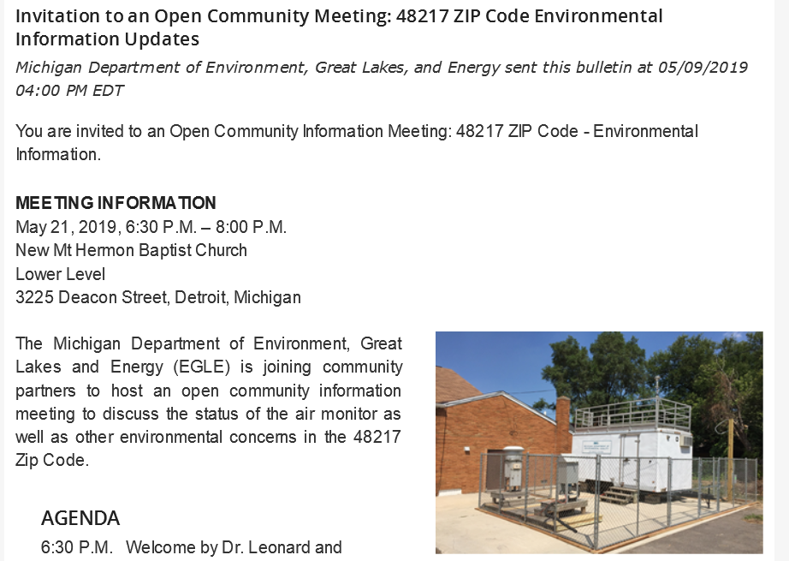
Community Engagement
Increasing Public Outreach
Dedicated websites, regular meetings, holding public hearings on certain enforcement settlements
Proactive
More Townhall meetings, including translation services
Timely responses to public concerns

Slide 91
Questions?

Slide 92
Community Planning Session
Notes:
Air Quality Division
Air Monitoring Section

Slide 93
Flint Air Priorities
What topics do you want to know more about?
Walk around the room and write the topics you want to know more about on the paper.
What are your air priorities?
Walk around the room and read what other people wrote
Use your stickers to vote for your top eight (8) priorities

Slide 94
Next Steps & Closing

Slide 95
Questions?

Slide 96
THANK YOU!

