Slide 1
2024 Chemical Data Reporting Requirements
May 2024
Notes:
Welcome to EPA’s overview of the 2024 Chemical Data Reporting requirements. Chemical Data Reporting is commonly referred to as CDR. The purpose of this overview is to orient you to the regulatory requirements for CDR, changes made from past reporting, and the variety of helpful resources that EPA has made available on the CDR webpage and in the electronic reporting tool.

Slide 2
Agenda
TSCA and CDR Background
CDR 2024 Reporting Requirements
Overview and Determining the Need to Report
Search EPA’s Substance Registry Service
What Information is Reported
Special Reporting Cases
Additional Resources
Notes:
This training consists of several sections. The first section will cover some background information on the Toxic Substances Control Act (TSCA), the Chemical Data Reporting (CDR) program, and a general overview of the reporting requirements. The second section provides more detail on the 2024 CDR reporting requirements.

Slide 3
Background: TSCA and the TSCA Inventory
Toxic Substances Control Act (TSCA)
The Toxic Substances Control Act of 1976 provides EPA with authority to require reporting, recordkeeping, and chemical testing and to implement restrictions relating to chemical substances and/or mixtures
Frank R. Lautenberg Chemical Safety for the 21st Century Act (Lautenberg Act) amended TSCA on June 22, 2016
Certain substances are generally excluded from TSCA, including, among others, food, drugs, cosmetics and pesticides
For more information, see Summary of the Toxic Substances Control Act | US EPA
TSCA Chemical Substance Inventory (TSCA Inventory)
Comprehensive listing of chemicals in commerce
Created in late 1970s and currently lists about 87,000 chemical substances with about 42,300 of them identified as active in U.S. commerce
EPA maintains a public version and a non-public master file of the inventory
For more information, see How to Access the TSCA Inventory | US EPA
Notes:
The Toxic Substances Control Act, commonly called TSCA, is the premier chemical safety legislation in the United States. TSCA gives EPA the authority to require reporting, recordkeeping, and chemical testing, and to implement restrictions related to chemical substances and/or mixtures. TSCA, initially passed in 1976, was updated in 2016 with the Frank R. Lautenberg Chemical Safety for the 21st Century Act. TSCA broadly defines the universe of chemical substances that it regulates; however, certain substances are generally excluded from TSCA. These include food, drugs, cosmetics, and pesticides, unless the substance has a use that is not as a food, drug, cosmetic, or pesticide.
You can learn more about TSCA by following the provided link to a summary of TSCA.
As of March 2024, there are almost 87,000 chemical substances on the TSCA Inventory, with about 42,300 identified as being active in commerce. You can learn more about the TSCA Inventory by visiting the provided link to “How to Access the TSCA Inventory”.

Slide 4
Background: Chemical Data Reporting (CDR)
CDR is a collection of basic exposure-related information on the types, quantities, and uses of chemical substances manufactured domestically or imported into the United States
Chemical substances listed on the TSCA Inventory
Certain classes of chemicals, such as polymers, are exempted from reporting
Information is submitted every four years
Most recently submitted in 2020, covering calendar years 2016-2019
The current submission period is in 2024, covering calendar years 2020-2023
In 2020, about 5,240 sites reported approximately 8,700 chemicals, resulting in close to 42,300 chemical reports
From time-to-time, EPA modifies the reporting requirements through rulemaking
The latest change (via the CDR Revisions Rule) was first implemented during the 2020 CDR
For a history of changes to CDR over time, view the Legislative and Regulatory Authority webpage
Notes:
TSCA Section 8 authorizes EPA to require the reporting and retention of information related to the manufacturing and processing of chemical substances. The Chemical Data Reporting program, commonly known as CDR, is one of EPA’s TSCA section 8 regulations. CDR provides a high-level view of chemicals in commerce in the United States, which includes basic exposure-related information on the quantities and uses of chemical substances manufactured domestically or imported into United States.
CDR data are collected for chemical substances listed on the TSCA Inventory. Certain classes of chemicals are exempted from reporting. This includes most polymers, naturally occurring substances, microorganisms, water, and certain forms of natural gas.
CDR data are submitted to EPA every four years. The reporting period for calendar years 2020 through 2023 opens June 1, 2024, and lasts through September 30, 2024. Prior to this 2024 reporting period, manufacturers reported in 2020 for calendar years 2016 through 2019.
During the 2020 submission period, about 5,240 sites reported information for about 8,700 chemicals. Because some chemicals are reported by multiple sites, this resulted in close to 42,300 chemical site-specific reports.
EPA uses CDR data for a variety of purposes within the TSCA program including work related to risk evaluations. CDR are also used by other EPA offices, including the Office of Water, Office of Air, and Office of Research and Development.
Additionally, EPA makes CDR data available to the public.
From time to time, EPA modifies the reporting requirements through rulemaking. The latest change was the CDR Revisions Rule, which was implemented during the 2020 CDR. For a history of changes to CDR, follow the provided link to the Legislative and Regulatory Authority webpage.

Slide 5
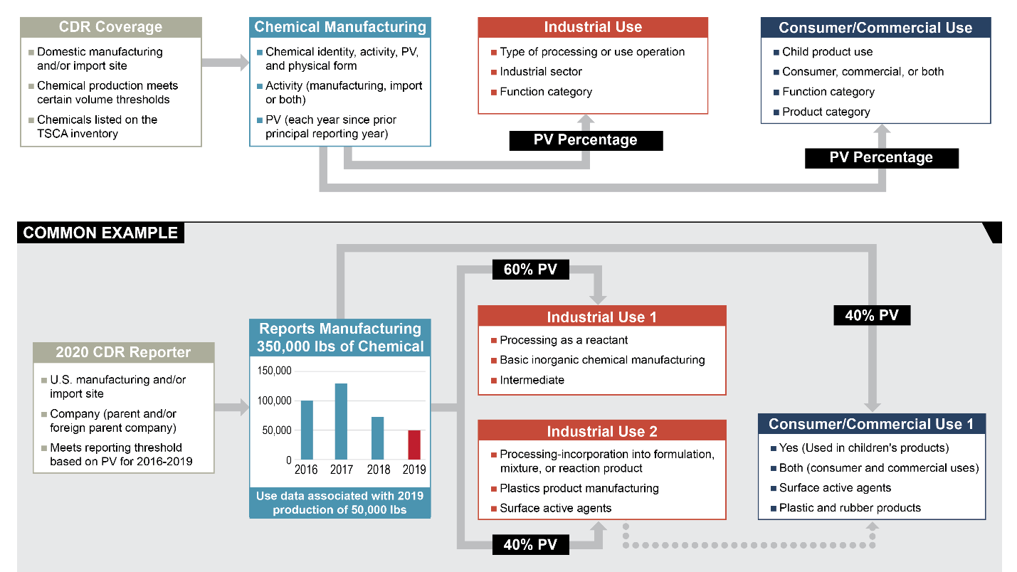
CDR Reporting Overview and Example
Notes:
CDR data reported to EPA by manufacturers include chemical identity, manufacturing information, industrial processing and use information, and consumer and commercial use information, as shown in this diagram. Note that this diagram is illustrative and not comprehensive.
The common example in the lower half of the diagram illustrates the type of information that might be reported in each category. In this example, a site that reported for the 2020 reporting cycle provided production volume (PV) information for each year in the reporting cycle (i.e., 2016 through 2019), for a total of 350,000 lb. The reporter provides additional manufacturing data and processing and use data—whether for industrial uses and/or consumer/commercial uses—for the principal reporting year (2019), to the extent it is known or reasonably ascertainable.
Within the diagram, of the 50,000 pounds reported as manufactured in 2019, the reporter indicates that industrial sites use 60% (30,000 pounds) of the chemical as an intermediate and 40% (20,000 pounds) as a surface active agent in a plastic product formulation. The reporter also indicates that 40% (20,000 pounds) of the chemical is incorporated into plastic products used by consumers or commercial users.
Note that the same percent PV (40%) and similar use information (plastic products and surface active agent) are reported for "Industrial Use 2" and "Consumer/Commercial Use 1;" this suggests these two uses are related (see dotted arrow in figure). While the industrial use and consumer/commercial use information is reported separately, EPA can analyze these use scenarios in detail (i.e., by site or by chemical) to identify connections to support various agency efforts.

Slide 6
CDR 2024 Reporting Requirements
Notes:
This section of the training discusses the CDR reporting requirements.

Slide 7
Overview of 2024 CDR Requirements
When: The submission period is June 1, 2024, to September 30, 2024
Who: Manufacturers, including importers, of chemical substances that:
Are listed on the TSCA Inventory as of June 1, 2024
Have a production volume of 25,000 lbs or greater at a site in at least one of the years 2020-2023
Unless subject to certain TSCA regulatory actions, in which case the production volume is 2,500 lbs or greater
Are not eligible for a full or partial exemption from CDR
Terminology note:
Principal Reporting Year is the year before the submission period (i.e., 2023)
Past Years are the other years covered by the reporting (i.e., 2020-2022)
Notes:
This section provides an overview of the reporting requirements. The submission period is from June 1st to September 30th, 2024. This applies to all manufacturers, which under TSCA includes importers, of chemical substances that are listed on the TSCA Inventory as of June 1, 2024, and have a production volume of 25,000 pounds or greater at a site in at least one of the years from 2020 through 2023. However, if a chemical substance is subject to certain TSCA actions, then the reporting threshold is a production volume of 2,500 pounds or greater. A manufacturer that meets the applicable production volume for a chemical is required to report. Later slides will discuss full or partial exemptions that may be applicable that could reduce or even remove the reporting requirement.
Please note that the term “principal reporting year” refers to the calendar year before the submission period year. For the 2024 submission period, the principal reporting year is 2023.
The term “past years” refers to the other three calendar years covered by the reporting. For the 2024 submission period, the past years are 2020, 2021, and 2022.

Slide 8
Overview of 2024 CDR Requirements
What: Submitters must report for each chemical substance at a single site:
Annual production volume for 2020-2023
Certain manufacturing information for 2023
Processing and use information for 2023
Exemptions may reduce reporting, explained later in this presentation
How: Submitters are required to report electronically
Where: Submitters report through EPA’s Central Data Exchange (CDX) CDX Home | Central Data Exchange | US EPA
Register with CDX CSPP CDX Registration Guide | US EPA
Access e-CDRweb, the CDR reporting tool
Create and submit a separate Form U for each site
Submit completed Form U following instructions in e-CDRweb
Notes:
Once reporting for a chemical is triggered, certain information about that chemical is required to be reported by the manufacturing site. For the Past Years of 2020 to 2022, report only the annual production volume from each calendar year (2020 to 2022). For the principal reporting year of 2023, report the production volume plus additional manufacturing information and report processing and use information. Note that exemptions may reduce reporting. Exemptions are explained in a later slide.
All submissions are sent to EPA electronically through EPA’s Central Data Exchange, in which a submitter will register in CDX, access the CDR reporting tool (e-CDRweb), create and submit a separate Form U for each site, and submit the completed Form U following instructions on the e-CDRweb reporting tool. Follow the provided links for more information about CDX and to access the CDX registration guide.

Slide 9
2024 CDR: Determining the Need to Report
To determine whether you are required to report, for each chemical substance that you domestically manufacture and/or import at a single site in any years between 2020-2023, consider the following steps:
Step I: Is Your Chemical Substance Subject to CDR?
Step II: Are You a Manufacturer Who is Required to Report?
Notes:
In determining whether you need to report, you must consider each chemical substance that you domestically manufactured or imported at a single site from 2020 to 2023. First, you must determine if your chemical substance is subject to CDR, and next, if you are a manufacturer who is required to report.

Slide 10
The 2024 CDR: Determining Need to Report
Step I: Is Your Chemical Subject to CDR?
Is your chemical substance listed on the TSCA Inventory?
Is your chemical substance manufactured for commercial purposes?
Is your chemical substance used for only non-TSCA uses, as defined by TSCA Section 3(2)(B)?
Is your chemical substance potentially exempt from reporting?
Is your chemical substance ineligible for exemption?
Notes:
To determine whether a chemical you manufacture (including import) is subject to CDR you must consider a few questions. First, is your chemical substance listed on the TSCA Inventory?
Next, is your chemical substance manufactured for commercial purposes, which means to produce, import or manufacture with the purpose of obtaining an immediate or eventual commercial advantage to the manufacturer?
Next, is your chemical substance used only for non-TSCA uses, as defined by TSCA Section 3(2)(B)? Is your chemical substance potentially exempt from reporting, or is your chemical substance ineligible for an exemption?
Substances excluded by the definition of “chemical substance” in TSCA Section 3(2)(B) need not be reported. Substances excluded by TSCA Section 3(2)(B) include: any pesticide as defined by the Federal Insecticide, Fungicide, and Rodenticide Act (FIFRA), when manufactured, processed, or distributed in commerce for use as a pesticide; any food, food additive, drug, cosmetic, or device, as defined by the Federal Food, Drug, and Cosmetic Act (FFDCA), when manufactured, processed, or distributed in commerce for use as a food, food additive, drug, cosmetic or device; tobacco or any tobacco product; any source material, special nuclear material, or byproduct material as such terms are defined in the Atomic Energy Act of 1954; and, any article the sale of which is subject to the tax imposed by Section 4181 of the Internal Revenue Code.
Note that chemical substances with uses beyond those regulated by these other statutes may also be regulated pursuant to TSCA, including CDR, for those other uses.

Slide 11
The 2024 CDR: Determining Need to Report
Chemical-Specific Exemptions (40 CFR 711.6)
Full exemption from reporting
Polymers, microorganisms, certain forms of natural gas & water
Naturally occurring chemical substances (not affected by TSCA actions)
Partial exemption from processing & use reporting
Listed petroleum process streams
Chemicals for which processing & use information is of low current interest
Added via petition process for each specific chemical
May be reversed if interest in chemical changes
Not eligible for exemptions if subject to certain TSCA actions
A rule proposed or promulgated under TSCA Sections 4, 5(a)(2), 5(b)(4), or 6
Is the subject of an Enforceable Consent Agreement under 40 CFR 790
An order in effect under TSCA Section 4, 5(e), or 5(f)
Relief that has been granted under as civil action under TSCA Sections 5 or 7
Notes:
Chemical-specific exemptions are identified in the Code of Federal Regulations (CFR) at 40 CFR 711.6. Some chemicals are fully exempt from reporting, such as polymers, microorganisms and certain forms of natural gas and water, as well as naturally-occurring chemical substances.
Some chemicals are partially exempt from processing and use reporting. There are two groups of partially exempted chemical substances: listed petroleum processing streams and chemicals whose processing and use information is of low current interest. Only those chemical substances specifically listed at 40 CFR 711.6(b) are partially exempted.
Some chemicals are not eligible for exemptions if they’re the subject of certain TSCA actions, such as a rule proposed or promulgated under TSCA sections 4, 5(a)(2), 5(b)(4), or 6, or one of the other actions listed in the slide.

Slide 12
The 2024 CDR: Determining Need to Report
Effect of TSCA Actions on Chemical-Specific Exemptions
†Full exemption for naturally occurring chemicals is not affected. *Applies to both proposed & promulgated rules
TSCA Action | CDR Requirement
 | Not eligible for full† or partial exemptions from reporting (40 CFR 711.6)
TSCA section 4 rules* | ✓
Enforceable Consent Agreements (ECAs) | ✓
TSCA section 5(a)(2) SNURs * | ✓
TSCA section 5(b)(4) rules* | ✓
TSCA section 6 rules* | ✓
TSCA section 4 orders | ✓
TSCA section 5(e) orders | ✓
TSCA section 5(f) orders | ✓
TSCA section 5 civil actions | ✓
TSCA section 7 civil actions | ✓
Notes:
This is a list of TSCA actions that would make your chemical ineligible for an exemption. Note that the full exemption for naturally occurring chemicals is not affected by these actions.

Slide 13
The 2024 CDR: Determining Need to Report
Step II: Are You a Manufacturer Who is Required to Report?
Did you manufacture a chemical substance in an amount that met or exceeded the reporting threshold for the chemical?
Production volume (PV) of 25,000 lbs or 2,500 lbs
PV must be considered for each year for calendar years 2020, 2021, 2022, and 2023
Notes:
After you determine that you have one or more chemical substances that are subject to CDR, Step 2 in determining whether you need to report involves identifying if you are a manufacturer who is required to report under CDR.
Begin by evaluating if the production volume for your chemical at your site meets or exceeds the applicable reporting threshold.
Remember that the production volume threshold for most chemicals is at 25,000 pounds, but a lower 2,500-pound threshold applies for chemicals subject to certain proposed or final TSCA actions. You must consider the production volume for each of the calendar years of the reporting period and if your production of a chemical is equal to or higher than the applicable threshold for any year in the reporting period, then reporting over the whole period is required. For this upcoming report period, that means the years 2020, 2021, 2022 and 2023.

Slide 14
Example: Reporting Threshold
ChemInc Company manufactures the following chemicals at a single site:
Note:
These chemicals are not the subject of any listed TSCA actions
Applicable reporting threshold is 25,000 lb
Chemical | Production Volumes (lbs) |  |  |  | Reporting required?
 | 2020 | 2021 | 2022 | 2023
Chem A | 2,000 | 5,000 | 0 | 25,000 | Yes
Chem B | 0 | 34,000 | 0 | 0 | Yes
Chem C | 1,000 | 2,000 | 0 | 0 | No
Notes:
Let’s evaluate the production volumes of an example company, ChemInc. ChemInc manufactures three different chemicals – Chemical A, Chemical B, and Chemical C. Each chemical is manufactured at a single site. None of these chemicals are the subject of TSCA actions that would trigger the lower reporting threshold.
For Chemical A, in 2020, 2021 and 2022, the production volume was under 25,000 pounds, but in 2023, it was 25,000 pounds. Because the production volume in 2023 met the reporting threshold, Chemical A needs to be reported under the CDR.
For Chemical B, the only production occurred in 2021 and in that year ChemInc exceeded the reporting threshold. Chemical B needs to be reported under CDR.
For Chemical C, the production in all four years was under the reporting threshold and, therefore, ChemInc does not need to report Chemical C under CDR.

Slide 15
The 2024 CDR: Determining Need to Report
Step II: Are You a Manufacturer Who is Required to Report?
Did you manufacture a chemical substance in an amount that met or exceeded the reporting threshold for the chemical?
Production volume (PV) of 25,000 lbs or 2,500 lbs
PV must be considered for each year for calendar years 2020, 2021, 2022, and 2023
Did you manufacture a chemical substance subject to a lower reporting threshold due to its TSCA regulatory status?
Notes:
In general, the reporting threshold remains at 25,000 pounds. However, a reduced reporting threshold of 2,500 pounds applies to chemical substances subject to certain proposed or final TSCA actions. Not all of the certain TSCA actions listed earlier in this training impacts the reporting threshold. See the next slides for a detailed listing of the certain TSCA actions and an example.

Slide 16
The 2024 CDR: Determining Need to Report
Effect of TSCA Actions on Reporting Thresholds
*Applies to both proposed & promulgated rules. †Full exemption for naturally occurring chemicals is not affected.
TSCA Action | CDR Requirement
 | Reporting threshold (must be one or the other)
 | 25,000 lb (40 CFR 711.8(a)) | 2,500 lb (40 CFR 711.8(b))
Not subject to any TSCA actions below | ✓
TSCA section 4 rules * | ✓
Enforceable Consent Agreements (ECAs) | ✓
TSCA section 5(a)(2) SNURs * |  | ✓
TSCA section 5(b)(4) rules * |  | ✓
TSCA section 6 rules * |  | ✓
TSCA section 4 orders |  | ✓
TSCA section 5(e) orders |  | ✓
TSCA section 5(f) orders |  | ✓
TSCA section 5 civil actions |  | ✓
TSCA section 7 civil actions |  | ✓
Notes:
This table lists TSCA actions that trigger the lower reporting threshold. The first three listed actions do not affect the reporting threshold, so it remains at 25,000 pounds. The remainder of the TSCA actions do trigger the lower reporting threshold.

Slide 17
Example: Reporting Threshold
ChemInc Company manufactures the following chemicals at single site:
Chemical | Production Volumes (lbs) |  |  |  | Reporting required?
 | 2020 | 2021 | 2022 | 2023
Chem A | 2,000 | 5,000 | 10,000 | 25,000 | Yes
Chem B | 0 | 34,000 | 0 | 0 | Yes
Chem C | 1,000 | 2,000 | 0 | 0 | No
Chem D* | 1,000 | 3,000 | 2,000 | 1,200 | Yes, because TSCA section 6 rule
Chem E** | 0 | 900 | 2,400 | 2,100 | No
Chem F** | 700 | 1,300 | 2,700 | 4,500 | Yes, because TSCA section 5 SNUR
* Chemical D is the subject of a TSCA Section 6 Rule
** Chemicals E & F are both subjects of a Proposed SNUR under TSCA Section 5
Notes:
To evaluate the impact of these TSCA actions on reporting thresholds, let’s return to our example, ChemInc. We’ve already discussed Chemicals A, B and C that this company makes, but they also make three more chemicals – Chemicals D, E and F. We’re going to look at these chemicals and evaluate whether or not they need to be reported to CDR. Each chemical is manufactured at a single site.
Chemical D is the subject of a TSCA Section 6 rule, which would trigger the lower reporting threshold. And in 2021, we see that they manufactured 3,000 pounds of Chemical D, which exceeds the 2,500 lb reporting threshold. ChemInc must report Chemical D under CDR.
Chemicals E and F are the subjects of TSCA Section 5 proposed SNURs, which means that ChemInc needs to consider the lower reporting threshold of 2,500 lb for each of these chemicals.
Chemical E is not reportable because the highest production volume of 2,400 lb, occurring in 2022, is lower than the reporting threshold.
Chemical F is reportable because the production volume in 2022 and 2023 each exceeded the 2,500lb reporting threshold.

Slide 18
The 2024 CDR: Determining Need to Report
Step II: Are You a Manufacturer Who is Required to Report?
Did you manufacture a chemical substance in an amount that exceeded the reporting threshold for the chemical?
Production volume (PV) of 25,000 lbs or 2,500 lbs
PV must be considered per year for calendar years 2020, 2021, 2022, and 2023
Did you manufacture a chemical substance subject to a lower reporting threshold due to its TSCA regulatory status?
Do you qualify as exempt because you are a Small Manufacturer or a Small Government?
Do you qualify for any other reporting exemptions?
Notes:
The final portion of determining if you are a manufacturer who is required to report is to consider whether you qualify for any exemptions based on whether you are a small manufacturer or if your activities are exempted.

Slide 19
Small Manufacturer: Definition
The term “Small Manufacturers” is defined in 40 CFR 704.3 (referenced by 40 CFR 711.3)
Total annual sales means annual sales of submitter combined with its parent company, domestic or foreign (if any)
The term “Small Government” is defined in 40 CFR 704.3 (referenced by 40 CFR 711.3)
Definition of Small Manufacturer
First standard
Total annual sales <$120 million and annual PV ≤ 100,000 lb at a site
Second standard
Total annual sales <$12 million, regardless of PV
Definition of Small Government
The government of a city, county, town, township, village, school district, or special district with a population of less than 50,000.
Notes:
The small manufacturer definition used by CDR in this reporting cycle is the same that was used for the 2020 reporting cycle.
The definition of “small manufacturer” has two standards to consider: First, a manufacturer would be considered small if they have total annual sales under $120 million AND have annual production volume at or under 100,000 lb at a site. The production volume portion of this standard is applied on a chemical-by-chemical basis, such that manufacturer could meet the standard for one chemical but not another. Under the second standard, a manufacturer could be considered small if their total annual sales is under $12 million, regardless of a chemical’s production volume. And to clarify, the total annual sales are for the whole company, including any parent company, whether foreign or domestic.
Reporting under CDR by governments is unusual but does happen. A government would be considered small when its population is less than 50,000 people.

Slide 20
Effect of TSCA Actions on Reporting Thresholds & Some Exemptions
TSCA Action | CDR Requirement
 | Reporting threshold (must be one or the other) |  | Not eligible for exemptions (separate issues)
 | 25,000 lb (40 CFR 711.8(a)) | 2,500 lb (40 CFR 711.8(b)) | Full† or partial exemptions from reporting (40 CFR 711.6) | Small manufacturer exemption (40 CFR 711.9)
Not subject to any TSCA actions below | ✓
TSCA section 4 rules * | ✓ |  | ✓ | ✓
Enforceable Consent Agreements (ECAs) | ✓ |  | ✓
TSCA section 5(a)(2) SNURs * |  | ✓ | ✓
TSCA section 5(b)(4) rules * |  | ✓ | ✓ | ✓
TSCA section 6 rules * |  | ✓ | ✓ | ✓
TSCA section 4 orders |  | ✓ | ✓ | ✓
TSCA section 5(e) orders |  | ✓ | ✓ | ✓
TSCA section 5(f) orders |  | ✓ | ✓
TSCA section 5 civil actions |  | ✓ | ✓ | ✓
TSCA section 7 civil actions |  | ✓ | ✓ | ✓
*Applies to both proposed & promulgated rules. †Full exemption for naturally occurring chemicals is not affected.
Notes:
As with the other exemptions, a small manufacturer may still need to report if they manufacture a chemical that is the subject of some of the certain TSCA actions. The final column of this table identifies which TSCA actions impact the applicability of the small manufacturer exemption. For example, a chemical that is the subject of a SNUR is reportable when its production volume is 2,500 lb or greater, is not eligible for any full or partial exemptions listed in 40 CFR 711.6, but it is eligible for the small manufacturer exemption.

Slide 21
Searching SRS – www.epa.gov/srs
Search SRS to research if:
Your chemical substance is listed on the TSCA Inventory
Your chemical substance is potentially partially or fully exempt from reporting
Your chemical substance is the subject of certain TSCA actions which may impact reporting requirements
2024 CDR updates will be finalized to reflect chemicals’ status as of June 1, 2024
Notes:
You can use the Substance Registry Service (SRS) to find out if your chemical substance is listed on the TSCA Inventory, if your chemical substance is potentially partially or fully exempt from reporting, or if your chemical substance is the subject of certain TSCA actions, which may impact reporting requirements. The next several slides provide additional information about searching in SRS.
Note that, for reporting under CDR, the status of the chemical as of June 1 of the submission year is the status that determines the reporting threshold and ability to take certain exemptions. Within SRS, EPA provides lists specific to the submission year. The lists that apply will start with the submission year and “CDR” (e.g., 2016 CDR, 2020 CDR, 2024 CDR). Additionally, EPA combines these lists into a convenient table that is made available on the CDR webpage.
The 2024 CDR lists were added to SRS prior to the 2024 reporting period but cannot be finalized until June 1, 2024. If you accessed the lists prior to June 1, you should revisit the list after June 1.

Slide 22
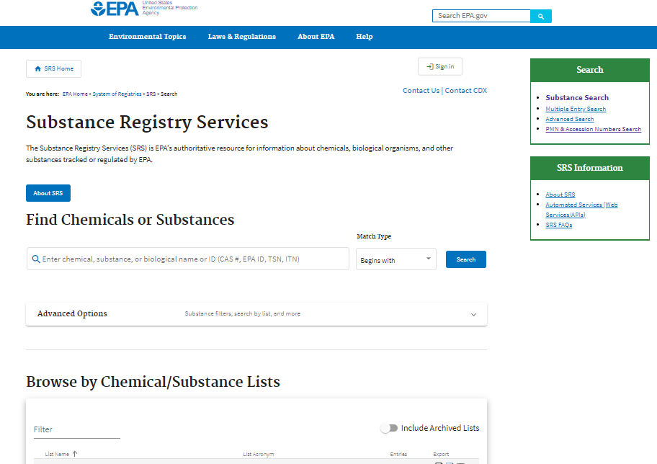
Searching SRS – www.epa.gov/srs
Notes:
This is a screenshot of the homepage for SRS on EPA’s website. To access this site, visit www.epa.gov/srs. Note that when using e-CDRweb, the CDR reporting tool, the reporting tool searches SRS and provides information about the reporting status of each entered chemical.
To search on your own, you can search SRS by list, by a single chemical or CAS registry number, or by multiple chemicals. If you are interested in searching an older CDR list, you will need to include the archived lists. Click on the switch circled in red to include lists from the 2016 CDR or 2020 CDR.
Also, chemicals that are on the confidential portion of the TSCA Inventory are listed by TSCA Accession Number, not CAS registry number. Chemicals that are on the confidential portion of the TSCA Inventory are only searchable in SRS by using the separate “PMN & Accession Numbers Search” circled in yellow.

Slide 23
Searching SRS – By Substance List
Note: for 2024 lists, use “2024” in the filter
Notes:
Using the filter in the lists search helps to find the CDR-related lists. To find the 2024 lists, filter by “2024” instead of “2020.”
The 2020 CDR list search serves as an illustration of the lists that are available. Note that, to determine the reporting requirements for a particular chemical, you need to determine whether a chemical that is in the full exempt list is also in one of the other lists that changes the applicability of the exemption. On the CDR website, EPA provides a spreadsheet that combines the information from these various lists to make it easier to identify the reporting status of the chemical of interest.
The CDR lists are snapshots in time. To search TSCA lists that are not connected to the June 1 date for a CDR submission period, use “TSCA” as your filter term. The TSCA lists are updated regularly and therefore may differ from the CDR lists. For reporting under CDR, use the CDR lists for the applicable submission year.

Slide 24
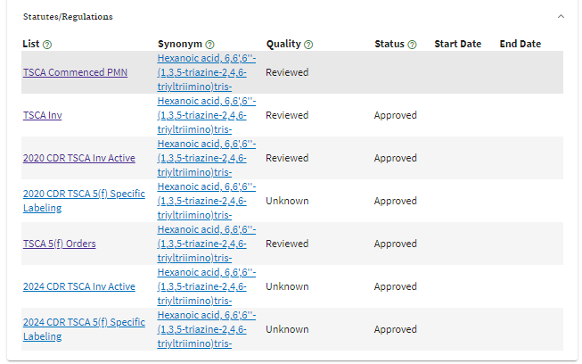
Searching SRS – by Chemical Substance
Hexanoic acid, 6,6',6''-(1,3,5-triazine-2,4,6-triyltriimino)tris- CASRN: 80584-91-4
Information from www.epa.gov/srs
Notes:
Here are the results for an SRS chemical-specific search. The chemical is on the TSCA Inventory “TSCA Inv” and was on it as of June 1, 2024 “2024 CDR TSCA Inv Active”. In addition, the chemical is the subject of a TSCA 5(f) Order (“2024 CDR TSCA 5(f) Specific Labeling” list), which means the applicable reporting threshold is 2,500 lb. The small manufacturer exemption, if applicable for the reporting company, would continue to apply.

Slide 25
What is Reported?
Site Identification Information
Highest level U.S. parent company and, if applicable, the highest-level foreign parent company (see definition of “highest-level parent company” in 40 CFR 711.3)
Company name and address
Company Dun & Bradstreet number
Manufacturing (including importing) site
Site name and address
Site Dun & Bradstreet number
Importers must report a U.S. address for the site
NAICS code for the site of manufacture
Technical contact(s) information
Name and address
Telephone number and email address
Notes:
The focus thus far has been on determining the need to report. We will now shift our focus to what information is reported under the CDR rule.
Reporters will submit site identification information, including highest-level parent company, manufacturing site, and technical contact information. Both the highest-level U.S. and foreign parent companies (if applicable) must be reported. Note that the CDR definition for “highest-level parent company” includes a list of scenario-specific guidelines to help with determining the company information to report. The CDR definitions are located at 40 CFR part 711.3. The CDR Instructions for Reporting provides a naming convention of company names and addresses.
For parent companies and all sites, report the specific Dun & Bradstreet number associated with the location.
For importing sites, the reporting site must be a U.S. site. Additional information about how to identify the import site is discussed in a later slide.
Along with the manufacturing or importing site information, there is a requirement to report a NAICS code associated with that site. For context, NAICS is the North American Industry Classification System. Submitters are required to report at least one NAICS code, but up to three NAICS codes may be reported.
Technical contact information is also required. The technical contact should be the person whom EPA may contact for clarification of the information in your CDR submission, someone who can answer questions about the reported substances. Typically, a person located at the manufacturing site is best able to answer such questions.

Slide 26
What is Reported?
Manufacturing-Related Data
Chemical Identity
CASRN and Chemical Name
Accession Number and Generic Chemical Name for CBI substances
Production Volume (PV) and other Volumes
Number of workers that are reasonably likely to be exposed (in ranges)
Maximum concentration
Physical form and percent production volume in the form
Indication of whether a chemical is recycled instead of being treated as a waste
The percent production volume that is a byproduct (voluntary)
2023 Data | 2022 Data | 2021 Data | 2020 Data
Domestically Manufactured PV | Total PV only | Total PV only | Total PV only
Imported PV
Indicate whether chemical never physically at reporting site
Volume used at reporting site
Volume directly exported from reporting site
Notes:
After the site-associated information, reporters provide manufacturing-related data, which includes the chemical identity by name and CAS Number, or by generic name and the Accession Number if your chemical is on the confidential portion of the Inventory.
Also reported is the production volume for the past four years – 2020, ’21, ’22 and ’23. For the principal reporting year of 2023, reporters provide much more detailed information, including whether the volumes are imported or domestically manufactured and, if imported, whether the chemical is never physically at the site; also, the volumes used onsite or directly exported from the site.
Additional information for the principal reporting year specifically includes the number of workers that are reasonably likely to be exposed, the maximum concentration of the chemical at the time it leaves the site or at the time it’s used to produce another chemical on-site, the physical form and the associated percent production volume; also, the indication of whether the chemical is recycled or otherwise used instead of being treated as a waste.
Lastly, there is a voluntary data element that submitters can choose to report, the percent production volume that is a byproduct. The submitter has a number of options from which to choose. The responses include: zero percent of the production volume, greater than zero but less than 50 percent, greater than or equal to 50 percent but less than 100 percent, and 100 % of the production volume.
Note that this is not asking for the percent of your substance that contains the byproduct, rather the percent of the production volume that is the byproduct versus a product. As such, we expect this is likely to be reported as zero or 100 percent.

Slide 27
Example: Reporting Specific Chemicals
ChemInc Company manufactures the following chemicals at a single site:
* Includes Manufacturing information beyond production volume, such as physical form.
Chemical | Production Volumes (lbs) |  |  |  | Reporting required? | Report Processing & Use?*
 | 2020 | 2021 | 2022 | 2023
Chem A | 2,000 | 5,000 | 10,000 | 25,000 | Yes | Yes, on 25,000
Chem B | 0 | 34,000 | 0 | 0 | Yes | No, because 2023 PV=0
Chem C | 1,000 | 2,000 | 0 | 0 | No | N/A
Chem D | 1,000 | 3,000 | 2,000 | 1,200 | Yes, because TSCA 6 rule | Yes, on 1,200
Notes:
Here are a few example reporting scenarios per chemical that a single company site could come across when determining the need to submit manufacturing information and processing and use-related data.
Chemical A requires full reporting, including processing and use information, because the 2023 production volume meets the reporting threshold of 25,000 pounds.
In contrast, Chemical B requires reporting because the production volume in 2021 exceeds the reporting threshold. However, because production volume in 2023 is zero, only the production volume for the four years is reported. Because the additional manufacturing information and the processing and use information are only for the principal reporting year production volume, which is zero, there is no other information to report.
Chemical C does not meet the threshold for any year, so it doesn’t trigger the need to be reported.
Chemical D is the subject of a Section 6 rule and therefore is subject to the lower reporting threshold of 2,500 pounds. The production volume in 2021 exceeds this reporting threshold, thereby triggering the need to report. And because there is production volume reported for 2023, the full manufacturing and processing and use information is required to be reported.

Slide 28
What is Reported?
Processing- and Use-Related Data
Required for the production volume in the principal reporting year (if > 0 lbs), unless otherwise exempted
Industrial Processing and Use
Commercial and Consumer Use
Report up to 10 unique combinations: |  |  | For each unique combination, report:
Type of operation | Industrial sector | Function | Percent production volume | Number of reasonably likely to be exposed workers | Number of sites
Report up to 10 unique combinations: |  |  |  | For each unique category, report:
Product Categories | Commercial or consumer? | Function | Is use in a product intended for children? | Percent production volume | Maximum concentration | Number of reasonably likely to be exposed commercial workers
Notes:
The processing and use information is divided into two sections: industrial processing and use and commercial and consumer use. For each section, report up to 10 unique combinations of the first portion of each table.
For the industrial processing and use data, the unique combination includes the type of processing and use operation, sector, and function of the chemical. For each unique combination, report the associated percent production volume, number of workers and number of sites.
For the commercial and consumer use data, the unique combination includes the product category; whether the use is consumer, commercial, or both; the function of the chemical; and whether the chemical is used in products intended for children. For each unique combination, report the associated percent production volume, maximum concentration and number of commercial workers.
For a little context and what this information means to EPA, one combination of the first three elements that appear in the top table, the industrial type, sector and function is considered a unique exposure scenario. The same goes for the combination of the first four consumer/commercial use elements on the bottom table, which together also amount to a unique exposure scenario. Essentially, each of these scenarios ties into a specific condition of use for a chemical that may be used in a risk evaluation or management activities, among others under TSCA.

Slide 29
Example Table: Function Categories
Notes:
Here is a snapshot of a portion of the available function categories. Column A contains the categories that are reportable for the 2024 CDR. Column B contains historic categories used in the past and are included for reference only – the column B codes cannot be used for reporting.
The table of product categories, which is not shown in this presentation, is displayed similarly with the Column A and the connection to Column B. The full cross-walked tables can be found in the regulatory text at 40 CFR 711.15 and in the 2024 instructions for reporting, both of which are currently available through the CDR website.

Slide 30
Important to Know
Reporting is site-specific:
One Form U per site
One or more chemical substance reports on each Form U
Reporting standard is “known to or reasonably ascertainable by” for all data
See Table 4-1 from the Instructions for Reporting
Notes:
Reporting is site-specific, such that each reporting site would report on a single Form U. Each Form U is comprised of one or more chemical substance reports. For some perspective, there were about 8,700 unique chemicals reported in 2020, but around 42,500 chemical reports as a number of sites were manufacturing the same chemicals.
The reporting standard of CDR is known to or reasonably ascertainable by for all data. That term is defined at 40 CFR 704.3, which is referenced by 40 CFR 711.3, and means all information in a person’s possession or control plus all information that a reasonable person similarly situated might be expected to possess, control or know. This is not limited to the information known by management and supervisory employees. More in-depth examples of this type of information or standard can be found in the instructions for reporting.

Slide 31
Important to Know: Confidentiality Claims
Most information reported under CDR can be claimed as confidential.
Upfront substantiation is required for all claims of confidentiality at the time they are made, except for:
Production volume
Supplier identity, trade name, and formulation information associated with joint submissions
Substantiation questions and certification statement are incorporated into the reporting tool
Chemical identity as listed on the TSCA Inventory cannot be claimed as confidential
General use data elements cannot be claimed as confidential
Industrial: type of processing and use, industrial sectors, functions
Commercial/Consumer: product categories, functions, whether consumer or commercial, whether used in products intended for use by children
Notes:
Most information reported under CDR can be claimed as confidential information. Such claims are subject to review by EPA. To assist with that review and as required by TSCA, upfront substantiation is required for all claims of confidentiality at the time they are made, except for claims of confidentiality for production volume, which includes the five separate data elements per year 2020 through 2023, and supplier identity, trade name, and formulation information associated with joint submissions. The substantiation questions and certification statement are incorporated into the reporting tool.
There are some data elements that cannot be claimed as confidential. These include the chemical identity as listed on the TSCA Inventory and general use data elements such as those listed on this slide.

Slide 32
Special Reporting Cases
Importers
Byproducts
Co-manufactured Chemicals
Notes:
This section covers additional information helpful to importers, byproduct manufacturers, and manufacturers of co-manufactured chemicals.

Slide 33
Importers: Requirements
Importers are subject to CDR
Under TSCA, manufacture includes import
If two or more persons meet the “importer” definition (in 40 CFR 704.3), they may determine who will report (but both are liable)
Site is defined for importers in 40 CFR 711.3
U.S. site of the unit directly responsible for importing
Must be a U.S. address, even if it is for an agent acting for the importer
An importer will indicate whether each imported chemical is never physically present at the reporting site
Imported articles are exempt under 40 CFR 711.10(b)
For more information:
Reporting Fact Sheet: Importers
Reporting Fact Sheet: Imported Articles
Notes:
Requirements for importers. Under TSCA the definition for manufacture includes import, and importers of chemical substances, including in mixtures, report the same information as do those domestically manufacturing a chemical substance.
Are you an importer? Or is another entity the importer? There may be more than one entity that meets the definition of importer, found in 40 CFR 704.3 and described in the CDR Instructions for Reporting and an Importer-specific fact sheet. If more than one entity meets the definition, they should determine among themselves who will report, If neither reports, EPA could hold both companies liable.
What is the import site? Site is the U.S. location of the unit directly responsible for importing (see 40 CFR 711.3 for the definition of “site”). The site must be a U.S. address and may be the address of an agent for the importer.
There are a few data elements specific to importers. An importer identifies whether each imported chemical is never physically present at the reporting site. If a mixture is imported, the importer reports the individual chemical components of the mixture, including the percent composition. This information may require the use of a joint submission, discussed on the next slide.
Imported articles are exempted from the need to be reported. See 40 CFR 711.10(b)
For more information, see the two reporting Fact sheets, one for importers and one for imported articles.

Slide 34
Identifying Your Imported Chemical Substance: Requirements
Sources of composition information include:
MSDS or SDS
Supplier provided composition information
A joint submission with the supplier is used when the chemical identity or mixture composition is unknown or claimed as CBI
Ask your supplier to provide the information directly to EPA
Both the primary and secondary submitters are able to identify parts of their submission as confidential
The secondary submitter of a joint submission reports the composition of the mixture and the specific identities and function of each chemical within the mixture
Use known or reasonably ascertainable information to determine whether your production volume triggers reporting
Overall production volume for a chemical substance from all sources: all imports by the site plus domestically manufactured at the site.
Notes:
When identifying any reporting requirements for your imported substances, consult the likely sources of information for composition information. You can refer to the Material Safety Data Sheet, or SDS, or to the supplier to provide composition information. If composition is claimed as confidential, you can ask your supplier to provide the information directly to EPA through a joint submission.
A joint submission with the supplier is used when the chemical identity or mixture composition is unknown by the primary submitter, such as when the supplier considers the identity to be confidential. In the joint submission, the supplier is considered the secondary submitter and must register with CDX in the secondary roles in order to supply the information to EPA. The secondary submitter provides the composition of the import, including chemical identities and functions. The primary submitter provides other information associated with the import, such as import volume and physical form, and with processing and use of the imported substance or mixture. EPA combines the information provided by the primary and secondary submitters in a manner to protect any confidentiality claims. Such claims must be asserted at the time the information is submitted to EPA.
As for reporting for domestically manufactured chemicals, both the primary and secondary submitters of imports should use known or reasonably ascertainable information to determine whether the production volume for a particular chemical triggers the need to report under CDR. Note that if an importer is importing a particular chemical from multiple sources, the importer needs to consider the overall production volume at a site for the chemical from each source, including from different imported mixtures or manufactured volumes.

Slide 35
Byproducts: Requirements
Byproduct chemical substances may be subject to CDR
Defined as: A chemical substance produced without a separate commercial intent during the manufacture, processing, use, or disposal of another chemical substance or mixture (40 CFR 704.3)
Typically manufactured for a commercial purpose (40 CFR 704.3)
Reportable when used for a non-exempt commercial purpose (40 CFR 720.30(g), referenced by 40 CFR 711.10(c))
For more information:
Byproducts, Impurities, and Recycling Scenarios
Notes:
Byproduct chemical substances are substances that are produced without a separate commercial intent during the manufacture, processing, use, or disposal of another chemical substance or mixture. If the byproduct chemical substance is not used for a commercial purpose apart from the purpose that resulted in the production of the byproduct, then the byproduct is not subject to reporting under CDR. (See 40 CFR 720.30(h)(2), referenced by 40 CFR 711.10(c))
However, if the byproduct is used for a separate commercial purpose, then it is reportable under CDR unless the separate commercial purpose is exempted by 40 CFR 720.30(g), referenced by 711.10(c).
In addition, there are two other byproduct chemical exemptions described on the next two slides.
For more information, please view the linked documents. These will help with your understanding of the reporting requirements for byproducts.

Slide 36
Byproducts: Exemptions
EPA will exempt specifically listed byproducts that are recycled in a site-limited manner when:
the substance is recycled or used in physically enclosed systems; and
the substance remains on site; and
the site is reporting the byproduct substance or another substance from the same overall manufacturing process
Listed industries and byproducts:
Portland Cement manufacturing: cement kiln dust
Kraft pulping cycle: black liquor, oxidized black liquor, and calcium carbonate
Notes:
Byproducts listed at 40 CFR 711.10(d)(1) that are recycled in a specific, site limited manner are exempted from reporting under CDR. Specifically, the listed byproducts are exempted when they are recycled or used in physically enclosed systems, in a site-limited manner, and when the site is reporting the byproduct or another substance from the same overall manufacturing process.
Site-limited means the byproduct remains onsite after it is manufactured or processed. The industries and byproducts that were listed and are eligible for this exemption are cement kiln dust from Portland cement manufacturing and black liquor, oxidized black liquor and calcium carbonate from the Kraft pulping cycle.

Slide 37
Byproducts: Other Exemptions
EPA will exempt byproducts manufactured in non-integral equipment
Meaning, byproducts that are generated in equipment that is not integral to the chemical manufacturing process of the site; specifically:
pollution control and
boiler equipment
An integral process is the portion of the manufacturing process that is chemically necessary or provides primary operational support for the production of the intended product
Notes:
Byproducts that are generated in equipment listed at 40 CFR 711.10(d)(2) that is not integral to the manufacturing process are also exempted. The listed equipment is pollution control equipment and boiler equipment; this equipment cannot be integral to the manufacturing process. For context, an integral process for the purposes of this exemption is the portion of the manufacturing process that is chemically necessary or provides primary operational support for the production of the intended product.
For example, reverberatory furnaces used for smelting and utilities using boilers to produce electricity as a product would be considered integral to the production process (and resulting byproducts would not be eligible for this exemption), whereas boilers used to produce heat or electricity for the facility, but not as a product, would not be considered integral (and resulting byproducts would likely be eligible for this exemption).
Examples of pollution control equipment that are likely to be non-integral include flue gas desulfurization and selective catalytic reduction systems, and circumstances where a byproduct is produced while treating wastewater from cleaning tanks from a manufacturer’s production process.

Slide 38
Co-Manufactured Chemicals: Reporting Requirements
A chemical substance is co-manufactured when:
A person who physically performs the manufacturing (i.e., the producing company)
Is contracted for such production (i.e., the contracting company)
And when that chemical substance, manufactured (not imported), is:
Produced exclusively for the person who contracts for such production, and
That person dictates the specific chemical identity of the chemical substance and controls the total amount produced and the basic technology for the manufacturing process.
Notes:
Co-manufacturing refers to a kind of manufacturing situation involving two parties – a contracting company and a producing company. The contracting company contracts with the producing company to domestically produce a chemical substance exclusively for the contracting company.
This flow diagram is a helpful tool to determine if you are in a co-manufacturing situation. It is found in the CDR Instructions for Reporting, available at the CDR webpage (www.epa.gov/CDR).
In this situation, both the producing and the contracting company are required to report the chemical substance under CDR. There are two choices for how to report. Both choices require the two companies to collaborate.
Note that if the producing company is manufacturing the chemical for its own use or for any person other than the contracting company, then the situation is not a co-manufacturing situation and only the producing company reports the chemical substance.

Slide 39
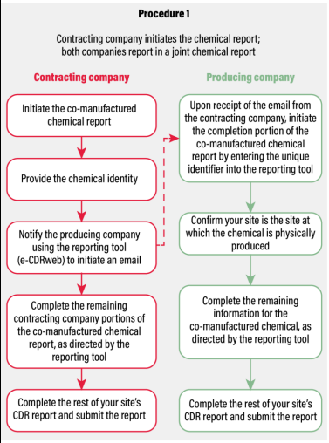
Co-Manufactured Chemicals: Reporting Procedure One
First reporting methodology
Contracting company initiates the co-manufactured chemical report and notifies the producing company using the e-CDRweb reporting tool
Reporting responsibilities:
Data Elements | Contracting Company | Producing Company
Chemical Identity | ✓
Production Volume | ✓ | ✓
Manufacturing Information |  | ✓
Processing and Use Information | ✓
Notes:
Under the first reporting methodology, presented in this slide, the contracting company initiates the co-manufactured chemical report and notifies the producing company using the e-CDRweb reporting tool. With this procedure, both the contracting company and producing company report their own production volumes. The contracting company reports the chemical ID and the processing and use information, and the producing company reports all of the manufacturing information.
Choose the procedure (procedure one) if you have information required for the CDR submission that you do not want to share with your co-manufacturing partner. Submitting the information separately enables you to protect your confidential information. Be sure to assert and substantiate your confidential claim on you CDR submission.

Slide 40
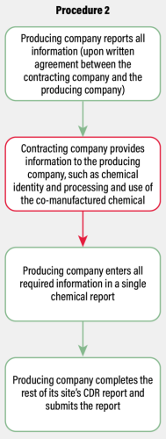
Co-Manufactured Chemicals: Reporting Procedure Two
Second reporting methodology
Contracting and producing company, upon written agreement, work together to complete the reporting
Producing company (instead of the contracting company) initiates and completes the reporting
Provides exposure information from manufacturing site
Contracting company provides additional information
Although the producing company submits the report, both parties are responsible for the report
Notes:
Using the second procedure, the contracting and producing company, upon written agreement, work together to complete the reporting. In this scenario, the producing company initiates and completes the reporting, providing exposure-related manufacturing information while the contracting company provides additional information, as needed, to the producing company. Although the producing company submits the report, both parties are responsible for the report.
Choose this procedure (procedure two) when you have a written agreement with your co-manufacturing partner to share the information needed for the CDR submission.

Slide 41
Additional Resources
Notes:
This section covers what resources are available to you when making your CDR submission, including various topic-specific fact sheets and guidance documents, and how to ask for assistance, if necessary.

Slide 42
Where to Get More Information
Two ways to access guidance documents such as: 2024 CDR Instructions for Reporting
CDR website (www.epa.gov/CDR)
CDR GuideME (https://tscaguideme.epa.gov/)
Multiple ways to ask questions
Click on “Contact Us” on the CDR webpage for full information (see next slide)
Send reporting-related questions to eCDRweb@epa.gov
Notes:
There are multiple ways to get more information. Helpful documents such as the Instructions for Reporting, multiple subject-specific fact sheets, sample Form Us, and Questions & Answers are available both through the CDR website and through CDR GuideME. Note that the documents in these two different locations are the same documents, but the CDR GuideMe format is new.
The Contact Us page, also available on the CDR webpage, lists three different locations to get other questions answered. See the next slide for screenshots. For example, reporting-related questions can be sent to ecdrweb@epa.gov; general TSCA-related questions can be sent to the TSCA hotline; and questions related to Central Data Exchange (CDX) can be sent to the CDX helpdesk.

Slide 43
Contact Us on Chemical Data Reporting under TSCA
Notes:
The Contact Us page contains who to contact for what and provides guidance as to the type of questions to ask each hotline. Before contacting us, please explore the resources available on the website that may answer many of your questions regarding your reporting requirements under CDR.

