Slide 1
Integrated Pest Management Outreach
Biopesticides and Pollution Prevention Division
Office of Pesticide Programs

Slide 2
Overview
IPM Webinars
Participation
Increasing the Value Proposition
Extending Outreach
Teleclasses
Center for IPM Inquiries
Mass email distribution platform (GovDelivery)
Supporting OPP and Regional Outreach
Additional IPM Efforts

Slide 3
Integrated Pest Management Webinar Series
Steady growth since 2014
Most webinars draw >1,000 participants
Announcements reaching 41,500+ IPM subscribers
Most states and several professional organizations offering continuing education credits to licensees for their attendance
Online repository for past webinars - epa.gov/ipm
Upcoming webinars
Notes:
OPP’s outreach activities around Integrated Pest Management are centered in a group within the Biopesticides and Pollution Prevention Division.
This team is effectively sharing information on smart, sensible and sustainable pest control practices primarily through its IPM webinar series.
Starting in 2014, this series has seen remarkable growth with us consistently reaching well over 1,000 participants with most webinars in recent years.
News of our webinars goes out to over 41,500 on our IPM Listserv.
Use this QR code to get signed up for our upcoming webinars.
You can also watch recordings through our IPM website.
Some states are even using our on-demand webinars as continuing education in their instructional venues, outside of the scheduled webinar series

Slide 4
IPM Webinar Participation
Avg = 60%

Slide 5
Extending Outreach Through Partnerships: Continuing Education Credits
Partnerships with most states and many professional organizations to support IPM-related continuing education credits.
Significantly increased the value proposition for IPM webinar participation.
State Partnerships (initiated in 2020)
State lead agencies for pesticides
State health departments / sanitarians
Professional Organizations
International Society of Arboriculture
Society of American Foresters
NJ Licensed Tree Care Experts

Slide 6
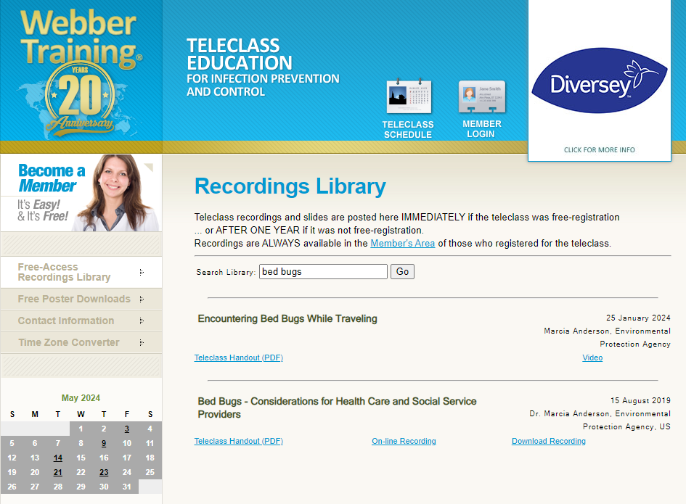
Extending Outreach Through Partnerships: Teleclasses
Bed Bug Teleclasses Reach Worldwide Audience
Encountering Bed Bugs While Traveling (2024)
8,600 participants in live event
29,000+ views of online recording
Bed Bug Considerations for Health Care and Social Service Providers (2019)
950 participants in live event

Slide 7
Center for IPM - Inquiries

Slide 8
IPM GovDelivery Subscribers

Slide 9
Supporting OPP and Regional Outreach
 | Date | Attendees
Office of Pesticide Programs
Pesticide Registration Review | 11/2022 | 901
PIPs Final Rule (BPPD) | 06/2023 | 157
Electronic Submission Portal for PIPs (BPPD) | 07/2023 | 40
Bee Kill Investigations | 09/2023 | 560
Bulletins LIVE! Two (PRD/EFED) | 11/2023 | 1,114
Best Practices for Antimicrobial Product Registration (AD) | 03/2024 | 494
EPA Region 6
Integrated Rodent Management in Commercial Properties | 01/2022 | 650
Reducing Pesticides in Surface Water: An Introduction to the Problem | 06/2022 | 361
Integrated Approaches to Control Invasive and Noxious Plants in Riparian Areas and Watersheds | 07/2022 | 54
Integrated Pest Management in Agriculture using Low Toxicity Pesticides | 08/2022 | 56
Reducing Pesticides in Water in Indian Country: IPM in Agriculture Along Rivers & Streams | 09/2022 | 32
EPA Region 3 Varroa Mite IPM | 08/2022 | 728

Slide 10
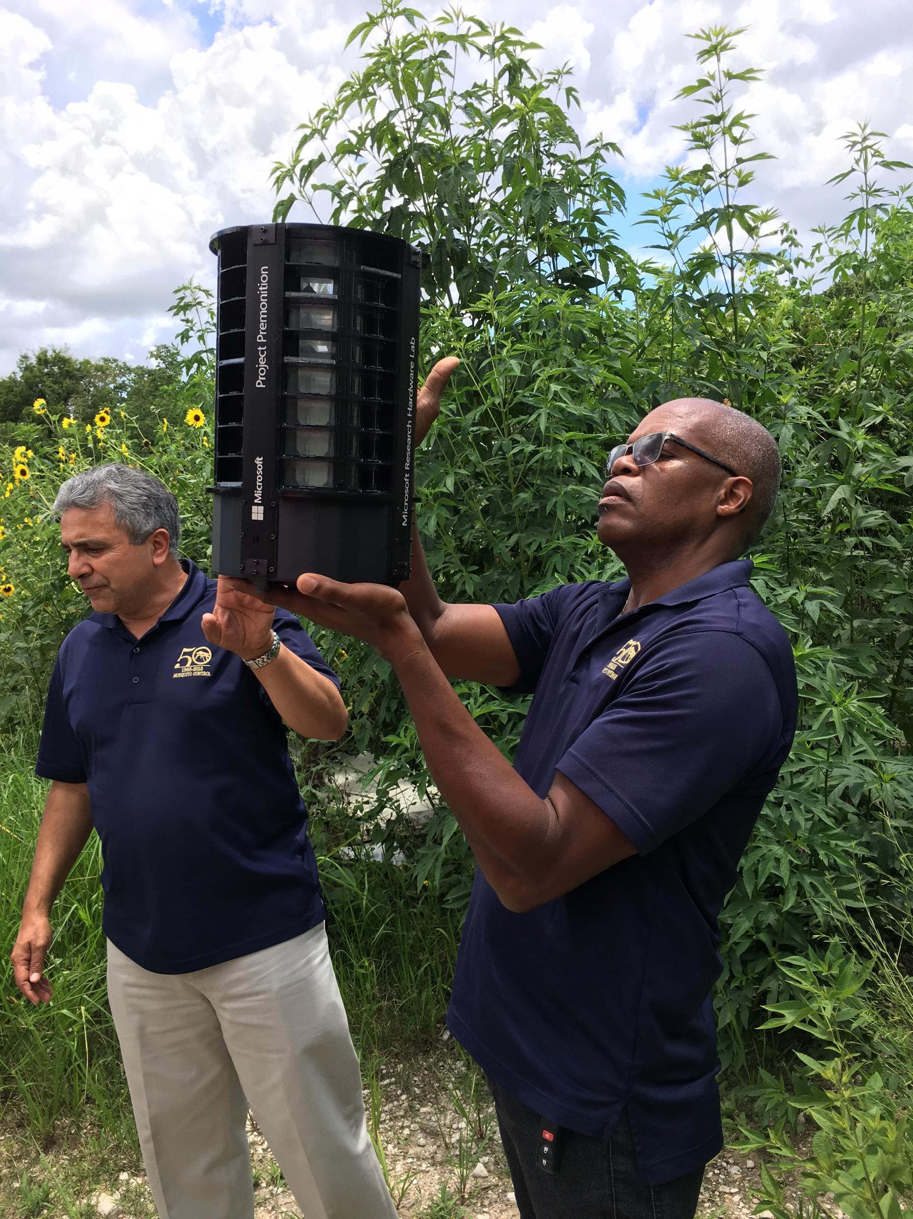
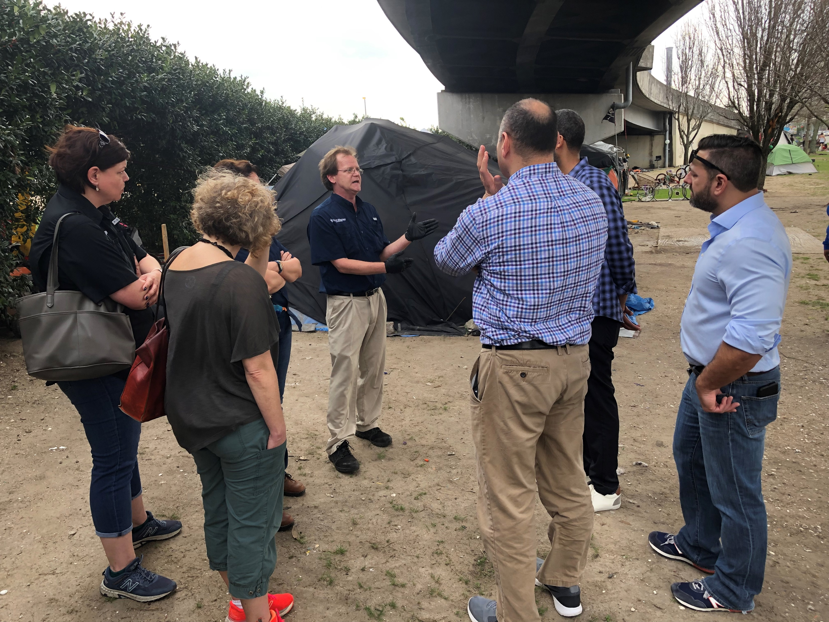
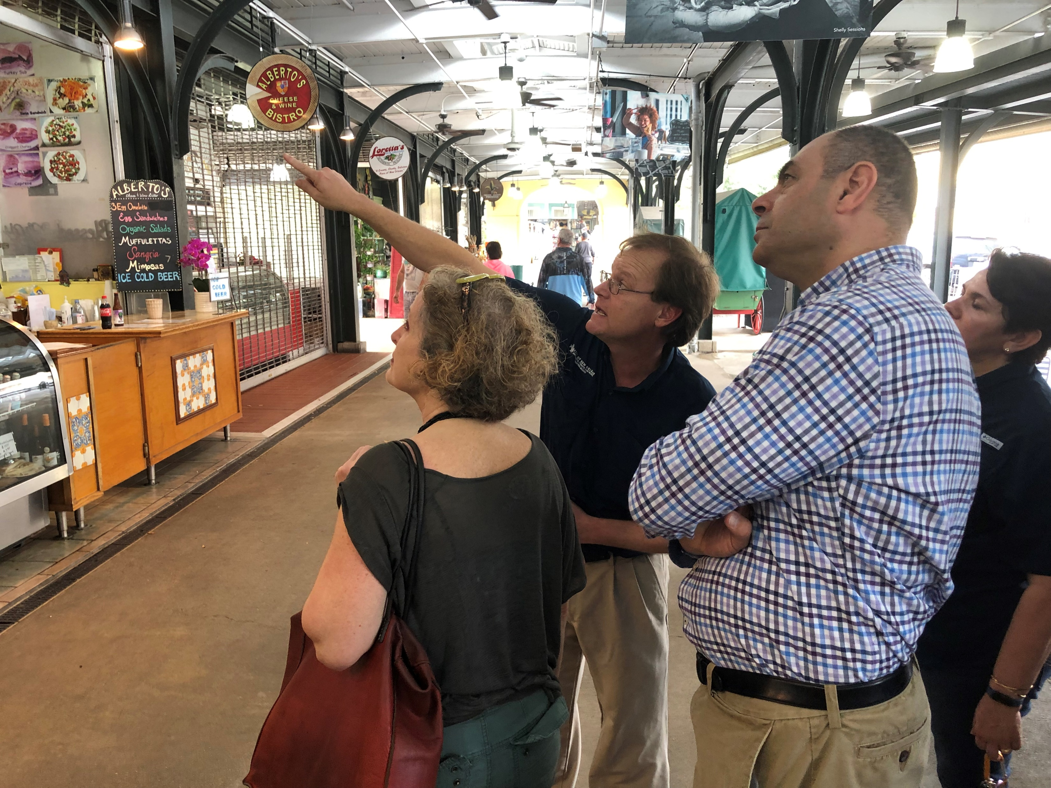
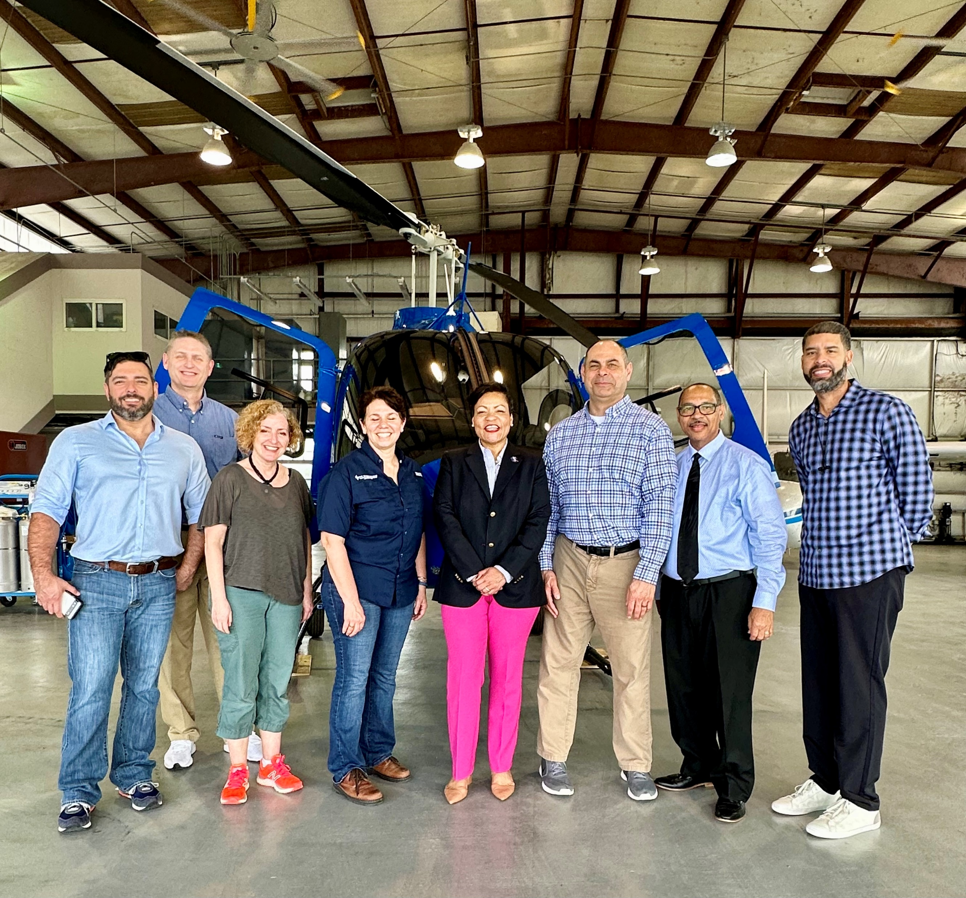
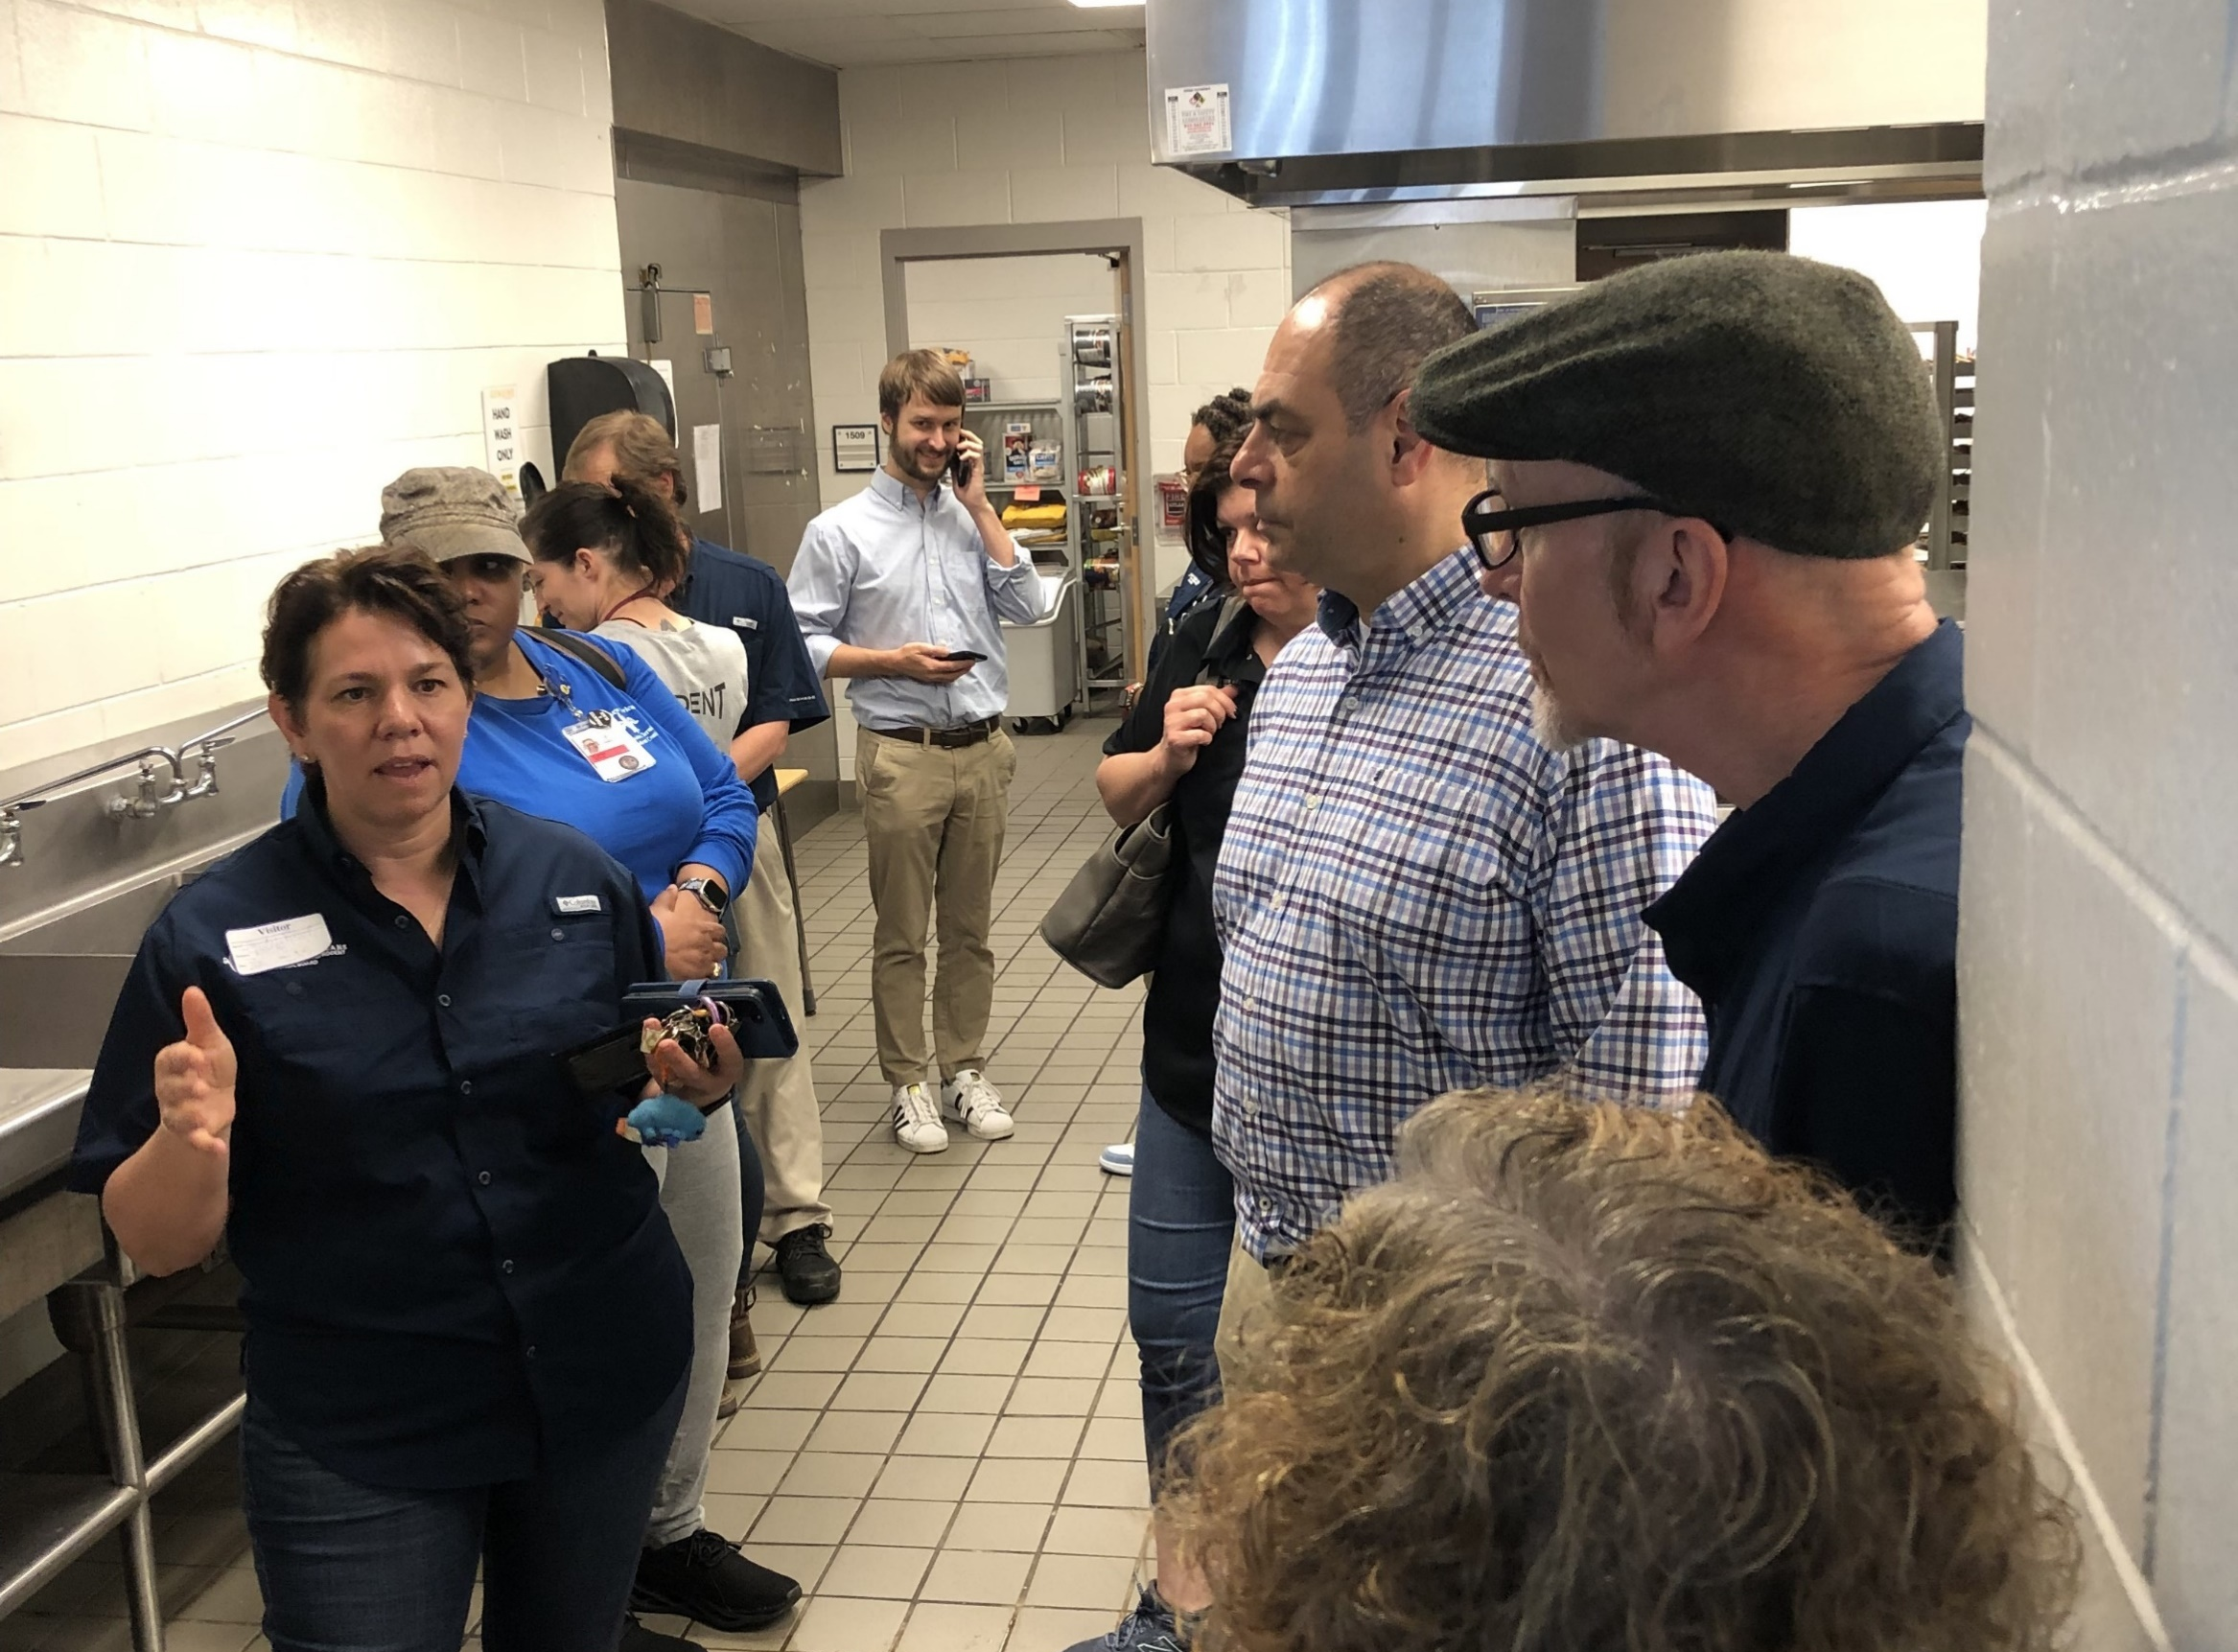
Additional IPM Efforts
Center for IPM
Provides IPM program support and responds to pest-specific inquiries
Supports EPA Regional IPM activities
IPM Grants
Six agricultural IPM grants ($750k) concluding by early 2025
Educational Field Experiences
Provide opportunities for senior OCSPP/OPP leaders to see IPM in action
IPM for schools, mosquitoes, rodents in AZ, CA, FL, IN, LA, TX
Notes:
In addition to the regular IPM webinars, the team also participates in other outreach events.
Our Center for IPM puts on our webinars and they also provide the public with information on IPM program implementation, respond to pest specific questions, and support our Regional Offices in their IPM activities.
Our only active IPM grants – six focused on issues – will be wrapping up in the next year.
And the team does a great job of organizing and coordinating IPM Educational Field Experiences for senior leaders in OCSPP and OPP. Through these efforts, we’ve been able to see various IPM programs in action in a number of states over the past 10 years.

