Slide 1
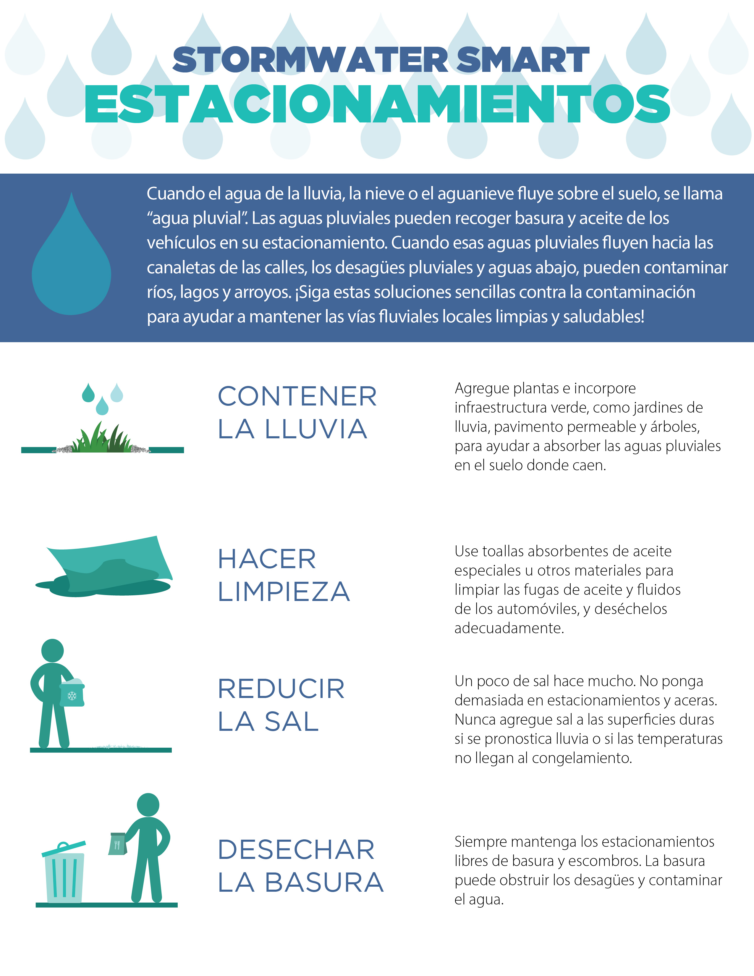

Insert organization’s URL

