Slide 1

EPA Small Business Innovation Research (SBIR)
2024-25 Informational Webinar (updated 6/19/24)
April Richards, Program Manager
June 5, 2024

Slide 2
Welcome to the EPA SBIR Webinar
All participants are muted
For questions or comments, please use the chat
Slides and Q&A will be posted on our website after the webinar
  epa.gov/sbir/2024-2025-epa-sbir-phase-i-solicitation-informational-webinar

Slide 3
Agenda
EPA SBIR Program background
Annual solicitation
  EPA SBIR Topics
  How to Apply
Contracting Office (Megan Fliter, EPA SBIR Contract Specialist)
Fraud Waste & Abuse (Matt Goss, EPA Office of Inspector General)
Foreign Risk
Success Stories
Q&A

Slide 4
Federal SBIR Program
Set-aside program for small businesses to engage in federal R&D
Goal is commercialization
Non-dilutive funding
11 agencies participate
3.2% of Agency’s Extramural R&D Budget
$4+ Billion across federal government
www.SBIR.gov

Slide 5

Mission
EPA: Protect human health and the environment
SBIR: Seed technology innovations to meet Agency’s mission
U.S. Environmental Protection Agency
5

Slide 6
EPA SBIR Funding
Budget: ~$5.0 M
One funding cycle per year
  Phase I proof of concept = $100,000 for 6 months
  Phase II development & commercialization = $400,000 for 2 years
    Commercialization Option = $100,000 supplement to match 3rd party investment
Projects awarded as contracts

Slide 7
EPA SBIR’s Last Phase I Cycle
15% funding rate
50% of small business applicants had no prior SBIR awards
41% of EPA SBIR awardees were first-time SBIR recipients

Slide 8
EPA SBIR Program
Applying
Have fairly specific topics – proposals should be responsive
Funded Projects
Provide companies with EPA technical/topic connection
Goals
Provide commercialization support
Communicate successful projects
Help to protect the planet

Slide 9

Phase I Solicitation/BAA
(planned dates)
Open: June 26, 2024
Close: August 21, 2024
Information at: https://www.epa.gov/sbir/sbir-funding-opportunities
Subscribe to SBIR listserv: https://www.epa.gov/sbir/sbir-listserv

Slide 10
EPA SBIR Topics

Slide 11
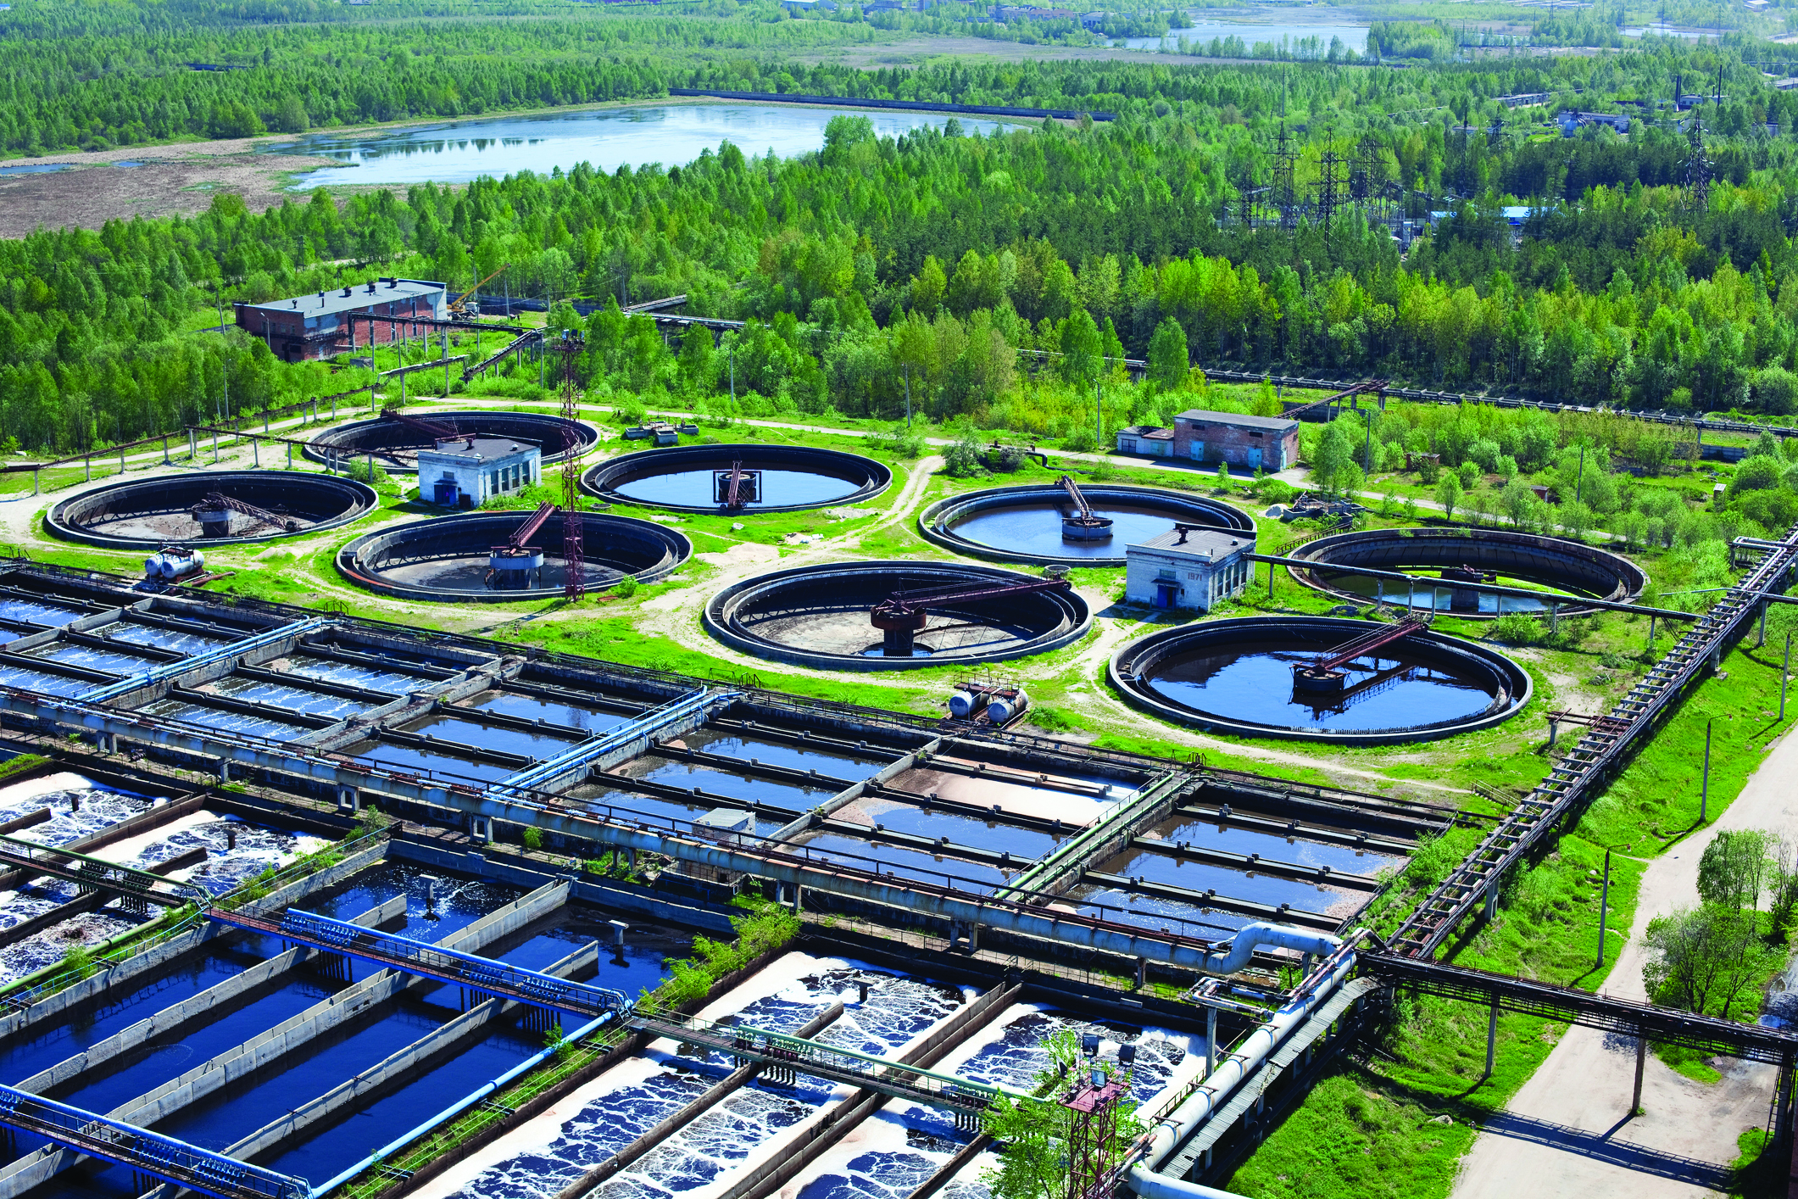
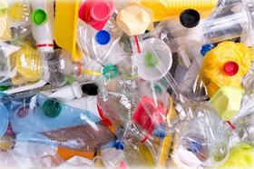
Solicitation- Broad Focus Areas
Clean and Safe Water
Air Quality & Climate
Homeland Security
Circular Economy/Sustainable Materials
Safer Chemicals

Slide 12
Topics
CLEAN AND SAFE WATER
Nature-based Solutions for Water Reuse
Technologies for the Treatment of PFAS in Wastewater Sewage Sludge and Biosolids
Treatment for Cyanobacteria and Cyanotoxins in Drinking Water at the Household Scale
AIR QUALITY & CLIMATE
Technologies and Tools to Monitor and Reduce Air Toxics Exposures
Air Pollution Control Technologies for Small Sources
HOMELAND SECURITY
Scenario-Based Training for Disaster Response
CIRCULAR ECONOMY/SUSTAINABLE MATERIALS
Preventing and Recycling Food Waste
Source Reduction and Reuse
Lowering Embodied Carbon in the Built Environment
SAFER CHEMICALS
Rubber Anti-Degradants that are Lower Concern for Human Health and the Environment
Next Generation Fertilizers
Solicitation is official word….

Slide 13
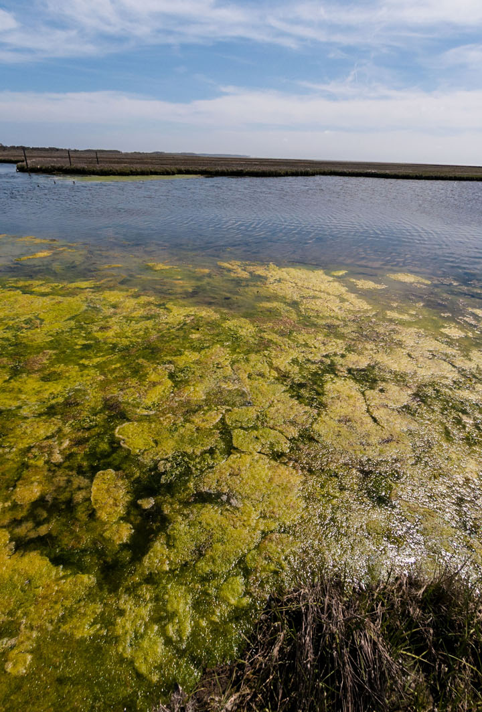
Clean and Safe Water
Nature-based Solutions for Water Reuse
Technologies for the Treatment of PFAS in Wastewater Sewage Sludge and Biosolids
Treatment for Cyanobacteria and Cyanotoxins in Drinking Water at the Household Scale

Slide 14

Air Quality & Climate
Technologies and Tools to Monitor and Reduce Air Toxics Exposures
Air Pollution Control Technologies for Small Sources

Slide 15
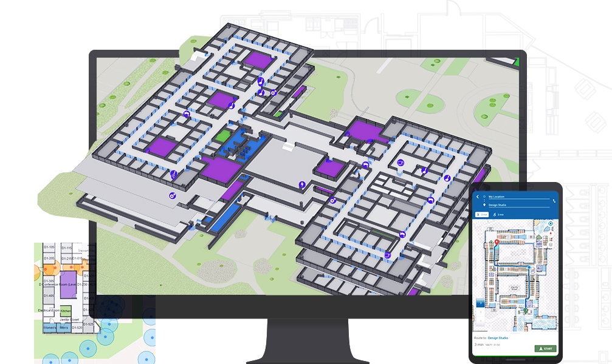
Homeland Security
Scenario-Based Training for Disaster Response
Notes:
User’s position within an indoor setting

Slide 16
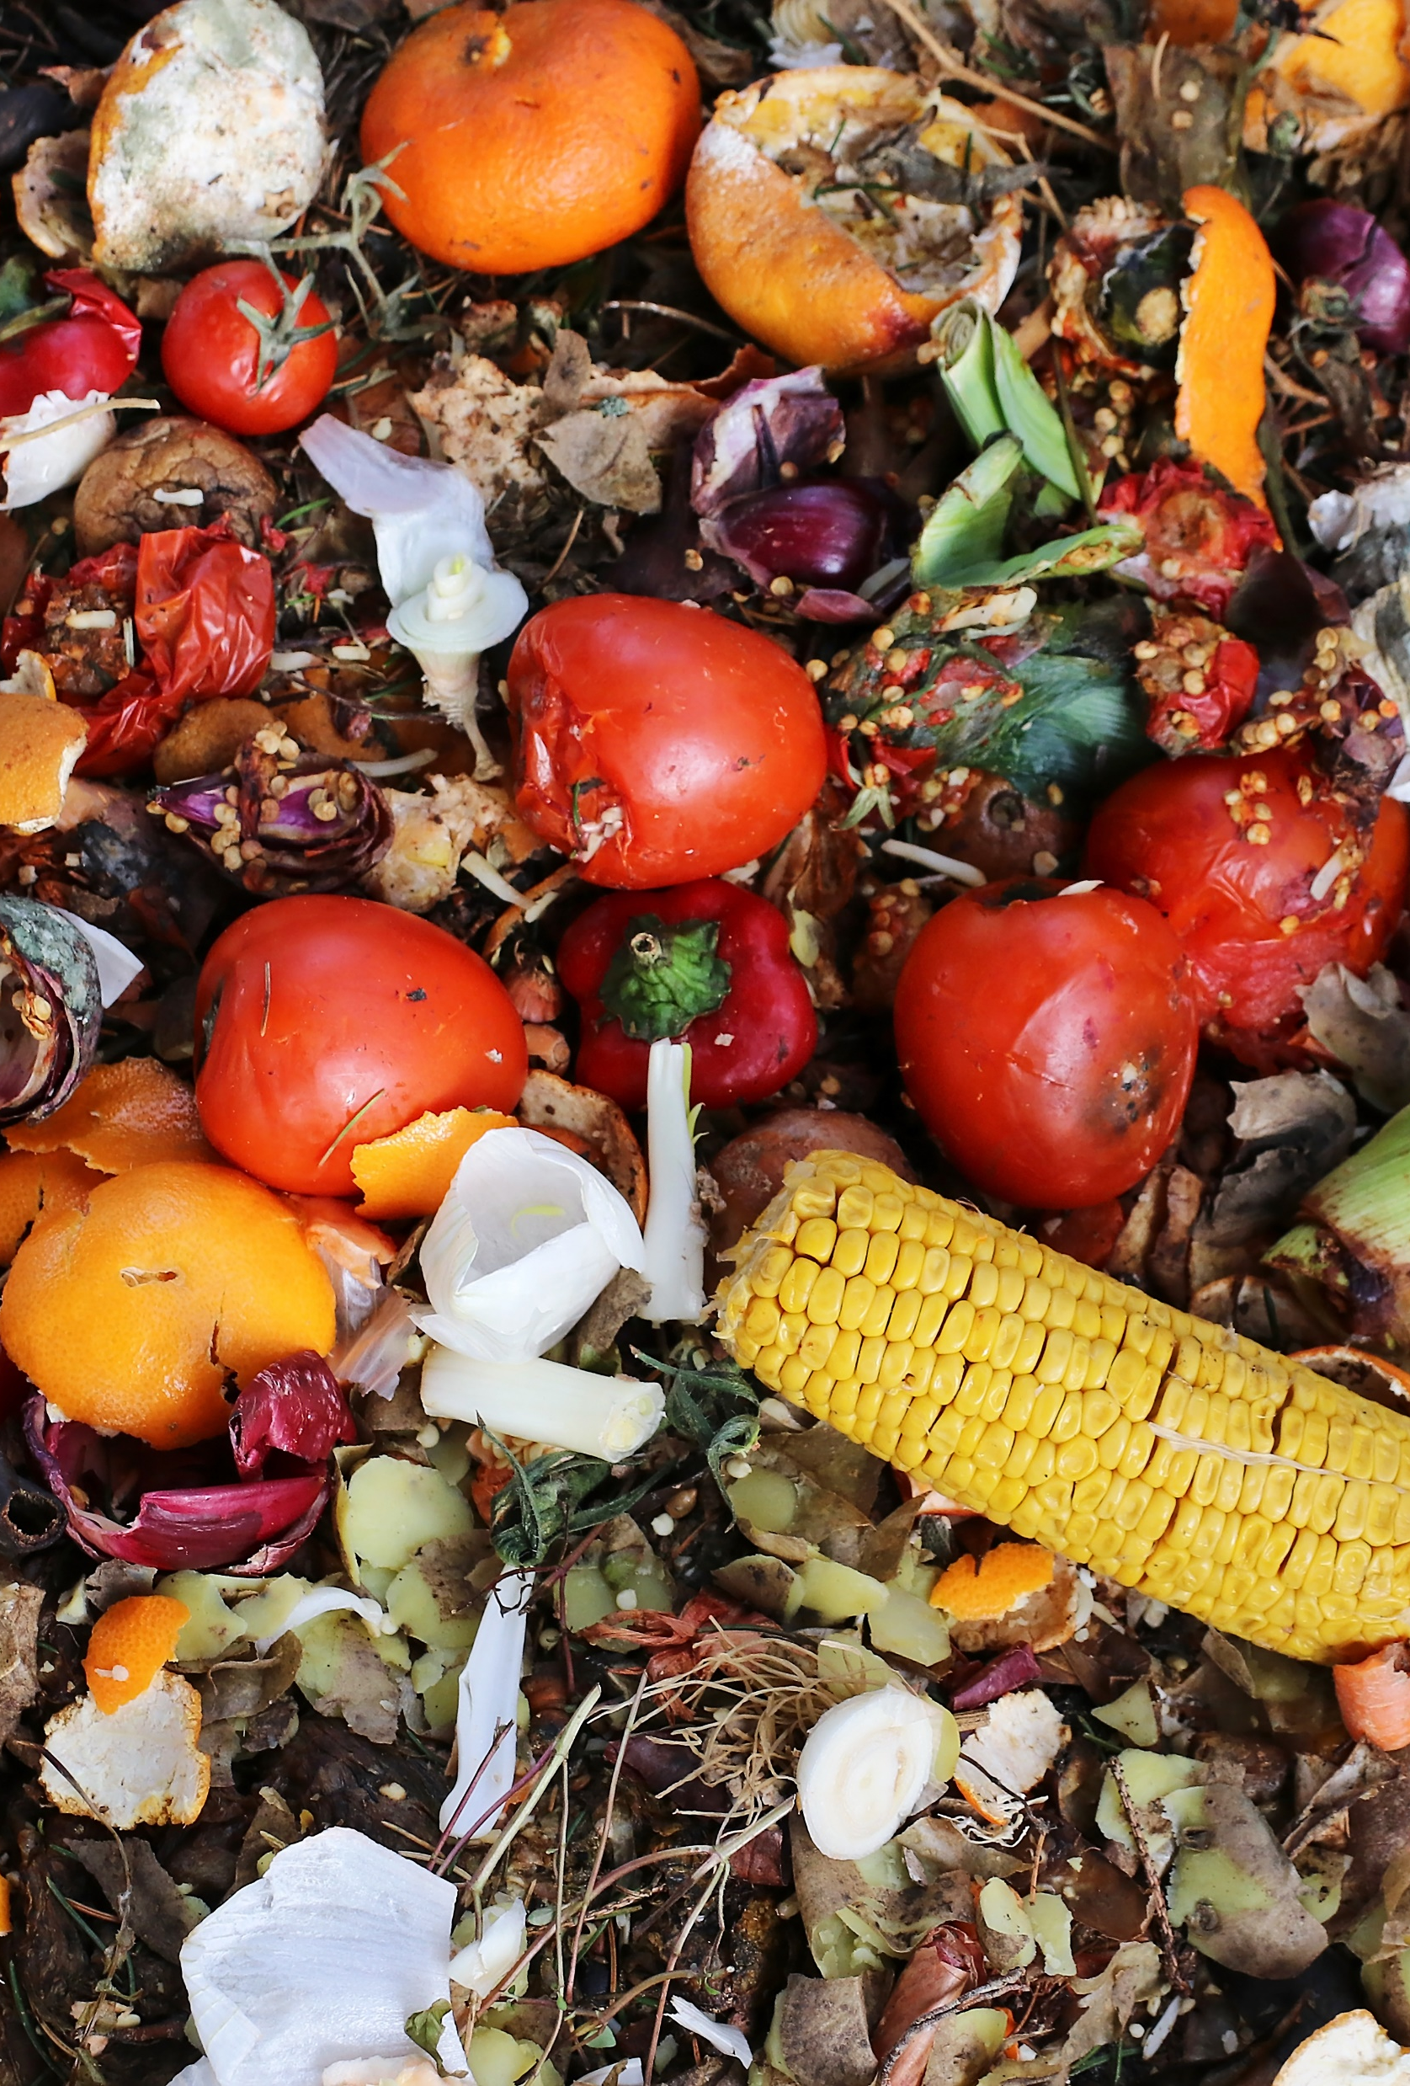
Circular Economy/ Sustainable Materials
Preventing and Recycling Food Waste
Source Reduction and Reuse
Lowering Embodied Carbon in the Built Environment

Slide 17
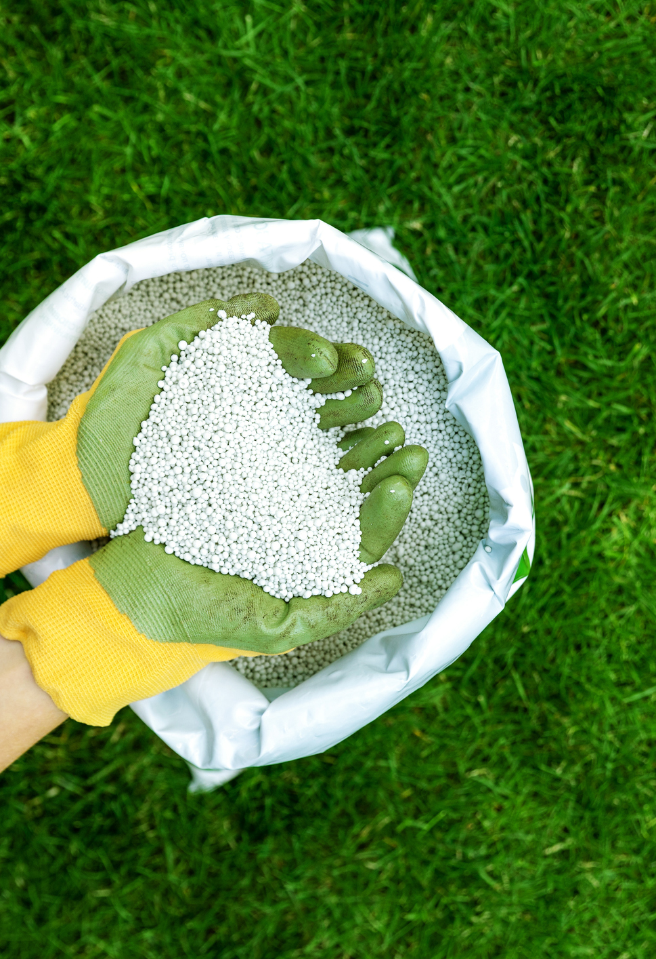
Safer Chemicals
Rubber Anti-Degradants that are Lower Concern for Human Health and the Environment
Next Generation Fertilizers

Slide 18
How to Apply

Slide 19

Applying
Proposals should be responsive to specific topics
Program manager can provide general advice on your proposed technology
Always your choice whether to submit or not

Slide 20
Anticipated Schedule
Phase I
Phase II
Solicitation Closes: August 2024
Estimated start date: December 2024
Solicitation Opens: June 2024
Solicitation Opens: end of Phase I (May 2025)
Estimated start date: October 2025
Solicitation Closes: ~45 days later (July 2025)

Slide 21
Proposal Evaluation & Selection
Proposals
Awards
EPA Internal -
Technical and
Relevancy Review
External - Commercial
Review

Slide 22
Proposal Evaluation Criteria
Technical Review
Technical Approach
Company/Team (Technical)
Relevancy Review
Impact/Relevance to topic
Commercial Review
Innovation/IP
Market Opportunity
Company/Team (Commercial)
Commercialization Approach
(1/3 of overall score)
(1/3 of overall score)
(1/3 of overall score)
Solicitation is official word….

Slide 23

Apply Via FedConnect
FedConnect is a web portal that connects EPA to vendors
https://www.fedconnect.net/FedConnect/
Can view the solicitation through “public opportunities”
Must be registered to respond to solicitation

Slide 24
Required Registrations
SBA Company Registry: Register at SBIR.gov to obtain an “SBC Control ID”. See solicitation for instructions on how to register and how to indicate proof of registration in your proposal.
System for Award Management (SAM): Applicants must complete and maintain an active SAM registration, which requires renewal at least annually. The renewal process may require as much time as the initial registration.
Unique Entity Identifier Number (UEI): (Replaces DUNS numbers to identify entities.) All small businesses are now required to use the UEI assigned by the System for Award Management (SAM.gov). All current SAM.gov registrants have been assigned their UEI and can view them on SAM.gov.
FedConnect: FedConnect is the platform EPA uses for posting solicitation and proposal submission. Companies must be registered with FedConnect to submit a proposal.

Slide 25
Human Subjects
Research that involves human subjects may be subject to additional regulations
Research will be considered to involve human subjects if the research obtains information through
  Intervention or interaction of human subject(s)
  Using, studying, analyzing, or generating identifiable private information.
    This includes interactive research such as surveys, questionnaires, etc
Due to the short timeframe associated with Phase I of the SBIR process, EPA does not recommend the submission of proposals that require the use of human subjects research.

Slide 26
Contracting Office
Megan Fliter, EPA SBIR Contract Specialist
Tips:
  Offerors need to be registered in SAM, FedConnect, and as a Small Business Concern with the SBA – This should be your first step
  Please read the first two pages of the Solicitation/BAA carefully
  Please utilize the checklist (last page of the Solicitation) to perform a self-check to ensure proposal is conforming
FedConnect:
  You will find the Solicitation posted to FedConnect; Proposals must be submitted via the response button. Note: Questions or proposals submitted via messages will not receive a response.
  Only contract related questions submitted to me, via email at fliter.megan@epa.gov may receive a response.
SAM:
  Ensure you complete your registration in its entirety
  Ensure you elect both Contracts and Grants (THIS IS A CONTRACT)
  Ensure you keep your SAM renewal up to date

Slide 27
Fraud, waste, and abuse within the sbir program
Presented By:
Special Agent Matt Goss

Slide 28
Fraud, Waste, and Abuse
SBIR Convictions & Settlements: https://www.sbir.gov/fraud-waste-abuse
SBA tutorial: https://www.sbir.gov/tutorials/fraud-waste-abuse/tutorial-1
  Covers 4 main types of fraud:
    Misrepresentations to obtain SBIR funding (e.g., falsified letters of reference, identifying ineligible principal investigators)
    Misrepresentation of expended funds
    Misuse of award funds (e.g., using the funds to pay for purchases other than the funded research)
    Duplication of funds (receiving multiple SBIR awards to conduct the same research)
Notes:
SBIR Convictions and Settlements can be found on the SBIR.gov website listed here in the slide.
Additionally, you can find a tutorial on their website that discusses the 4 main types of fraud:
Misrepresentations to obtain SBIR Funding
Misrepresentation of expended funds
Misuse of award funds
Duplication of funds

Slide 29
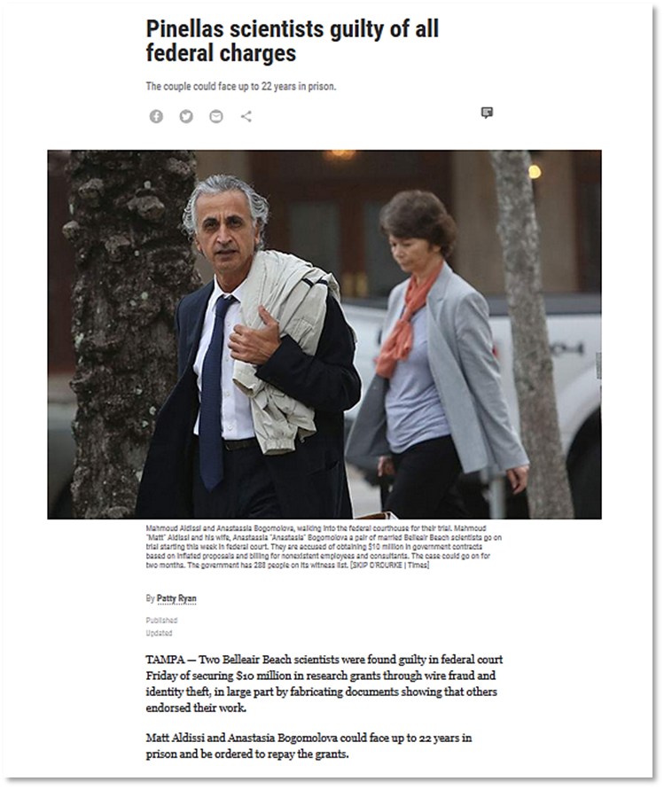
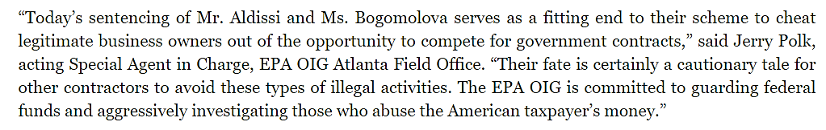
Aldissi and Bogomolova
Notes:
Aldissi and Bogomolova secured $10M in research grants. They both were found to have submitted fabricated documents showing that other reputable peers endorsed their work.

Slide 30
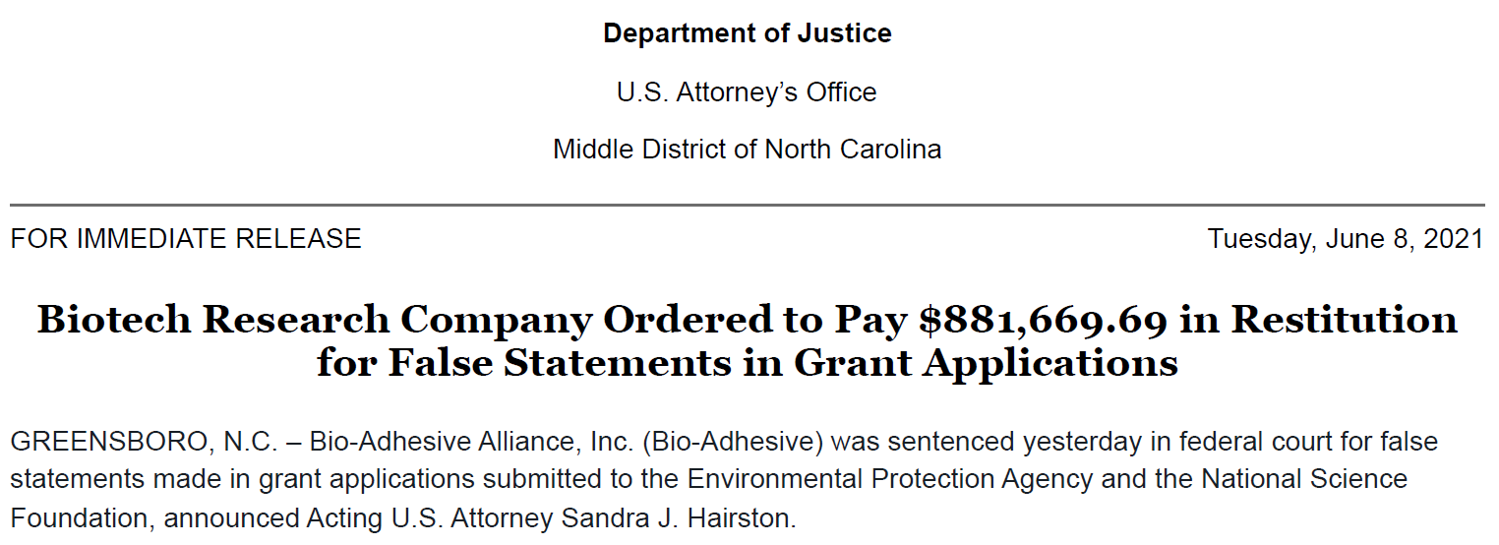
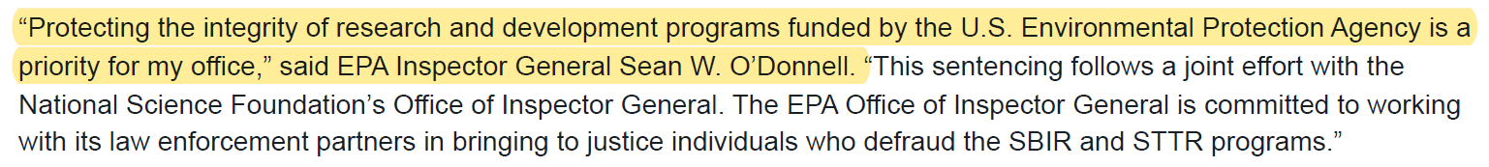
Bio-Adhesive Alliance, inc
Notes:
Bio-Adhesive Alliance, Inc was found to have made several fraudulent statements to the EPA and NSF in their SBIR grant applications. As a result, they were ordered to pay over $880,000 in restitution.
EPA’s Inspector General, Sean O’Donnell responded to the sentencing, stating: “Protecting the integrity or research and development programs funded by the EPA is a priority for my office”.

Slide 31
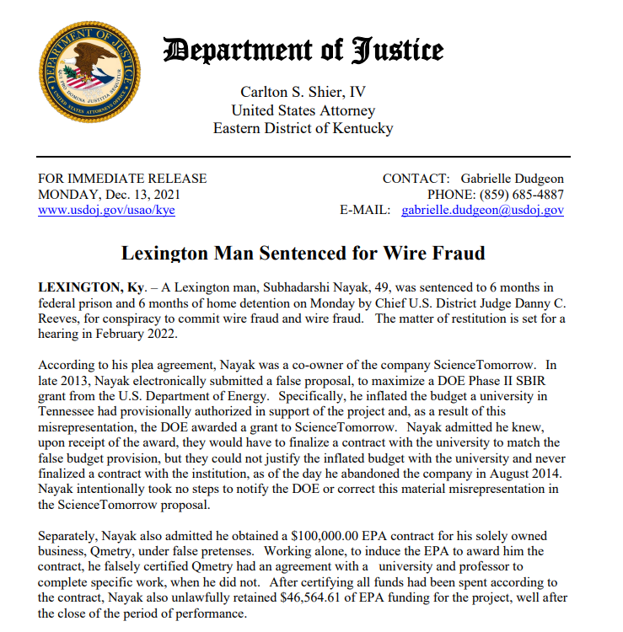
Subhadarshi Nayak
Notes:
Nayak submitted a fraudulent Phase II SBIR grant application in which he inflated the budget that a university had previously authorized in support of his project. As a result of this misrepresentation, DOE awarded a grant to his company.
Nayak was sentenced to 6 months in prison, 6 months of home detention and was ordered to pay over $999,000 in restitution.

Slide 32
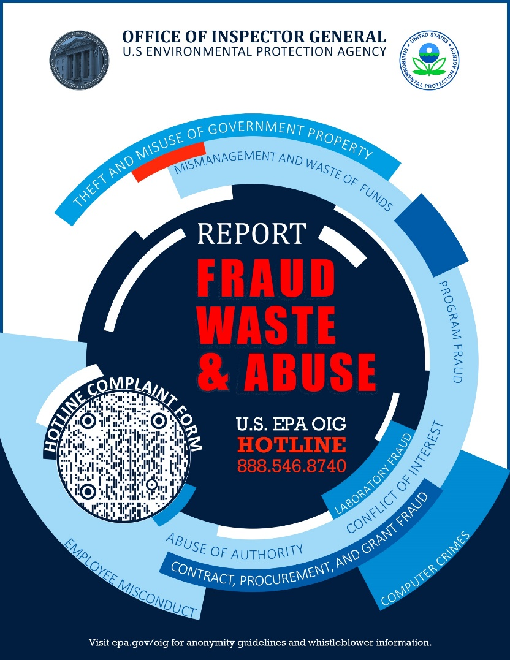
Reporting Fraud, Waste, and Abuse to the OIG
Online: EPA OIG Hotline Complaint Form
Email: OIG_Hotline@epa.gov
Phone: (888) 546-8740
Notes:
These examples are not to scare you or discourage you from applying. They only serve to illustrate the importance of maintaining integrity within this program.
We understand that circumstances, or plans may change after you submit your proposal and that’s perfectly fine. You just need to communicate with April Richards, or another member of the SBIR program here at EPA.
With that said, here are a few different ways you can alert OIG if you suspect Fraud, Waste, or Abuse.

Slide 33
Foreign Risk - New Requirements
SBIR Program reauthorized by Congress in 2022
New requirements to address risks related to:
  Foreign personnel/affiliations
  Patents
  Cybersecurity
For EPA, new due diligence requirements:
  Disclosure form related to foreign affiliations (required if selected for award)
  Cybersecurity education (required if awarded)

Slide 34
Environmental SBIR Funding
National Science Foundation (NSF)
National Institute of Environmental Health Sciences (NIEHS)
Department of Energy (DOE)
United States Department of Agriculture (USDA)
National Oceanic and Atmospheric Administration (NOAA)
Notes:
NSF – “almost all areas of technology” https://seedfund.nsf.gov/
NIEHS/Superfund Research Program (SRP) - Hazardous Substances Remediation and Site Characterization https://www.niehs.nih.gov/research/supported/centers/srp/funding/hwaerp/index.cfm
DOE
Office of Biological and Environmental Research
-Environmental Focus Area: Scientific Instrumentation to Characterize Water, Soil, and the Atmosphere
-Next Topics Issued: July 11, 2022
Office of Fossil Energy and Carbon Management
-Environmental Focus Area: Carbon Capture and Removal
-Next topics issued: November 7, 2022
More information: https://science.osti.gov/sbir/Funding-Opportunities/FY-2023
USDA – https://www.nifa.usda.gov/grants/programs/small-business-innovation-research-program-sbir
Forests
Conservation of Natural Resources
Aquaculture
Biofuels and Biobased Products
NOAA – climate, weather, oceans and coasts (including clean water (oceans, Great Lakes) and air) https://techpartnerships.noaa.gov/sbir/

Slide 35
Environmental SBIR Funding- More Information
NSF – “Almost all areas of technology”
NIEHS/Superfund Research Program (SRP) - Hazardous Substances Remediation and Site Characterization
DOE – Scientific Instrumentation to Characterize Water, Soil, and the Atmosphere, Renewable Energy, Carbon Capture and Removal, Remediation, Water-Energy nexus
USDA - Forests, Conservation of Natural Resources, Aquaculture, Biofuels and Biobased Products
NOAA – Climate, weather, oceans and coasts (including clean water and air)
Notes:
NSF – “almost all areas of technology” https://seedfund.nsf.gov/
NIEHS/Superfund Research Program (SRP) - Hazardous Substances Remediation and Site Characterization https://www.niehs.nih.gov/research/supported/centers/srp/funding/hwaerp/index.cfm
DOE
Office of Biological and Environmental Research
-Environmental Focus Area: Scientific Instrumentation to Characterize Water, Soil, and the Atmosphere
-Next Topics Issued: July 11, 2022
Office of Fossil Energy and Carbon Management
-Environmental Focus Area: Carbon Capture and Removal
-Next topics issued: November 7, 2022
More information: https://science.osti.gov/sbir/Funding-Opportunities/FY-2023
USDA – https://www.nifa.usda.gov/grants/programs/small-business-innovation-research-program-sbir
Forests
Conservation of Natural Resources
Aquaculture
Biofuels and Biobased Products
NOAA – climate, weather, oceans and coasts (including clean water (oceans, Great Lakes) and air) https://techpartnerships.noaa.gov/sbir/

Slide 36

Take Home Messages
Make sure your technology fits one of the specified topic areas
Read solicitation carefully
Start your registrations early
Develop a strong, readable proposal
Address all review criteria
Please do not wait until the last minute--submit your proposal before the deadline
Thank you for helping us protect the planet!
U.S. Environmental Protection Agency
36

Slide 37
If you decide to apply
Solicitation is official word on all proposal requirements
Find guidance on the EPA SBIR how to apply page
Proposal
  Forms - Most forms are now electronic and fillable and can be found on the EPA SBIR Required Forms page
  Page limit – entire proposal must be no more than 35 pages (with all attachments)
  Checklist – use checklist at end of solicitation to make sure you have all required elements
FedConnect
  Click “submit” in FedConnect
  You should receive automated response

Slide 38
I-corps Program
National Science Foundation (NSF) I-Corps Program at George Washington (GW) University training can help participants
  identify their first customers,
  build the right product initially based on market feedback, and
  increase the teams' potential for success in the next phase of development
The program accepts participants on a rolling basis to their two-week Regional Short Course

Slide 39
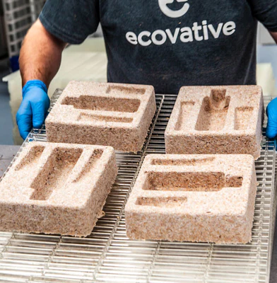
Ecovative Design, LLC: Green Island, NY
Developed mushroom-based materials for various uses including packaging, construction materials, and furniture
Bio-fabrication using mycelium grown on natural/waste products
Commercial success:
  Clients include Ikea, Dell and Crate & Barrel
  Raised over $110 million in capital in 2021
  Launched spinoff, MyForest Foods, to produce gourmet mycelia for whole-food, meat-free ingredients
  Launched the Fashion for Good Cooperative to partner with leading brands to develop sustainable products using mycelium materials

Slide 40
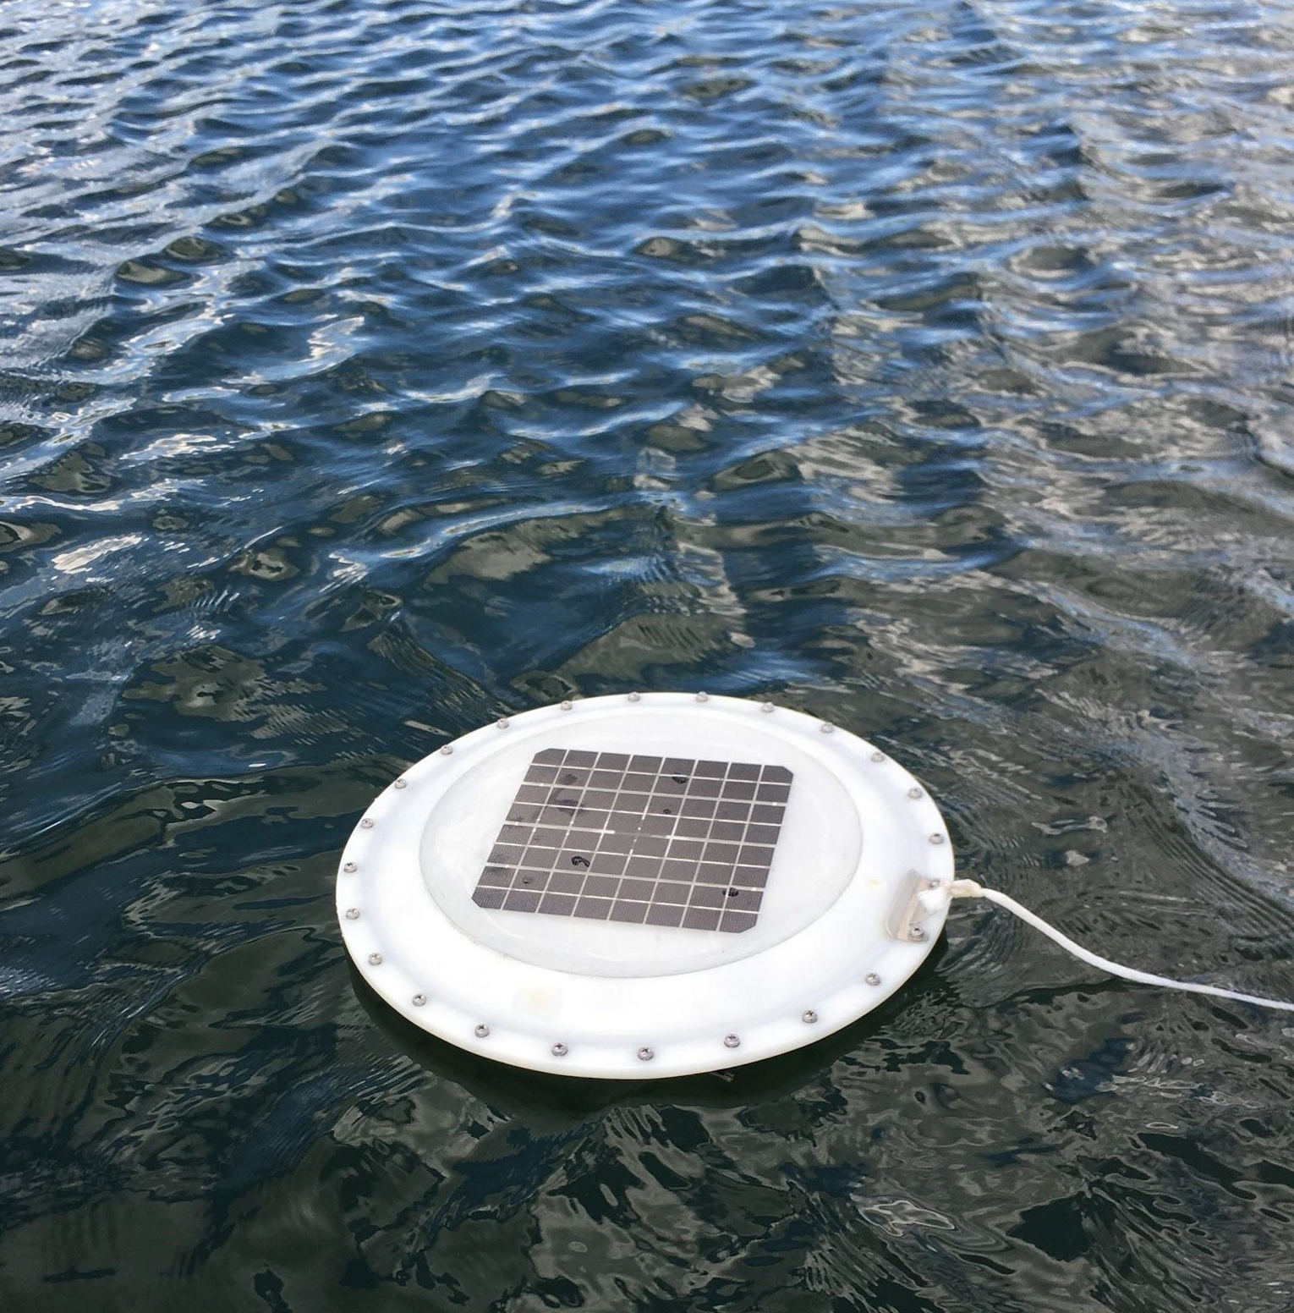
AquaRealTime, Inc.: Boulder, CO
Developed AlgaeTrackerTM, an early detection system for water contamination (including harmful algal blooms (HABs))
  Reduces closures, expenses and health hazards leveraging Internet of Things (IOT) sensors and data analytics
Network of floating HABs sensor buoys
SBIR funding allowed AquaRealTime to pilot AlgaeTrackerTM across the US
Currently sell data to multiple government clients

Slide 41

For More Information
  EPA SBIR Program Manager:
    April Richards richards.april@epa.gov
  Website: www.epa.gov/sbir
  Listserv: https://www.epa.gov/sbir/sbir-listserv
  Program Overview/About EPA SBIR: https://www.epa.gov/sbir/about-epas-sbir-program
  SBA SBIR website: www.SBIR.gov
U.S. Environmental Protection Agency
41

Slide 42

QUESTIONS?
Please submit questions in the chat. We will address as many as time allows.
The presentation slides and Q&A will be posted on our website.
U.S. Environmental Protection Agency
42

